Slide 1
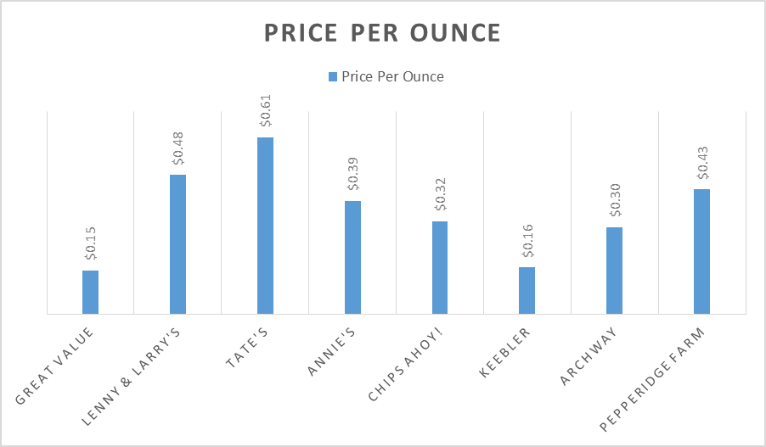
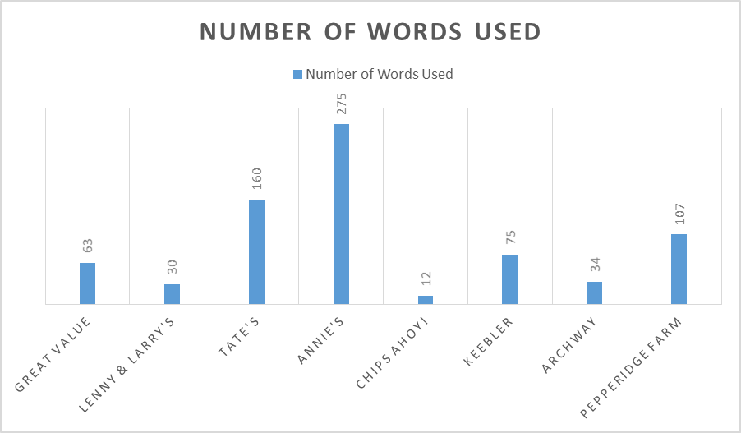
Tasteful Cookie Lingo
Sheldon Baringer
Sociology of Food, Department of Political Science & Sociology, Murray State University
METHODS
RESEARCH QUESTION(S)
FINDINGS
DATA & METHODS
Does language used change on packaging based on who is being marketed to?
Does the language used on packaging influence who buys it?
What relationship does price play in comparison to words used and number of words used?
I find that the more expensive a product becomes the more words used towards health and authenticity increases. This article breaks down packaging literature and demonstrates how products can use different words to communicate to the specific needs of different social economic standings. Furthermore, I display how literature on packaging changes as price increases.
Data includes a variety of chocolate chip cookies sold from a local Kroger. These cookies vary in price per ounce and all are from different companies. My method of data collection is through a coding sheet comprised of a number of different findings. These stem from a simple word count to complexity of language used.
BACKGROUND
LITERATURE REVIEW
In stores today, several brands of cookies use selective word choices directed towards the consumer, for example, by using the words organic or natural. Prior research has analyzed in a similar fashion, but to my knowledge has not used this specific test group. In this research, I show how packaging for cookies affect buyer’s choice, as well as, price in comparison to health. Importantly, as claims on package towards a healthier product increase, so does price. I further examine how cost changes the focus of the product from healthy to delicious, or bulk size, in order to demonstrate how consumers are persuaded based on their social economic status.
CONCLUSIONS
CONCLUSIONS
When analyzing the number of words, we can see that it has no correlation in my test group displayed in Fig.1 & 2. There are some that do increase in the number of words as the price increases per ounce but not enough to declare it to be true in all cases. In my research I am able to see that language complexity and authenticity claims increase as price grows.
Fig 1. Price Per Ounce of Cookie Brands.
REFERENCES
REFERENCES
Freedman, Joshua, and Dan Jurafsky. 2011. “Authenticity in America: Class Distinctions in Patato Chip Advertising.” Gastronomica 11(4):46-54.
Guptill, Amy E., Denise A. Copelton, and Betsy Lucal. 2017. Food & Society Principles and Paradoxes. 2nd ed. Malden, MA: Polity Press.
Harith, Z. T., Ting, C. H., & Zakaria, N. N. A. (2014). Coffee packaging: Consumer perception on appearance, branding and pricing. International Food Research Journal, 21(3).
Harrison, M., Lee, A., Findlay, M., Nicholls, R., Leonard, D., & Martin, C. (2010). The increasing cost of healthy food. Australian and New Zealand Journal of Public Health, 34(2), 179-186.
Schnurr, B. (2019). Too cute to be healthy: How cute packaging designs affect judgments of product tastiness and healthiness. Journal of the Association for Consumer Research, 4(4), 363-375.
Svederberg, E. (2002). Consumers’ Views Regarding Health Claims on Food Packages. Contextual Analysis by Means of Computer Support. Forum: Qualitative Social Research, 3(1), 15–30.
Fig 2. Number of Words used on packaging

