Slide 1



Integration of Autism Specific Care Plans for Pediatrics: Increasing Satisfaction
Madison Vandiver
Murray State University

Slide 2
Abstract
Recent studies have explored the importance on integrating Autism-Specific Care Plans (ACP) into practice. These care plans provide patients with Autism Spectrum Disorder (ASD) or those who are their caregivers the opportunity to identify individualized needs that are imperative for healthcare providers to provide personalized care and accommodations. These ACPs display information relating to the baseline characteristics, behavior patterns, communication techniques and management strategies for the patient with ASD during hospitalization. The focus of the ACP is to recognize patient needs and make those available to all healthcare providers caring for the patient. By understanding the patient’s normal behavior variations that may alert providers to a problem can be identified and factors that are a stressor to the patient can be avoided. The goal is to understand patient needs and expectations in order to deliver individual care, which leads to better outcomes and satisfaction.

Slide 3
Problem/Background
Every year the prevalence of Autism Spectrum Disorder increases in the United States.
Children with an ASD are frequently afflicted with certain comorbid conditions that can cause more frequent hospitalizations.
Extreme variation in Autism Spectrum Disorder presentation has led to a lack of standardized plans of care for these patients in acute care settings.
Lack of standardized plan of care can lead to poor outcomes in patients, including patient and caregiver dissatisfaction in care received.

Slide 4
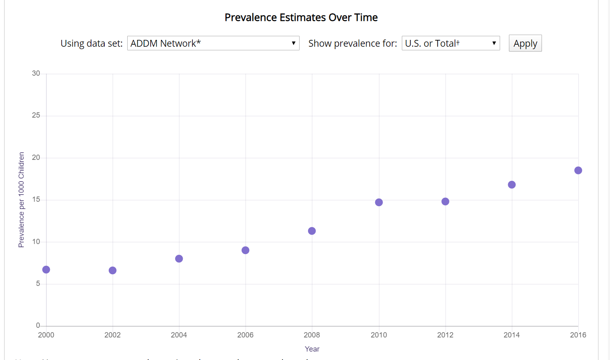
(Centers for Disease Control and Prevention, 2020)

Slide 5
Theoretical Framework
Betty Neuman’s Systems Model on the importance of managing stressors to ensure positive client outcomes.
Goal: prevent or mitigate stressors through primary, secondary or tertiary prevention.
Primary prevention: “identification and reduction of possible or actual risk factors”. Identifying stressors on the ACP allows for prevention planning – such as environmental manipulation (controlling noises, lighting, etc.) to avoid overstimulation.
Secondary prevention: occurs after a stress response and concerns “treatment to reduce the noxious effects” of the response”. After an unavoidable stressor, a patient might begin stimming. Not interrupting the stimming will lessen the stress response.
Tertiary prevention: the “adjustive and reconstitution process”, the goal comes back to primary prevention. Provider referral to Applied Behavior Analysis therapy, OT therapy, sensory integration therapy etc. can aid in preventing/lessening future stress response activation.
(Petriprin, 2016), (Advent Health University, 2017)

Slide 6
Evidence
This pilot study looked at the effects that ACPs had on safety events, length of stay and experience at MassGeneral Hospital for Children. No differences in safety and length of stay was found when using an ACP.
Results showed that every patient with an ACP in their file had it accessed during their admission.
ACP use also greatly impacted satisfaction with 88% of users reporting improved hospital experience. Caregivers also reported staff “helped their child deal with the fear or stress of being in the hospital”, “more likely to ask about intolerable parts of the physical exam” and “better staff attention to the child’s ASD specific needs”.
Nurses accessed ACPs more than any other employee, emphasizing the importance of nurse education on ACP importance and advantages.
This study shows the importance of healthcare provider awareness regarding varying ASD presentation and how recognition of differences allows for opportunities to improve care and therefore satisfaction.
(Broder-Fingert et al., 2015)

Slide 7
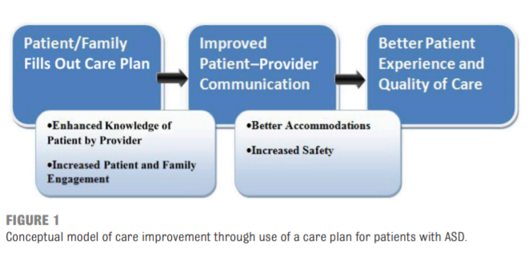
(Broder-Fingert et al., 2015)

Slide 8
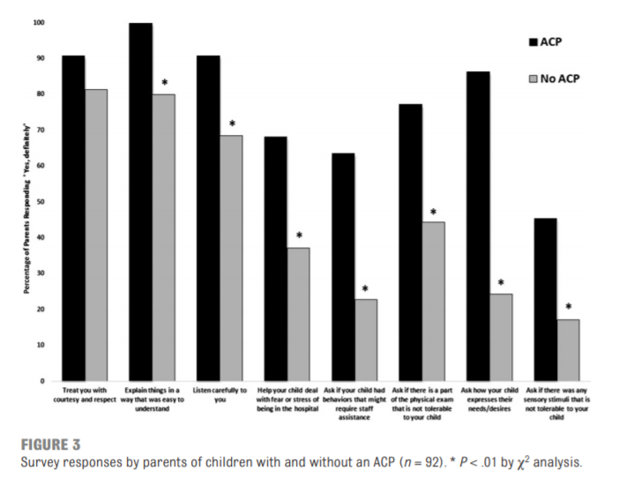
(Broder-Fingert et al., 2015)

Slide 9
The most common challenging behaviors seen in children with ASD during hospitalization are noncompliance, hyperactivity, sensory defensiveness and self-injury.
Noncompliance is noncooperation. This includes outbursts, tantrums and kicking/yelling, which is usually due to overstimulation and anxiety.
Hyperactivity includes running away and getting into things.
Sensory defensiveness is aversion to environmental elements that cause overstimulation, such as noise, textures and odors.
Common self-injury behaviors include pinching, head banging, and biting self.
This study also offers interventions and strategies on how to prevent as well as mitigate these behaviors, which were included in this policy.
(Johnson & Rodriguez, 2013)

Slide 10
The multifactorial medical needs of patients with ASD as well as their higher healthcare resource utilization rates make it important to educate healthcare workers on ASD needs.
A survey of individuals with ASD and their families identified that medical personnel did not understand communication and behavioral impairments associated with ASD.
Researchers developed an educational program to impart knowledge regarding ASD and the associated medical conditions that lead to higher medical care utilization.
The goal was to present an approach to effectively acquire a history of the acute presentation, conduct an assessment, obtain labs and testing, and initiate treatments.
This study led to the development of instrument to prepare for acute care of individuals with ASD, which was used to develop this policy.
(McGonigle et al., 2013)

Slide 11
Recommendations For Practice
The ACP should be completed prior to or at the beginning of hospital admission and placed in the patient's medical record. Every employee should be educated on where this can be found.
Teach staff the importance of ensuring an ACP is offered to every patient with ASD.
Stress the importance of reviewing the ACP during the patient’s admission to ensure individualized care.
To successfully implement this policy, staff education should focus on characteristics of ASD, the importance of have giving individualized care and strategies for best care.
Staff must also be trained in helping patients/caregivers complete these forms and explain the benefits of an ACP.

Slide 12
Conclusions/Summary
There is no standard presentation in ASD, therefore standardized care is not effective. Each patient needs a care plan that is catered to their specific needs.
Getting patients/caregivers involved in their care by filling out an ACP will ensure that the entire team is on the same page and that patient/caregiver expectations can be met.
Healthcare providers should have baseline education on ASD and know common stressors that can trigger an individual with ASD while hospitalized.
Knowing common triggers as well as patient-specific needs provides the opportunity to manipulate the environment and optimize care which improves outcomes and satisfaction.

Slide 13
References
Advent Health University (2017, April 13). Neuman systems model. Retrieved from
https://online.ahu.edu/blog/neuman-systems-model/
Broder-Fingert, S., et al. (2015). A pilot study of autism-specific care plans during hospital admission. Pediatrics. 137(s2): s196-s204. DOI: 10.1542/peds.2015-2851R
Centers for Disease Control and Prevention (2020, March 25). Autism Data Visualization Tool. Retrieved from https://www.cdc.gov/ncbddd/autism/data/index.html
Johnson, N. & Rodriguez, D. (2013). Children with autism spectrum disorder at a pediatric hospital: a systematic review of the literature. Pediatric Nursing. 39(3):131-141.

Slide 14
References Cont.
McGonigle, J., et al. (2014). Development and evaluation of educational materials for
pre-hospital and emergency department personnel on the care of patients with autism spectrum disorder. Journal of Autism & Developmental Disorders. 44: 1252-1259. DIO: 10.1007/s10803-013-1962-0
Petriprin, A. (2016). Neuman’s systems model. Retrieved from https://nursing-theory.org/
theories-and-models/neuman-systems-model

