Slide 1
Recommending School Nurses Provide Mental Health Screenings to Students
By: Mariah Dufault

Slide 2
Abstract
“Half of adults with mental health disorders report or have been shown to have experienced symptoms by age 14” (Bartlett, 2015).
Childhood mental health issues that are not being identified early, caused by a lack of knowledge and awareness in childhood mental health can lead to lifelong debilitating issues. Educating school nurses to screen for and notice the signs and symptoms of mental health disorders in the pediatric population would have a positive impact on mental health outcomes in the future. It is important for a school nurse to be educated on and screen for these issues because they are happening in every school and can easily be overlooked, underplayed, or ignored in a busy environment.

Slide 3
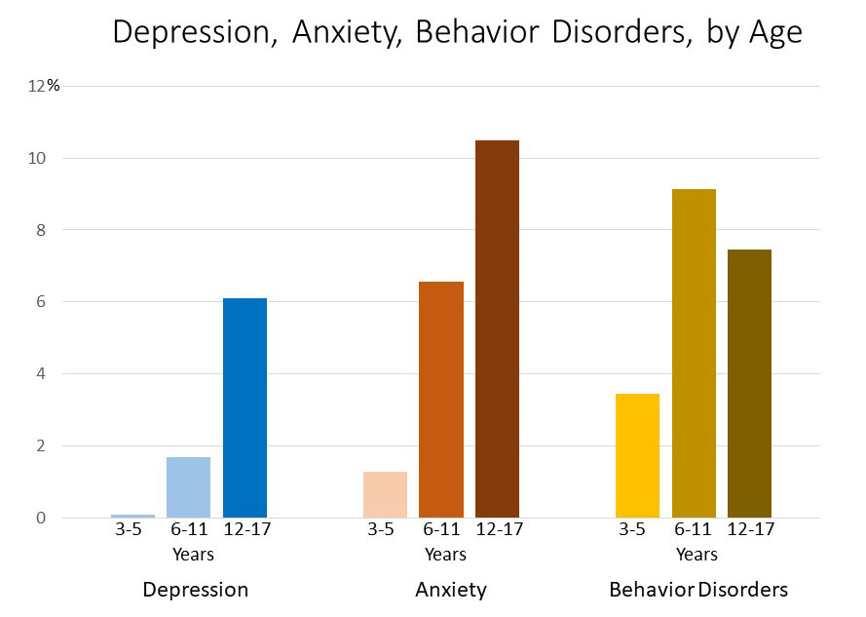

Slide 4
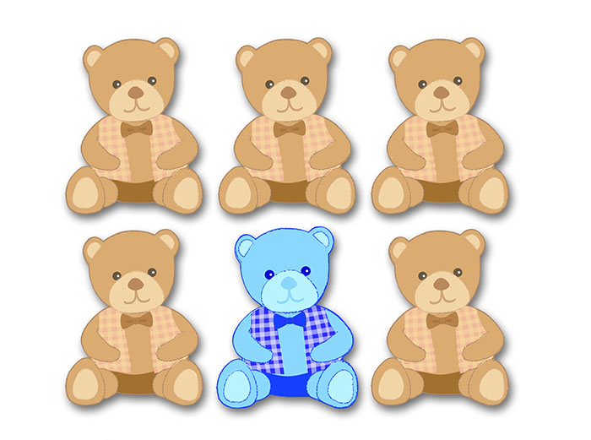
1 in 6 U.S. children aged 2–8 years (17.4%) had a diagnosed mental, behavioral, or developmental disorder (CDC, 2020)

Slide 5
Theoretical Framework
Peplau’s Theory of Interpersonal Relations
Person: A developing organism that tries to reduce anxiety caused by needs.
Environment: Existing forces outside the organism and in the context of culture
Health: A word symbol that implies forward movement of personality and other ongoing human processes in the direction of creative, constructive, productive, personal and community living.
Nursing: A significant therapeutic interpersonal process. It functions cooperatively with other human process that make health possible for individuals in communities.
https://www.amazon.com/Hildegard-Peplau-Psychiatric-Nurse-Century/dp/0826138829

Slide 6
Peplau’s Theory of Interpersonal Relations believes the nurse has six primary roles:
Stranger
The school nurse can help create an environment that will help build trust
Teacher
Offering knowledge on current issues that can be going on in the school, such as stress relieving techniques.
Resource Person
The school nurse can offer resources to students such as mental health tips, or referrals to a more specialized provider.
Counselor
The school nurse can play the role as a counselor when the times comes, if the student has built a trusting relationship with them.
Surrogate
The nurse can help the student become aware of their dependence/independence and become an advocate for that student.
Leader
As the leader the nurse will help the student read their goals to obtain a more positive mental health outlook.

Slide 7
Research & Evidence
A study titled Mental Health Matters in Elementary School: First-Grade Screening Predicts Fourth Grade Achievement Test Scores by Maria Guzman found that psychosocial risks identified through screening and poor achievement scores were strongly associated, providing clear evidence that mental health matters for children. Screening tools would benefit the outcomes of the child and the school for testing and achievements, and help implement supplemental educational opportunities to students who need extra help.

Slide 8
The World Health Organization states that 10-20% of children and adolescents have experience with some type of mental disorder.
“of 1 in 10 children with a functionally impairing mental disorder, as few as one- fifth receive services…. Untreated mental disorders persist into adulthood” (Walter, 2019).
Young Minds estimated that 100,000+ young people would need hospitalization due to self-harm in 2020 (Membride, 2015).
“It is estimated that school nurses spend approximately 33% of their time addressing student mental health…. School nurses provide an important interface between health and education and the promotion of good mental health has been shown to have a positive impact on educational, social and physical outcomes” (Bohnenkamp, 2019).

Slide 9
Proposed Procedure
Beginning their 5th grade year mental health screenings should be offered for at-risk students. Such as students with adverse childhood events (neglect, broken households, divorce, death or a loss, abuse, parental mental illness and violence). Students could voluntarily come in, or if a parent or teacher has a concern about a child's behavioral or mental state could refer them to see the nurse for screening and assistance.
“School nurses may offer open seminars, classroom seminars, and smaller group discussions with adolescents focusing on… stress management, relaxation techniques, normal emotional variants, body image, self-esteem and autonomy” (Bjørnsen, 2019).

Slide 10
Offering screenings to students will better improve the quality of care that they receive, assist the teacher in providing specialized care if needed and greater improve their future outcomes.
For the school nurse to offer mental health screenings and education will create a better understanding of where they can find help, a healthier school environment, taking the stigma away from mental health disorders and allowing more students to speak out about their mental health.

Slide 11
Implementing into Practice
Multiple screening tools are available, many available at no cost. Examples are:
Ask Suicide-Screening Questions (ASQ)
Drug Abuse Screen Test (DAST-20)
Health, Education, Activities, Drugs, Suicide/Depression, Safety (HEADSSS)
Pediatric Symptom Checklist, Strength and Difficulties Questionnaire
Vanderbilt Diagnostic Rating Scales for ADHD (Ivey,2020)
Although the screenings are evidence-based, mental health is not black and white; it is difficult to describe and identify. These screening tools help give a better understanding on where the students’ current mental health status lies and where it may be in the future.

Slide 12
Conclusion
When school nurses are provided the tools and education to identify early signs of mental health disorders, they can more effectively serve the students in their respective schools. “Early identification is important so that children can get the help they need. Work with families and healthcare professionals if you have concerns about the mental health of a child in your school” (CDC, 2020).
School nurses have the opportunity to observe, assess and intervene if undiagnosed mental health disorders are suspected in students at their school. “School nurses are in a position to provide mental health education and may therefore greatly influence adolescents’ mental health and well-being (Bjørnsen, 2019).

Slide 13
“The nursing profession’s ability to meet the challenge of recognizing a child’s mental health needs and being ready to intervene is crucial. Commitment to enrolling in and expanding the scope of continuing education by individual groups and agencies is necessary, along with mentoring experiences in practice” (Ivey, 2020)

Slide 14
References
Bartlett, H. (2015). Can school nurses identify mental health needs early and provide effective advice and support? British Journal of School Nursing, 10(3), 126–134. https://doi-org.ezproxy.waterfield.murraystate.edu/10.12968/bjsn.2015.10.3.126
Bjørnsen, H. N., Espnes, G. A., Eilertsen, M.-E. B., Ringdal, R., & Moksnes, U. K. (2019). The Relationship Between Positive Mental Health Literacy and Mental Well-Being Among Adolescents: Implications for School Health Services. Journal of School Nursing, 35(2), 107–116. https://doi-org.ezproxy.waterfield.murraystate.edu/10.1177/1059840517732125
Bohnenkamp, J. H., Hoover, S. A., Connors, E. H., Wissow, L., Bobo, N., & Mazyck, D. (2019). The Mental Health Training Intervention for School Nurses and Other Health Providers in Schools. Journal of School Nursing, 35(6), 422–433.
Data and Statistics on Children's Mental Health. (2020, June 15). Retrieved October 08, 2020, from https://www.cdc.gov/childrensmentalhealth/data.html
Guzman, M., Jellinek, M., George, M., Hartley, M., Squicciarini, A., Canenguez, K., Kuhlthau, K., Yucel, R., White, G., Guzman, J., & Murphy, J. (2011). Mental health matters in elementary school: first-grade screening predicts fourth grade achievement test scores. European Child & Adolescent Psychiatry, 20(8), 401–411. https://doi-org.ezproxy.waterfield.murraystate.edu/10.1007/s00787-011-0191-3
Holden, C., McNeill, E. B., Shipley, M., & McDonald, S. (2018). The World Needs Me: A Suicide Prevention Teaching Technique. Health Educator, 50(1), 38–45.
Ivey, J. (2020). Mental Health Screening for Children and Adolescents. Pediatric Nursing, 46(1), 27–10.

Slide 15
Leadbeater, B., Gladstone, E., & Sukhawathanakul, P. (2015). Planning for Sustainability of an Evidence-Based Mental Health Promotion Program in Canadian Elementary Schools. American Journal of Community Psychology, 56(1/2), 120–133. https://doi-org.ezproxy.waterfield.murraystate.edu/10.1007/s10464-015-9737-8
Membride, H., McFadyen, J., & Atkinson, J. (2015). The challenge of meeting children’s mental health needs. British Journal of School Nursing, 10(1), 19–25.
Mental Health Impacts In Schools. (2016, May 24). Retrieved October 01, 2020, from https://childmind.org/report/2016-childrens-mental-health-report/mental-health-impacts-schools/
(n.d.). Retrieved October 08, 2020, from http://currentnursing.com/nursing_theory/interpersonal_theory.html
Peplau's Theory of Interpersonal Relations. (2020, July 21). Retrieved September 26, 2020, from https://www.nursing-theory.org/theories-and-models/peplau-theory-of-interpersonal-relations.php
Ravenna, J., & Cleaver, K. (2016). School Nurses’ Experiences of Managing Young People With Mental Health Problems. Journal of School Nursing, 32(1), 58–70. https://doi-org.ezproxy.waterfield.murraystate.edu/10.1177/1059840515620281
Salerno, J. P. (2016). Effectiveness of Universal School-Based Mental Health Awareness Programs Among Youth in the United States: A Systematic Review. Journal of School Health, 86(12), 922–931. https://doi-org.ezproxy.waterfield.murraystate.edu/10.1111/josh.12461
Walter, H. J., Kaye, A. J., Dennery, K. M., & DeMaso, D. R. (2019). Three‐Year Outcomes of a School‐Hospital Partnership Providing Multitiered Mental Health Services in Urban Schools. Journal of School Health, 89(8), 643–652. https://doi-org.ezproxy.waterfield.murraystate.edu/10.1111/josh.12792
What Are Childhood Mental Disorders? (2020, March 30). Retrieved October 01, 2020, from https://www.cdc.gov/childrensmentalhealth/basics.html
Williams, S. G. (2017). Mental Health Issues Related to Sexual Orientation in a High School Setting. Journal of School Nursing, 33(5), 383–392. https://doi-org.ezproxy.waterfield.murraystate.edu/10.1177/1059840516686841

