Slide 1
Implementing PPE and Precaution Use Among Patient Families and Visitors
Ashley Dunn, SN
School Of Nursing

Slide 2
Current Policy
Research on compliance and knowledge among visitors and families is little at this time.
Increased need for education involving this topic and acknowledging the importance of personal protective equipment (PPE)
CDC currently recognizes the need for education to prevent transmission of infectious agents (Centers for Disease Control and Prevention, 2019).
PPE used for all who enter isolation room
Visitors and families are sources of infection

Slide 3
Investigation
Communication with health care workers in the Paducah and Murray, KY areas and their policies.
A) Low hand hygiene compliance
B) Improper PPE wearing
C) Inappropriate wearing of PPE in locations other than room
D) Noncompliance entirely

Slide 4
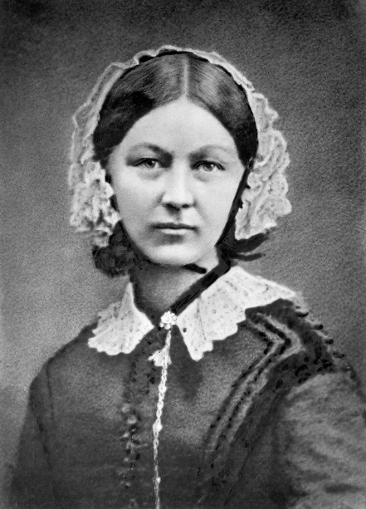
Theoretical Framework
Florence Nightingale’s Environment Theory
Helped shape patient environment cleanliness and focuses on environmental factors that affect health.
Nightingale’s contribution modernized nursing practice.
Application to this research project:
Isolation equipment protection
Maintaining cleanliness
Low hand hygiene compliance
(Petiprin, 2016).

Slide 5
Research and Evidence
Noncompliance was reported by health care workers in both Paducah and Murray
Noncompliance with precaution use is seen worldwide
Korean study of hand hygiene – overall compliance rate among visitors was 20.3%; before touching the patient 16.1%, and after touching the patient only 14%
Study in Miami, FL showed that of 55 visitors entering a unit, 35 did NOT perform hand hygiene
- performed hand hygiene = no unhealthy bacterial growth
- NO hand hygiene = 8 grew gram negative bacilli, 1 staphylococcus aureus
(Birnbach et al., 2015 and Jung et al., 2019).

Slide 6
Research and Evidence
Visitors and families are vectors for infectious agents
Could lead to potential infections or contribute to HAIs (healthcare associated infections)
Places patients, visitors, families, and others at risk
Studies call for an increase in awareness of the risk for infection and further recognition by health care workers and researchers.

Slide 7
Research and Evidence
A Study in a Midwestern tertiary hospital discussed what visitors know about PPE and how they feel about wearing it.
Findings:
- Despite available PPE, only 42% were compliant
- Staff use and reminders affected visitor use
- If they are family, do not feel need to wear it
- 42% were compliant because of sign use on doors
Calls for increased education and compliance by nurses for higher visitor and family compliance
(Seibert et al., 2018)

Slide 8
How Do We Bring About Change?
Upon Visitor Arrival Nurses Should:
Educate about the importance of hand hygiene to prevent infection transmission
Educate about the moments hand hygiene should be performed
Include laminated sheets with visuals on how to properly perform hand hygiene for 20-30 secs; soap and water for 40-60secs.
When to use hand sanitizer versus when to use soap and water
(World Health Organization, 2009)

Slide 9
How Do We Bring About Change?
E) Point out hygiene stations so they are aware of locations
F) Make the hygiene stations available in convenient locations
G) Place signs next to stations with “Required by all who enter room” at eye level in visible font
H) Have the visitor demonstrate
I) NURSES ROLE MODEL!

Slide 10
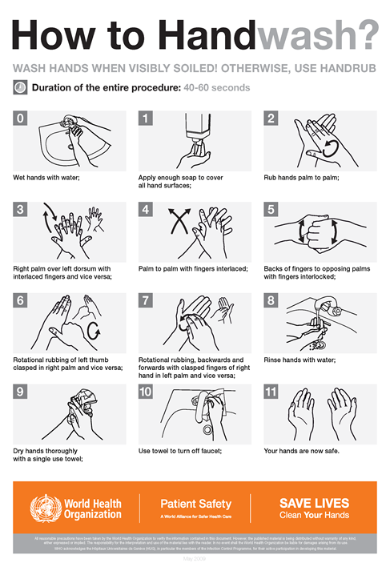
Hand Hygiene

Slide 11
Moments to Perform Hand Hygiene

Slide 12
How Could We Increase PPE Compliance?
Log sheet kept at the desk or on patient doors with time of entry and exit
Visitor sheet that should be signed stating they understand PPE must be worn
Laminated fact sheets to provide to family and visitors based on specific isolation precaution
- airborne, droplet, contact, contact-spore, neutropenic
-all depends on visitor policy

Slide 13
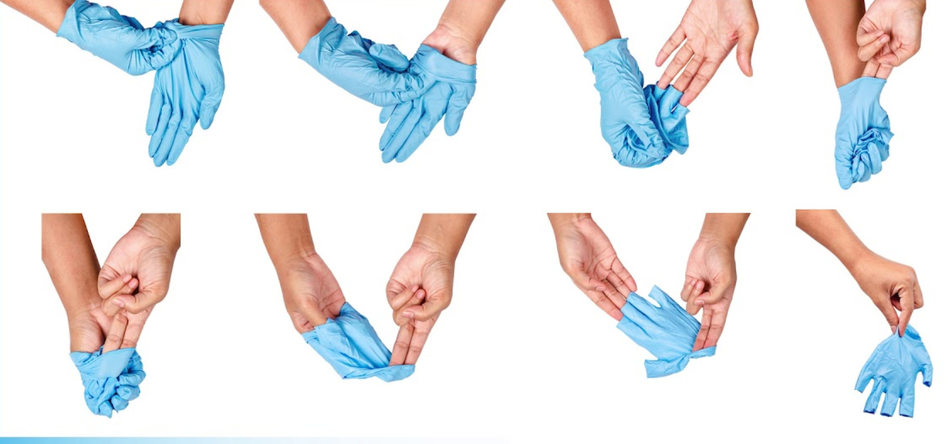
Examples

Slide 14
How Could We Increase PPE Compliance?
Educate about the importance of PPE as a barrier against transmission of infectious agents
- agents unseen to the eye, blood, body fluids, respiratory secretions
Educate about how to don and doff (put on/take off) PPE properly
- Ex) not touching gloves or outside of gown with hands, pull away from body
Where PPE should be worn – Rooms ONLY!
Visitors demonstrate how to don PPE before entry

Slide 15
How Could We Increase PPE Compliance?
Not complying? Visitor Restrictions.
Hard to Manage Visitors? May limit amount per day.
Check in occasionally to ensure compliance
NURSES ROLE MODEL!
Make sure PPE is always stocked and made available
Hang signs on patients doors showing reminders of how to don/doff, what to wear

Slide 16
Why Implement These Into Practice?
Prevent HAIs, infection transmission
Promote health, keep visitors and family safe
Promote patient outcomes
Increase knowledge and compliance with nurses, visitors and families

Slide 17
Why Implement These Into Practice?
Thorough education means less error
If visitor restrictions are needed, looks for other ways to stay connected
Ensure proper mask wearing due to current COVID-19 pandemic to help prevent transmission
Goal is to obtain 100% compliance

Slide 18
Conclusion
Let’s increase awareness of family and visitor noncompliance!
Let’s improve PPE and precaution compliance!
Remember to ALWAYS wear PPE and perform hand hygiene, especially nurses
Role modeling is key for visitor and family compliance
Educate and correct error
Together we can decrease infection transmission and risk to keep patients, families, visitors, and nurses safe!

Slide 19
References
Birnbach D.J., Rosen L.F., Fitzpatrick M., Arheart K. L., Munoz-Price, L.S. (2015). An evaluation of hand hygiene in an intensive care unit: Are visitors a potential vector for pathogens? Journal of Infection and Public Health, 8(6), 570-574. https://doi.org/10.1016/j.jiph.2015.04.027
Centers for Disease Control and Prevention. (2019, July 22). Fundamental elements needed to prevent transmission of infectious agents in healthcare settings. Retrieved from https://www.cdc.gov/infectioncontrol/guidelines/isolation/prevention.html
Jung M.Y., Kang J. (2019). Hand hygiene compliance among visitors at a long-term care hospital in Korea: A covert observation study. J Korean Acad Community Health Nurs, 30(1), 99-107. https://doi.org/10.12799/jkachn.2019.30.1.99
Petiprin, A. (2016). Nightingale’s environment theory. Retrieved from https://nursing-theory.org/theories-and-models/nightingale-environment-theory.php
Seibert, G., Ewers, T., Barker A.K., Slavick A., Wright M.O., Stevens L., Safdar, N. (2018). What do visitors know and how do they feel about contact precautions? American Journal of Infection Control, 46(1), 115-117. https://doi.org/10.1016/j.ajic.2017.05.011
Teska, J. (2020, June 12). Visitors to clients in isolation: Managing. Retrieved from https://www.ebscohost.com/assets-sample-content/SWRC-Visitors-to-Clients-in-Isolation-Managing-Practice-Skill.pdf
U.S. Food and Drug Administration. (2020, February 10). Personal protective equipment for infection control. Retrieved from https://www.fda.gov/medical-devices/general-hospital-devices-and-supplies/personal-protective-equipment-infection-control
World Health Organization. (2009, August). Hand hygiene: Why, how, and when? Retrieved fromhttps://www.who.int/gpsc/5may/Hand_Hygiene_Why_How_and_When_Brochure.pdf

