Slide 1
Implementation of music therapy to reduce anxiety in icu patients
Calley Womack
Murray State University School of Nursing

Slide 2
Abstract
Current practice in intensive care units regarding anxiety commonly results in administration of an anxiolytic, which can potentially increase patient’s time admitted and costs due to adverse effects. Studies have been conducted on implementing music therapy to reduce levels of anxiety in patients on ICU floors. However, these studies have shown that music therapy implemented in ICU patients have reduced levels of anxiety, as well as sedation frequency and costs. These results indicate there is significant benefits to use music therapy as a non-pharmacologic intervention to reduce anxiety in ICU units.

Slide 3
introduction
Anxiety upon admission into intensive care units is a common occurrence in patients. When looking at current policies to reduce anxiety in the ICU in patients who screened positive with an anxiety scale, a common intervention is to administer an anxiolytic medication such as Ativan. Using this class of medications can lead to adverse effects such as hypotension, immobility, bradycardia, and intestinal dysmotility that can produce further harm to the patient. To avoid these adverse effects, it is important to look to non-pharmacologic interventions such as music therapy.

Slide 4
Theoretical framework
Florence Nightingale’s Environmental Theory emphasized that the aspects of the patient’s environment have a significant impact on the outcomes of healthcare. This theory has aligned with my research by manipulating the patient’s environment in order to create optimal conditions to provide a more positive outcome through adjusting noise with the implementation of music therapy to reduce patient’s anxiety in the ICU.

Slide 5
Evidence-based practice
In Chlan, Heiderscheit, Skaar, and Neidecker’s study, they used music therapy tailored to the individual's preferences with an MP3 player and compared costs to usual ICU care. “Our results demonstrate that the experimental patient-directed music intervention can save about $2,000/patient and concurrently better manage anxiety with less sedative medication than usual care” (Chlan, et al., 2018).
However, Bradt and Dileo’s study found that listening to music has shown beneficial cognitive effects on anxiety as well as physiological effects. “The findings of this meta-analysis further indicate that music listening may reduce physiological responses including the respiratory rate and systolic blood pressure” (Bradt & Dileo, 2018).

Slide 6
Evidence-Based practice
In a study conducted by Chlan, Weinert, Heiderscheit, Tracy, Skaar, Guttormson, & Savik, the results of patient-directed music (PDM), noise cancelling headphones (NCH), and usual care were compared. “Among ICU patients receiving acute ventilatory support for respiratory failure, PDM resulted in greater reduction in anxiety compared with usual care, but not compared with NCH. Concurrently, PDM resulted in greater reduction in sedation frequency compared with usual care or NCH”(Chlan, et al., 2013). Patient-directed music had the better results when reducing both anxiety and sedation frequency compared to usual care.

Slide 7
Recommendations for practice
Based on these 3 articles, I am recommending to introduce this policy into practice starting by coordinating a staff meeting that provides an overview of the research and results found when implementing music therapy. Identifying the staff’s feelings directed towards implementing this intervention into practice and explaining how the staff will be involved is crucial for compliance. The staff will start by assessing a patient’s anxiety level and receiving the tools needed to direct music to the patient, such as an MP3 player, from a music therapist. After intervention, evaluating the results with a follow up is important in order for individuals to receive feedback to recognize that their efforts have made a difference in patient care.

Slide 8
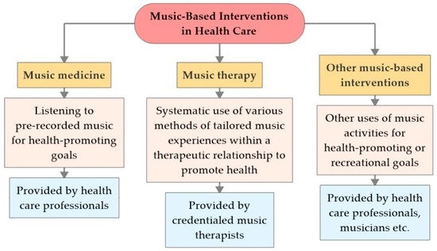
Examples of music-based interventions derived from Stegemann, Geretsegger, Phan Quoc, Riedl, and Smetana.

Slide 9
conclusion
Through current research, the implementation of music therapy has a very high potential to decrease the need for anxiolytics, reduce costs associated with the administration of anxiolytics, eliminate the risks of adverse effects, and create shorter lengths of admission in the ICU. Studies suggest that patients were less anxious and more comfortable with music therapy than patients receiving usual care. Music is a non-pharmacologic intervention that is inexpensive, easy to provide, and has no adverse effects.

Slide 10
References
Bradt, J. & Dileo, C. (2018). Music interventions for mechanically ventilated patients. Cochrane Database of Systematic Reviews, 12.
Chlan, L. L., Heiderscheit, A., Skaar, D. J., & Neidecker, M. V. (2018). Economic evaluation of a
patient-directed music intervention for ICU patients receiving mechanical ventilatory support. Critical
Care Medicine, 46(9), 1430–1435. https://doi.org/10.1097/CCM.0000000000003199
Chlan, L. L., Weinert, C. R., Heiderscheit, A., Tracy, M. F., Skaar, D. J., Guttormson, J. L., & Savik, K. (2013). Effects of
patient-directed music intervention on anxiety and sedative exposure in critically ill patients receiving
mechanical ventilatory support: a randomized clinical trial. JAMA, 309(22), 2335–2344. https://doi
-org.ezproxy.waterfield.murraystate.edu/10.1001/jama.2013.5670
Stegemann, T., Geretsegger, M., Phan Quoc, E., Riedl, & H., Smetana, M. (2019). Music therapy and other music-based interventions in pediatric health care: an overview. Medicines, 6, 25.

