Slide 1
Implementing psychiatric training for medical-surgical nurses
Hannah Berry

Slide 2
The reality for psych patients on medical-surgical units
Mental illness places a person at higher risk for physical illnesses, and thus at higher risk for hospitalization in acute settings
1 in 5 patients who present to acute care settings have some type of psychiatric illness
Studies have shown that patient with a mental illness experience deficits in quality of care when compared with patients without mental illness

Slide 3
Why is this true?
One theory as to why psychiatric patients receive less quality care in acute settings than do other patients is a lack of education on mental illness among healthcare professionals
Lack of education leads to anxiety and apprehension about the nature of mental illness
Lack of education can also mean that nurses will not have the tools and techniques to de-escalate aggressive patients
Another explanation for this care deficit is negative past experiences with caring for psychiatric patients
Studies have shown that the majority of nurses who have experienced an aggressive psychiatric patient have been emotionally hurt by them

Slide 4
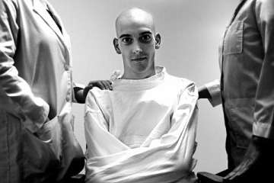
Why is this true? Cont.
Studies have also linked the poor healthcare for those with mental illness to a negative portrayal of mental illness in media and even in some educational settings
Vs.

Slide 5
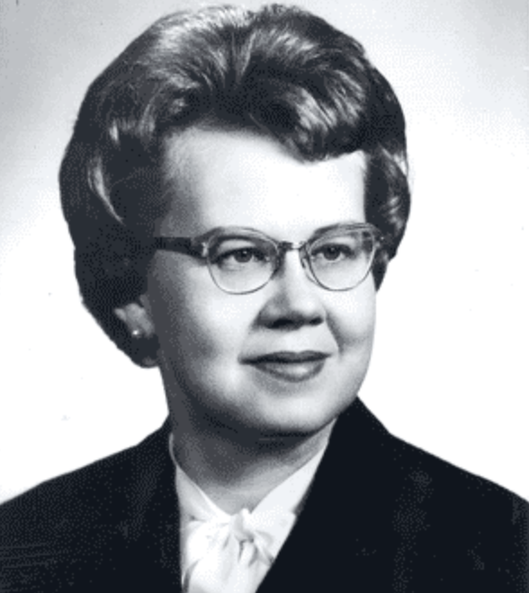
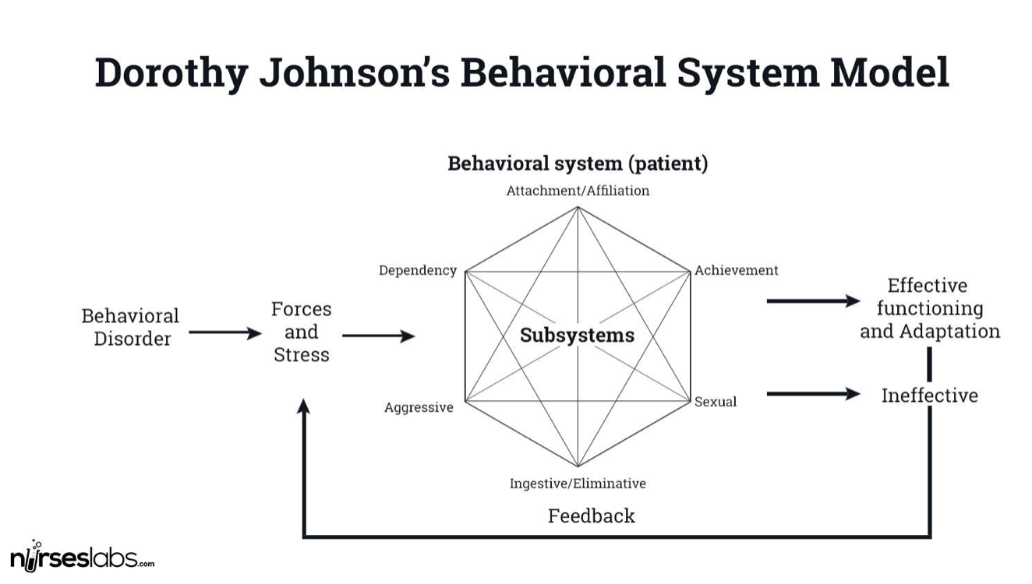
Theoretical Framework
Dorothy Johnson’s Behavioral Systems Model
Says that “each individual has patterned, purposeful, repetitive ways of acting that comprises a behavioral system specific to that individual”
It is the nurse’s responsibility to ensure these behavior systems are functioning at their best

Slide 6
So what can we as nurses do to provide better care for our psychiatric patients?

Slide 7
Educating on mental illnesses, their symptoms, and treatments will help to destigmatize mental illness and lessen the anxiety surrounding the unknown of caring for these patients
DSM5
Educating nurses on how to set up a room and plan care for a patient with mental illness will make the care process simpler
Single room
Near nurse’s station
Keep room quiet
Remove all objects that could be used as a weapon
Group activities together
Educate, educate, educate!

Slide 8
Educating on communication techniques for patients will mental illnesses will help nurses to feel better prepared to care for them
Calm voice
No “why” questions
Open-ended questions
Active listening
Thoroughly explain procedures and medications
Educate, educate, educate! Cont.

Slide 9
Policy:
All nurses working in the medical-surgical unit will complete a training on the symptoms and treatments of mental illness and how what techniques should be used in caring for patients with mental illness.
Purpose:
To provide better care for all patients by training medical-surgical nurse to understand how to care for patients with psychiatric comorbidities
Procedure:
Involves a teaching section with lecture and simulation/case study components, and a testing portion with a written exam and a practical clinical exam component
Proposed Policy

Slide 10
Thank you!!
Questions?

Slide 11
References:
Appropriate Care of the Psychiatric Patient. (2019, July 03). Retrieved October 11, 2020, from https://www.meditelecare.com/essential-information-needed-for-appropriate-care-of-the-psychiatric-patient/
Bernstein, K. S., & Saladino, J. P. (2007). Clinical assessment and management of psychiatric patients’ violent and aggressive behaviors in general hospital. Medsurg Nursing : Official Journal of the Academy of Medical-Surgical Nurses, 16(5), 301.
Bingham, H., & O’Brien, A. J. (2018). Educational intervention to decrease stigmatizing attitudes of undergraduate nurses towards people with mental illness. International Journal of Mental Health Nursing, 27(1), 311–319.
Gonzalo, A. (2019, September 11). Dorothy Johnson: Behavioral System Model (Study Guide). Retrieved October 05, 2020, from https://nurseslabs.com/dorothy-e-johnsons-behavioral-system-model
Hermanns MLS, & Russell-Broaddus CA. (2006). “But I’m not a psych nurse!” RN, 69(12), 28–2p.
Macneela, P., Scott, P. A., Treacy, M., Hyde, A., & O'mahony, R. (2012). A risk to himself: Attitudes toward psychiatric patients and choice of psychosocial strategies among nurses in medical-surgical units. Research in Nursing & Health, 35(2), 200-213.
Man in Straight Jacket. (2011). Retrieved October 10, 2020, from http://www.nufcblog.org/wp-content/uploads/2011/05/man-in-straitjacket.jpg

Slide 12
References: Cont.
Manchester, A. (2020). People with a mental illness miss out on palliative care. Kai Tiaki Nursing New Zealand, 26(8), 28–29
Rape, Cyndy; Mann, Tammy; Schooley, John; Ramey, Jana. Managing Patients With Behavioral Health Problems in Acute Care, JONA: The Journal of Nursing Administration: January 2015 - Volume 45 - Issue 1 - p 7-10.
Sakellari, E., Lehtonen, K., Sourander, A., Kalokerinou‐Anagnostopoulou, A. and Leino‐Kilpi, H. (2014), Adolescents' view of people with mental illness. Nurs Health Sci, 16: 358-364.
Rivier University, (2017, March 29). 17 Therapeutic Communication Techniques. Retrieved October 06, 2020, from https://www.rivier.edu/academics/blog-posts/17-therapeutic-communication-techniques/
Yoda - communication the key is. (n.d.). Retrieved October 11, 2020, from https://memegenerator.net/instance/61278919/yoda-communication-the-key-is

