Slide 1
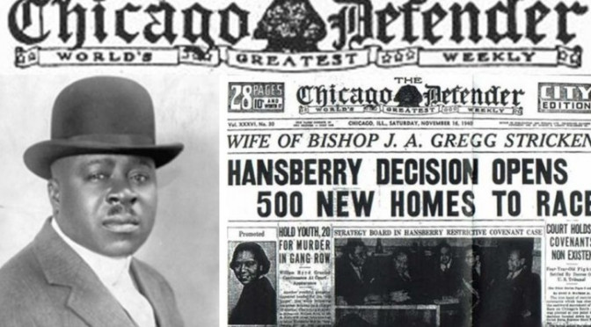
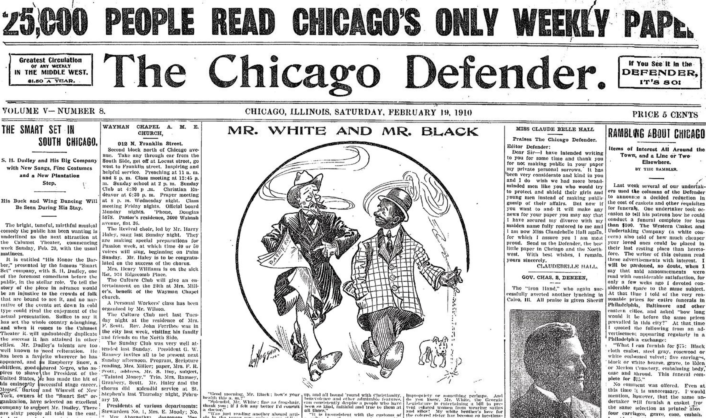
Chicago Defender: A study on Black Journalism and Transformation
Abdullah Balobaid
Murray State University
Abstract
Chicago Defender's Role in the Migration
-The newspaper's analysis of the push-pull theory was a unifying scripture for black Americans already in the North and inspires those that were willing to migrate. Whether it meant escaping the tough conditions for African Americans in the south or it meant exploring new job opportunities in the North all black either in the north or south would turn to their favorite and won newspaper for guidance, reassurance, and explanation of what the migration meant for them.
-The paper also encouraged migration to the north via the printing of letters of southerners who were willing to move to the north as well as getting printed feedback which was in the form of a letter to the editor by African Americans already in the North
Methods of study
This paper applies the content analysis method of study where secondary data like interviews are done back in the day about Chicago Defender, documentation information, and recording made by the paper or about it by scholars or journalists.
Methods of study
The Chicago Defender is the largest and most influential African American newspaper in the United States. This newspaper rose to be one of the most influential African American newspapers mid-20th century due to the role it played in addressing the issue of migration of African Americans from the South side to the North, as well as being at the forefront in fighting against racism, inequality and having a countrywide editorials standpoint.. This paper, therefore, examines how Negro reporting was done by the Chicago Defender under Abbott between the years 1910 to 1920.
Conclusion
Research on this newspaper will offer information about what was by the leading African American newspaper..
The importance of the study is that it will help in understanding the African American story and the role of journalism in the larger society and most importantly how the African American newspaper helped in portraying the community to the larger America.
This research will also offer a new perspective with regard to the role of African American media with respect to the advancement or improvement of the community termed to be lagging in the United States
Introduction
Chicago Defender is arguably one of the most influential newspapers in the United States owned by African Americans, but the paper remains to have a mythological narrative around it. According to the newspaper during then, the south was poor and lacked humanity, equity, and justice. It is based on that reason the newspaper encouraged southerners to migrate to the North which was perceived to have equity, humanity, and justice to all. This paper plays a huge role in influencing The Great Migration of African Americans from the Deep South which was rural to the urbanized North. This paper studies negro reporting of events between 1910 and 1920 on the Chicago Defender.
Discussion
Content analysis will be applied in this study because of the nature of the context in question which is the Chicago Defender's editorial and response letter of 1968 and therefore the research depends on secondary data as the source of information.
This research will examine how Negro journalistic events were reported by Chicago Defender. As an African American newspaper, the study will focus on uncovering the kind of instances that the paper took as important and ones that created discussion especially on topics like racism, equality in job employment, African pride, equity, and social change.

