Slide 1
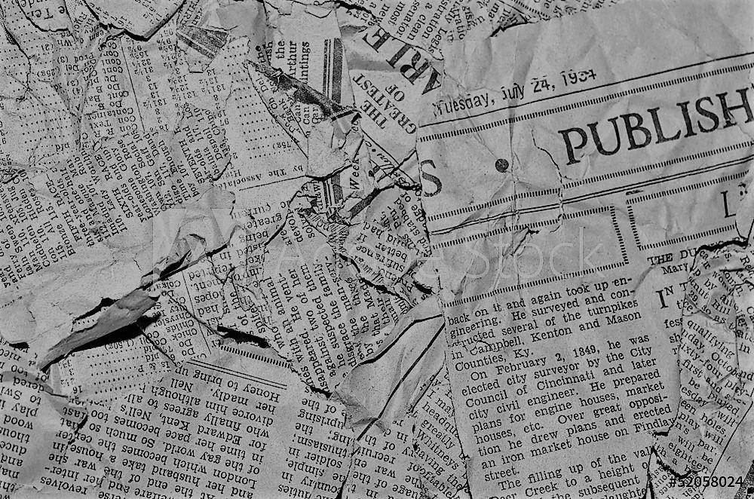
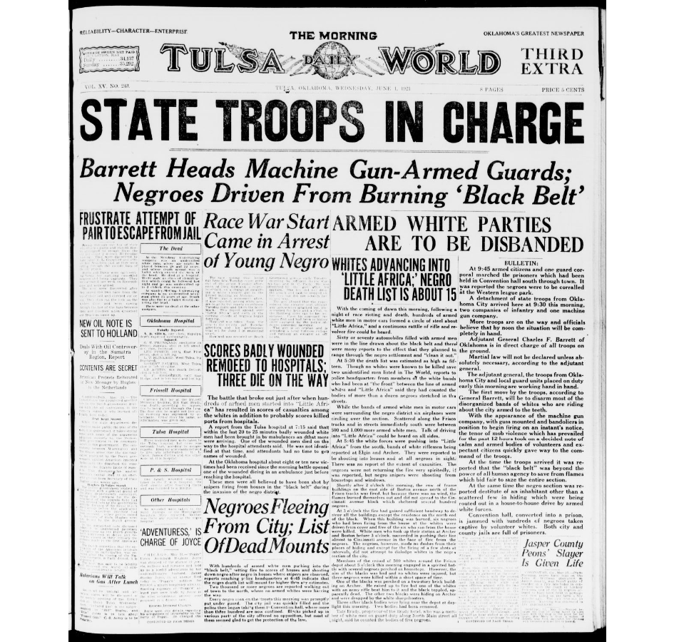
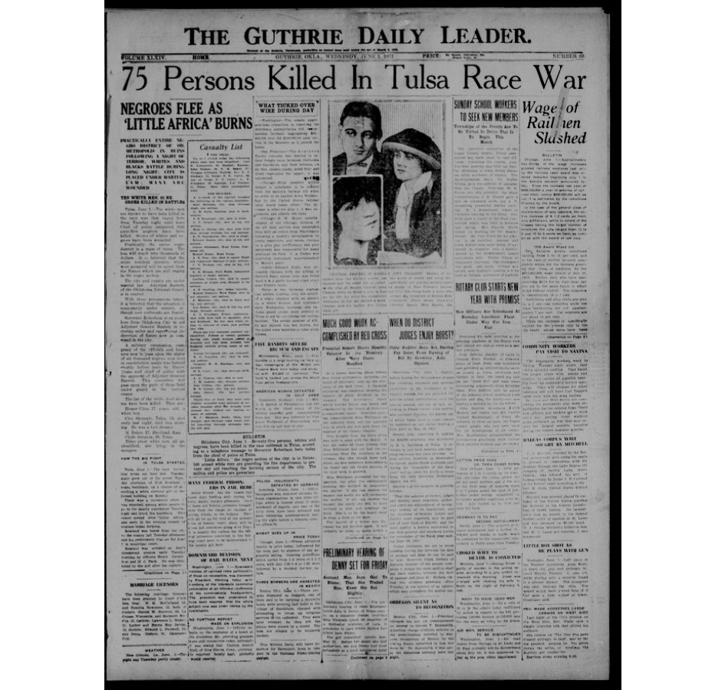
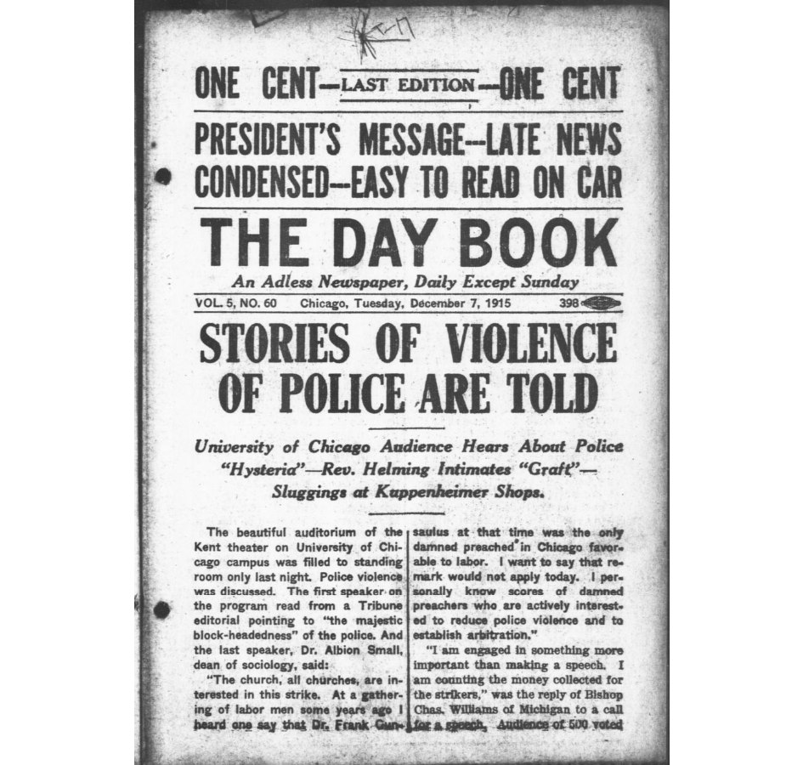
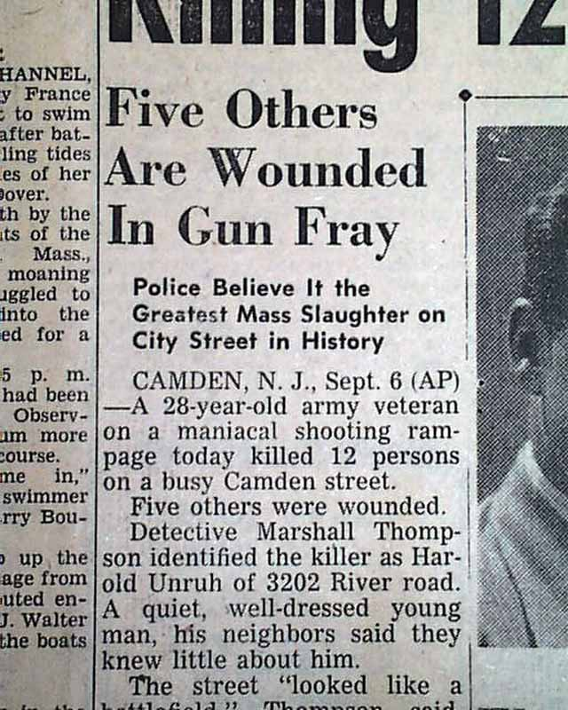
1831
Historical Review of Violence in Newspapers in the U.S.
1949
D'Myia Thornton
Do you see what I see?
ABSTRACT
From the beginning of newspapers to the dawn of click-for-profit in media today, mass shootings have become a trend in the 21st century. This research paper gives more insight on media coverage of violence. There is something wrong with the way the media reports violence. It’s detrimental to society to publicize so specifically, the details pertaining to these heinous acts. This study will be an empirical review of media coverage in the past, to determine the impact media has on mass shootings, violence and hate crimes to change the future for the better. This paper will explore vital works from credible sources like case studies and informal like newspapers in the U.S. from the 19th and 20th centuries. This research will examine the Chronicling America database for newspapers reporting of cases as it pertained to violence. The goal of this study is to understand the issue of violence in media coverage and to address solutions towards objectivity.
This is an analysis of newspaper articles journalizing a military vet and other accounts from citizens in Chicago on their encounter with violence, whether on the opposing side or as the aggressor.
Journalism in the past was heavily biased, how did this pertain to minorities? The reporting of the Tulsa Race Riot & Nat Turner's Rebellion depict racism, not just in the South but also in journalism in the 19th & 20th century.
CONCLUSION
All in all, journalism has evolved from the mistakes and violations of the 19th and 20th century. In the old days, journalists didn't see an issue with publishing Howard Unruh's address after he committed one of the first U.S. mass shooting. The past newspaper coverage of African Americans failed to portray the individual as a person because at the time, America was not willing to accept them as equal. Although times have improved, newspapers have been a contributor to systemic racism seen today.
Murray State University

