Slide 1
Naloxone Administration in Schools
Aleece Passman and Emily Weber
Murray State University

Slide 2
Introduction
As most know, there is currently an opioid epidemic affecting our country! This epidemic does not discriminate by age, gender, or ethnicity! Since this includes the school aged population, it is important for as many personnel as possible to be prepared and know what to do if an opioid overdose arises. This powerpoint will discuss a proposed policy, the statistics for this problem, and instructions on how to properly use the medication!

Slide 3
Statistics
In 2019 Drug overdose caused 2,089 of deaths in Tennessee, and across the U.S. caused 21.7% for a total of 70, 237 deaths
This is raised from previous years
TN has the 11th highest drug overdose death rate
In 2017 2.2 million people of ages 12-17 were illicit drug users
40.3% of nurses encounter opioid prescriptions in the school setting
97% of nurses had a way to store them and 3.6% had naloxone in case of overdose

Slide 4
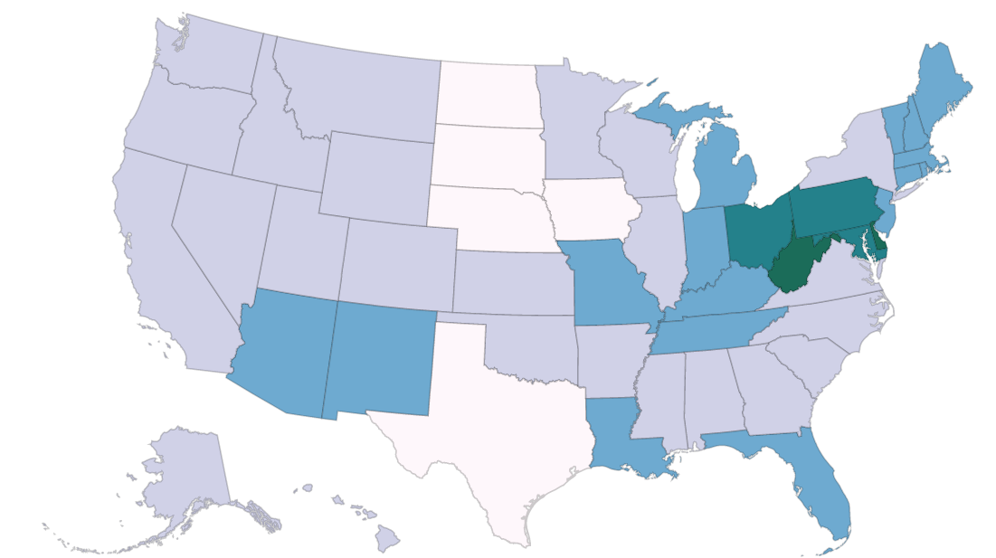
Drug overdose rates by states-from the CDC

Slide 5
Current Policy
In the Henry County School System, there is currently no policy in regards to school nurses using Naloxone.
This poses an increased risk to prolonged drug overdose symptoms due to there being limited availability of Naloxone.
The school nurse is usually the first or one of the first people on the scene of an incident and should be allowed to carry Naloxone in case it is needed.

Slide 6
The Research
The National association of school nurses has recommended that all school nurses have Narcan in case of an opioid overdose
This is due to high levels of adolescent drug users and nurses being the first to get to the scene in emergency situations
In one study 53.6 % of nurses did have naloxone on supply, and 5.2% were able to use it in an emergency situation
Naloxone does not cause harm if an emergency is not opioid related

Slide 7
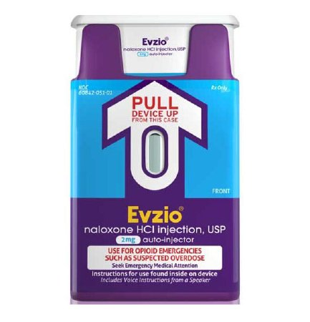
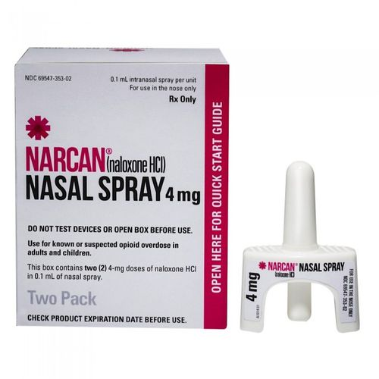
Research cont.
IM naloxone is more effective than nasal naloxone
IM injections needed a second dose 8.6% of the time and nasal sprays needed a second dose 23.1% of the time
State of TN lets nurses choose which type of Naloxone they want to carry, but must have a policy on where it is to be stored
In one study, only a quarter of nurses had received training on naloxone administration, and most felt like they could use more training
State of TN would require nurses to complete a training through the Department of Health
This course is online and takes aprox. 15-20 min
We will share the TN policy on Naloxone in schools

Slide 8
Storage
Naloxone should be clearly labeled in an unlocked, easily accessible supervised area
Expiration dates should be documented on an appropriate log at a minimum of two times a year
Other supplies that may be needed when responding to a possible overdose should be stored with the medication (i.e. gloves, mask)

Slide 9
Our suggestion of a Policy
Check for a Response
Try to arouse them by saying their name or shaking them
Perform a Sternal Rub
Listen for breath sounds or assess for signs of breathing
Assess lips and fingernail color; pale, blue or gray is a sign of an overdose
Call 911
Inform operator of location and that you are with a person who is not breathing
Inform them you are going to give Naloxone and follow any instructions they give you
Give Naloxone
How to instructions will be given in another slide
Start Rescue Breathing
Naloxone may take a few minutes to work, if the person is not breathing, provide rescue breaths
Give another dose of Naloxone
If after 3 minutes, the person does not respond, give another dose of Naloxone
Post Care of an Overdose
Stay with the person until help arrives
If person begins to breathe on their own, do not wake them up but roll them on their side, they may experience opioid withdrawal symptoms like chills, nausea, and muscle aches

Slide 10
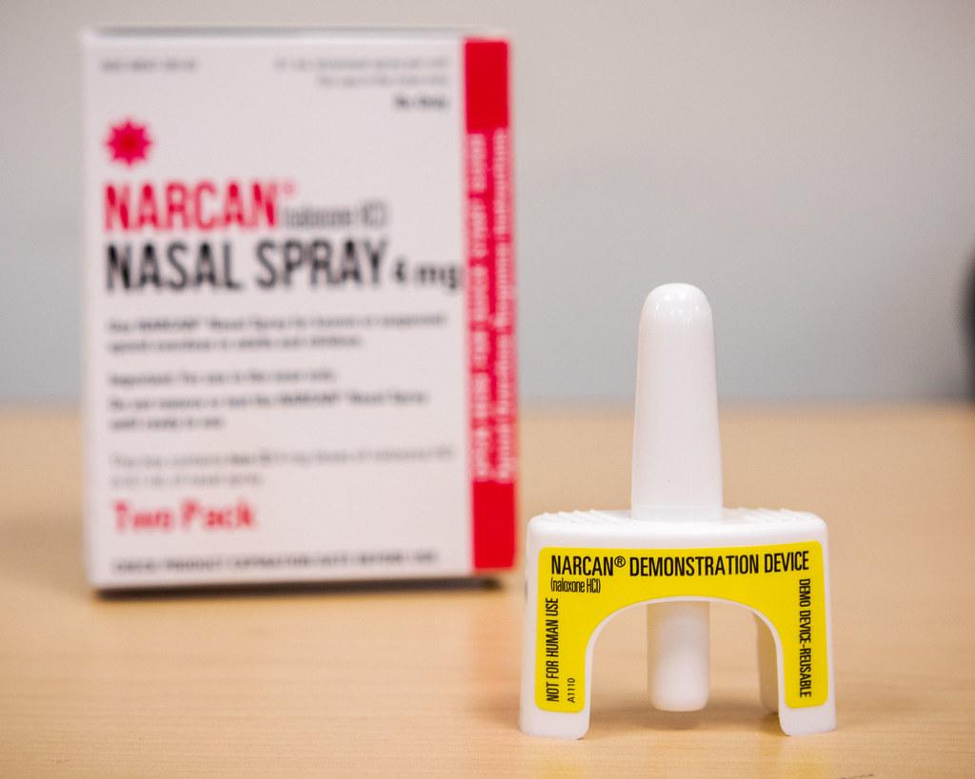
Instructions on Nasal Naloxone
Each spray comes already assembled
Do not test the spray! Each only works once
Peel back the package to remove the device
Place and hold the tip of the nozzle in either nostril; if the nose is bleeding, it may obstruct the effectiveness of the medication
Press the plunger firmly to release the dose into the nose

Slide 11
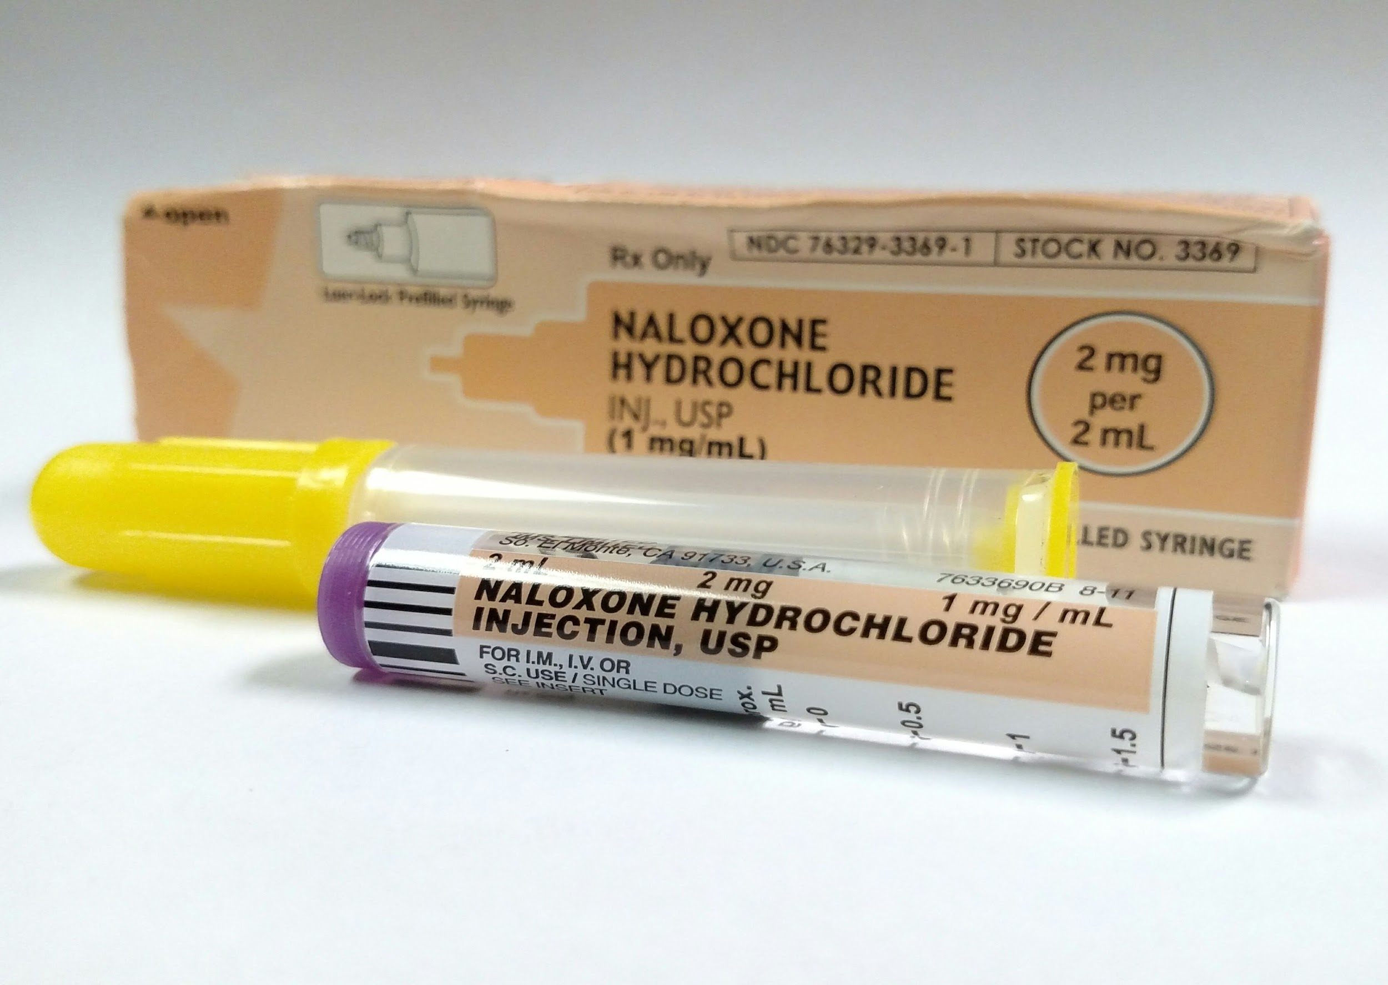
Instructions for Injectable Naloxone
Depending on the kit the school gets, you may have to draw up the Naloxone amount into the syringe. Other kits will have a pre-filled syringe included.
Remove the cap from the Naloxone vial and uncover the needle
Insert the needle through the rubber plug with vial upside down. Pull back on the plunger and draw up 1 mL
Inject 1 mL of Naloxone into an upper arm or thigh muscle

Slide 12
Implementation
Incorporating this policy could potentially save lives of students and employees
The school system may want to analyze the cost of implementing this policy across all of the schools
There are some programs that allow the school to receive this medication at no cost, however these programs change every day
Ensure you are following the policy on where and how to store the medication

Slide 13
References
Centers for Disease Control and Prevention. (2021, February 12). Drug Overdose Mortality by State. Centers for Disease Control and Prevention. https://www.cdc.gov/nchs/pressroom/sosmap/drug_poisoning_mortality/drug_poisoning.htm.
Dietze, P., Jauncey, M., Salmon, A., Mohebbi, M., Latimer, J., van Beek, I., McGrath, C., & Kerr, D. (2019). Effect of Intranasal vs Intramuscular Naloxone on Opioid Overdose: A Randomized Clinical Trial. JAMA network open, 2(11), e1914977. https://doi.org/10.1001/jamanetworkopen.2019.14977
Levasseur, S., Nelson, L., Crowe, D., & Major, K. E. S. (2020, June). Naloxone in the school setting. https://www.nasn.org/advocacy/professional-practice-documents/position-statements/ps-naloxone.
McDonald, C. C., Pinto-Martin, J., Compton, P., Parikh, M., & Meisel, Z. F. (2020). School nurse reported supply and administration of naloxone in schools. Public Health Nursing (Boston, Mass.), 37(3), 347–352. https://doi-org.ezproxy.waterfield.murraystate.edu/10.1111/phn.12715
Pattison-Sharp, E., Estrada, R. D., Elio, A., Prendergast, M., & Carpenter, D. M. (2017). School nurse experiences with prescription opioids in urban and rural schools: A cross-sectional survey. Journal of Addictive Diseases, 36(4), 236–242. https://doi-org.ezproxy.waterfield.murraystate.edu/10.1080/10550887.2017.1361725
Tennessee Department of Health and Tennessee Department of Education. (2017, October 20). Guidelines for the Administration of an Opioid Antagonist for Students Suspected of a Drug Overdose.
Washington State Department of Health. (2019, August). Use Naloxone for a Drug Overdose (Infographic). https://www.doh.wa.gov/Portals/1/Documents/Pubs/150-126-NaloxoneInstructions.pdf

