Slide 1
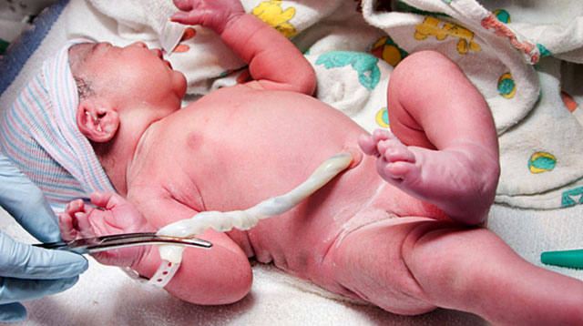
Benefits of Delayed Cord Clamping
By Chloe Robertson and Maddie Martin

Slide 2
Abstract
Our evidence-based practice project focuses on the benefits of delaying cord clamping. To guide our research, we used Sister Castilla Roy’s Adaptation Model of Nursing. Our research we used supports that delaying cord clamping is best for not only the baby, but also for the mother as well. We believe that a policy on delayed cord clamping should be implemented in order for health and adaption goals to be met.

Slide 3
Problem/Background
We got feedback from the nurses on the unit asking what needs to be added, changed, or researched and we went from there and began looking through the policy book.
We found that there is no policy regarding a time frame on umbilical cord clamping.
Studies show that delaying cord clamping has benefits for both the mother and the baby.
It has been witnessed that cord clamping on the floor usually occurs early (within 30 seconds after birth), even though no policy exists.
We believe that a policy should be implemented to match the evidence gathered that delaying cord clamping is the best practice.

Slide 4
Theoretical Framework
Sister Castilla Roy’s Adaptation Model of Nursing is made of up four components: person, health, environment, and nursing.
It states that a person is a bio-psycho-social being in constant interaction with a changing environment; he or she uses innate and acquired mechanisms to adapt.
In relation to this research, the newborn is interaction with change in the environment and is required to adapt quickly to changing from intrauterine life to extrauterine life.
In Roy’s Model of Adaptation, the goal of nursing is to promote adaptation; during delivery, nurses do this by clearing the newborn’s airway, clamping and removing the umbilical cord, administering any needed medications, and providing any needed resuscitation.

Slide 5
Evidence-Based Practice
In the article, “Effect of early versus delayed cord clamping in neonate on heart rate, breathing and oxygen saturation during first 10 minutes of birth - randomized clinical trial.”, one thousand five hundred and ten women were enrolled in the study. The results included an increase in oxygen saturation by 18% at 1 minute, 13% at 5 minutes, and 10% at 5 minutes. It also showed that the newborn's heart rate was 9 beath slower at 1 minute and 3 beats lower at 5 minutes compared to the controlled group (cord was clamped immediately after birth).
In the article, “Effects of Delayed Cord Clamping on 4-Month Ferritin Levels, Brain Myelin Content, and Neurodevelopment: A Randomized Controlled Trial.”, seventy-three health, term pregnant women and their single fetuses were randomized and studied.. The results showed that the 48 hr hematocrit was increased by 4.5%, and the 4 month ferritin levels were increased by 31.1 ng/dL. The infants were showns to have a greater myelin content and other maturing brain regions associated with motor, visual, and sensory processing/functioning.“
In the article, “Effects of Delayed Umbilical Cord Clamping vs Early Clamping on Anemia in Infants at 8 and 12 Months A Randomized Clinical Trial,” 540 late preterm and term infants were studied. The results stated that infants with delayed cord clamping had reduced prevalence of anemia 8 months prior to birth (197 vs 222), and reduced prevalence of iron deficiency (60 vs 103). The study also showed that at 12 months, delayed cord clamping still resulting in a hemoglobin level 0.3 higher than in early cord clamping and a relative risk of anemia of 0.91, resulting in NNT of 12.

Slide 6
Recommendations for Practice
Implement the proposed policy and patient teaching into practice.

Slide 7
Conclusion
Delaying umbilical cord clamping is research-backed, simple, quick intervention that the Registered-Nurse can use to implement the patient’s and their family’s health and quality of life.

Slide 8
References
KC, A., Singhal, N., Gautam, J., Rana, N., & Andersson, O. (2019). Effect of early versus delayed cord clamping in neonate on heart rate, breathing and oxygen saturation during first 10 minutes of birth - randomized clinical trial. Maternal Health, Neonatology and Perinatology, 5(1), 1–7. https://doi.org/10.1186/s40748-019-0103-y
KC, A., Rana, N., Målqvist, M., Jarawka Ranneberg, L., Subedi, K., & Andersson, O. (2017). Effects of Delayed Umbilical Cord Clamping vs Early Clamping on Anemia in Infants at 8 and 12 Months. JAMA Pediatrics, 171(3), 264. https://doi.org/10.1001/jamapediatrics.2016.3971
Mercer, J. S., Erickson-Owens, D. A., Deoni, S. C. L., Dean, D. C., Collins, J., Parker, A. B., Wang, M., Joelson, S., Mercer, E. N., & Padbury, J. F. (2018). Effects of Delayed Cord Clamping on 4-Month Ferritin Levels, Brain Myelin Content, and Neurodevelopment: A Randomized Controlled Trial. The Journal of Pediatrics, 203, 266-272.e2. https://doi.org/10.1016/j.jpeds.2018.06.006
Interprofessional Education and Research Committee of the Champlain Maternal Newborn Regional Program, C. M. N. R. P. (2013). Newborn Adaptation to Extrauterine Life and Newborn Assessment. Champlain Maternal Newborn Regional Program. http://www.cmnrp.ca/uploads/documents/Newborn_Adaptation_Assessment_2013_FINAL.pdf
Roy’s Adaptation Model of Nursing. (2020, July 21). Nursing Theory. https://nursing-theory.org/theories-and-models/roy-adaptation-model.php

