Slide 1
A New Approach to Bedside Nursing: Bedside Handoff Reporting
Regan Hancock & Samantha McClure
Murray State - Nursing 412

Slide 2
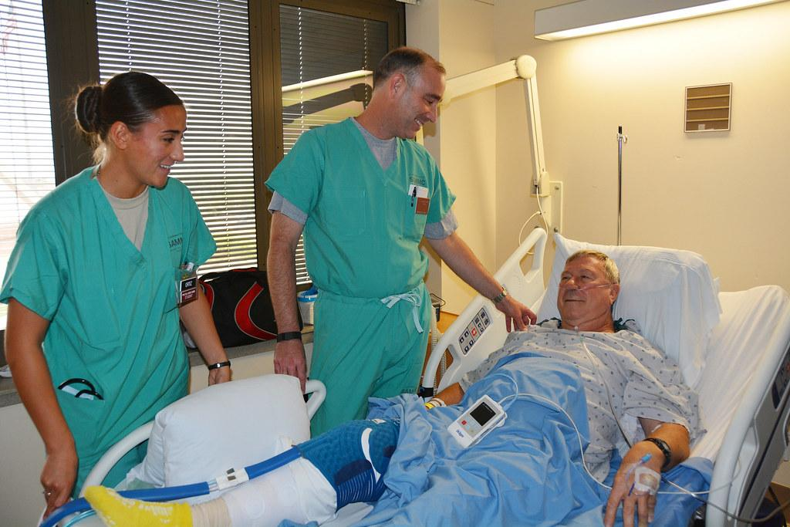
Purpose
The purpose of this presentation is to evaluate the effectiveness of bedside handoff reporting in this hospital.

Slide 3
The Problem
The current practice at this hospital is to do shift handoff reporting at the desk. There is not a standardized method for handoff reporting.
The issue with this current practice is that it allows for interruptions, decreases patient safety, and leads to communication errors.
We have conducted research on the effectiveness of implementing bedside report.

Slide 4
Theorist: Hildegard E. Peplau
Theory of Interpersonal Relations
This theory goes through different stages of interaction between the nurse and the patient including the orientation, identification, exploitation, and resolution phases.
By completing bedside reporting at the beginning and end of shift, the nurse is able to determine priorities with the patient, plan care accordingly, then communicate the interventions and further care needed to the nurse taking their place.
Notes:
By completing bedside reporting at the beginning and end of shift, the nurse is able to determine priorities with the patient, plan care accordingly, then communicate the interventions and further care needed to the nurse taking their place. The termination phase closely resembles the offgoing nurse’s relationship with the patient as they pass the reigns to the oncoming nurse during the bedside handoff.

Slide 5
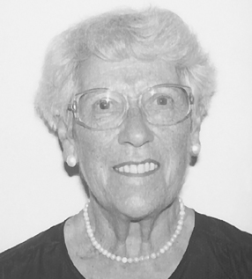
Theorist: Roper, Logan, and Tierney
A Model for Nursing Based on a Model for Living
This theory is constructed upon evaluating a patient’s activities of daily living. In assessing all aspects influencing the patient and their activities of daily living, the nurse can provide holistic care for the patient. If they fail to do so, they will assume all is well.
Nurses can quickly fall into a decreased level of care by being several hours into a shift and never lay eyes on the patient. By implementing use of this theory along with their bedside report, quality care for the patient increases tremendously.
Notes:
This theory parallels the goal of bedside handoff by allowing the nurse to observe patient needs upon initial assessment, look at their condition and needs, and base care provided throughout the shift on these needs. If the nurse takes this time to do a quick general assessment of the patient, the nurse can ensure needs of the patient are met and work towards providing more holistic care.

Slide 6
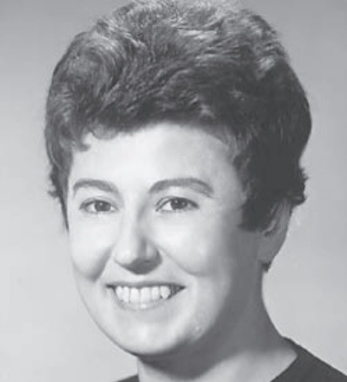
Theorist: Ida Jean Orlando
Nursing Process Discipline Theory
The theory is “is focused on the process of care in an immediate experience, and is concerned with providing direct assistance to a patient in whatever setting they are found in for the purpose of avoiding, relieving, diminishing, or curing the sense of helplessness in the patient” (Petiprin, 2020)
Implementation of the bedside reporting method allows for two sets of eyes to be laid on the patient by the oncoming and offgoing nurse. By doing so, the potential for quick-solving of an issue increases leading to quicker patient improvement and more positive outcomes.
Notes:
Orlando’s theory evaluates the effectiveness of an immediate judgement of the patient to identify immediate needs of the patient using verbal and nonverbal cues.

Slide 7
Evidence #1
“Three major themes reflect patients’ experience regarding the bedside shift reports: (i) ‘Being involved’; (ii) ‘Being the centre of nursing care processes’; and (iii) ‘Experiencing critical issues’. Patients are supportive of bedside shift reports as a right, as an opportunity to be involved, and of being in the centre of the nursing care process. By designing and implementing bedside shift reports, nurses also have an opportunity to increase patient safety and to provide concrete proof of the advancements achieved by the nursing profession in recent years”. (Bressan et al., 2019).

Slide 8
Evidence #2
Bedside handoff reporting increases patient satisfaction!
“Postservice bundle education implementation (September 2015): 60% of patients rated their overall quality of care as excellent, increasing our ranking to the 85.5 percentile”. (Skaggs et al., 2018).

Slide 9
Evidence #3
This issue of privacy seems to be the main concern of most nurses when it comes to the bedside handoff report.
“In our opinion, the use of bedside handovers does not inflict issues with privacy of such gravity and uniqueness that the method cannot be used safely in practice, as long as steps are taken to safeguard the patient’s privacy as much as possible. In cases where it does not infringe privacy, any arguments claiming otherwise are perhaps used under the false pretense to cover up other reasons to not perform the bedside handover”. (Malfait et al., 2018).

Slide 10
Proposed Policy Change
The proposed policy change is to move towards using bedside handoff reports during shift change.
The policy will enforce bedside handoff reporting by all nurses during shift change.
The bedside report will include the nurse leaving, the nurse coming on shift, nurse aid leaving, and the nurse aid coming on shift.
The bedside report should last 3-5 minutes and hit all the important points allowing for patients to add input when necessary.
A set document can be in place to help nurses with what needs to be discussed. We have attached a copy of an idea of one.
Notes:
Samantha

Slide 11
Policy Implementation
Implementation will include multiple steps.
Nurses will need to receive education regarding the new policy. Education needs to include why this change is important to overall patient care.
Leadership needs to be present during this change in the beginning.
Leadership needs to continue to monitor periodically that the implementation is still being used. This could mean random check-ins during handoff report time. This allows for compliance to be assessed.

Slide 12
Document Idea
https://docs.google.com/document/d/1YLoiUCWURmhPZ5TiyCpnyoc6D8Jh5ruQhJaeyrTPYTc/edit?usp=sharing
Notes:
Samantha

Slide 13
Conclusion
In conclusion, bedside handoff reporting is the gold standard in improving patient outcomes and satisfaction.
The research shows that by implementing the bedside handoff report patient satisfaction will increase, patient safety will increase, and nursing communication will strengthen leading to less errors.
In looking at nursing theorists/theories and evaluating current evidence, it is evidence based practice to utilize bedside handoff reporting at this hospital.

Slide 14
Sources
Bressan,Valentina., Cadorin, Lucia., Stevanin, Simone., Palese, Alvisa., (2019). Patients experience of bedside handover: findings from a meta-synthesis. Scandinavian Journal of Caring Sciences, 33(3). Retrieved from https://onlinelibrary.wiley.com/doi/full/10.1111/scs.12673
Petiprin, Alice., (2020) Orlando’s Nursing Process Discipline Theory, Nursing Theory, Retrieved from Orlando's Nursing Process Discipline Theory - Nursing Theory (nursing-theory.org)
Malfait, Simon., Hecke, Ann Van., Biesen, Wilm Van., Eeckloo, Kristof., (2018). Is privacy a problem during bedside handovers? A practice-oriented discussion paper. Sage Journals, 26 (7-8), Retrieved from https://journals.sagepub.com/doi/full/10.1177/0969733018791348
Skaggs, Mary., Daniels, Juli., Hodge, Angela., De Camp, Valerie., (2018). Using the evidence-based practice service nursing bundle to increase patient satisfaction. Journal of Emergency Nursing, 44(1). Retrieved from https://www.sciencedirect.com/science/article/abs/pii/S0099176717305470

Slide 15
THANK YOU!
We both would like to thank you for participating in our discussion on bedside handoff reporting. We hope you are able to utilize the knowledge gained from our presentation in addition to your own research to provide evidence-based practice to your patients. We have provided our contact information if you have any questions!

