Slide 1
Acuity Based Staffing
Halie Tabor and Perri Hogan
NUR 412
Fall 2021

Slide 2
Abstract
For decades nurses have been fighting for safe nurse to patient ratios. Thousands of studies have been done proving that an increased patient load leads to burnout, job dissatisfaction, occupational injuries, adverse events, and patient mortality. In an effort to keep nurses at the bedside, California passed The Patient Safety and Quality Improvement Act of 2005. This act was the first of its kind as it established legislatively mandated nursing ratios and required staff to take several breaks throughout the day. However, mandated ratios come with a cost that most institutions cannot afford and therefore is not appropriate as a stand alone intervention. Currently nursing assignments are made by assigning rooms in “blocks” with little to no consideration of acuity. While this is a very simple assignment making method, it allows for an unfair acuity mix, which can result in increased workload and job dissatisfaction. Implementing the proposed patient acuity tool has the potential to increase nurse satisfaction, patient safety, and decrease adverse events.
Notes:
Turn this into the universities research week and screenshot submission

Slide 3
Problem:
Throughout our three years at Murray State (nearly 800 clinical hours), previous work experience, and various observations we have seen first hand the injustices of nursing. From high patient ratios and high acuity, to unequal staffing assignments. Currently many institutions have no policy regarding the creation of nursing assignments or what to do if one is uncomfortable with their patient load.
Outcomes: Increased...
Job dissatisfaction
Intent to leave
Rates of burnout
Mortality rates
Adverse events
Workplace injuries
Preventable medical errors
Low quality care
Hospital acquired infections

Slide 4
Evidence
Nurse staffing and nurse outcomes: A systematic review and meta-analysis - ScienceDirect
Findings: “Greater nurse-to-patient ratio is related to increase in adverse nurse outcomes”.
Nurse Burnout- “ An increase of one patient per RN ratio was associated with a 7% increase in the odds of burnout” (Shin, 2018).
Job Dissatisfaction- “An increase of one patient per RN ratio was associated with an 8% increase in the odds of job dissatisfaction”(Shin, 2018).
Intent to Leave- “Nurses’ intention to leave was increased 1.05 times when the nurse-to-patient ratio was increased by 1” (Shin, 2018).
Needlestick Injury- “Three studies were included in this analysis (Figure 5). The overall effect size was 1.33”(Shin, 2018).
Article 1:
Purpose: The purpose of this review was to systematically assess the relationship between nurse staffing and nurse outcomes through meta-analysis.
Methods:
Peer-reviewed articles published between 2000-2016 were identified in CINAHL, PubMed, PsycINFO, Cochrane Library, EBSCO, RISS, and DBpia databases.
1,429 studies were found. Through the cross-examination and screening process approximately 13 studies were considered to have high quality evidence. Of those 13 studies approximately 106,831 nurses were included.
Notes:
Shin, S., Park, J.-H., & Bae, S.-H. (2018, February 26). Nurse staffing and Nurse Outcomes: A systematic review and meta-analysis. Nursing Outlook. Retrieved October 10, 2021, from https://www.sciencedirect.com/science/article/abs/pii/S0029655417302658.

Slide 5
Evidence
https://academic.oup.com/eurjcn/article/17/1/6/5925020?login=true
Findings:
Mortality- “higher level of nurse staffing decreased the risk of inhospital mortality by 14%” (Driscoll, 2018).
HAIs- “ A higher level of nurse staffing in CCUs was associated with a lower incidence of pressure ulcer development,use of physical restraints, and incidence of nosocomial infection” (Driscoll, 2018). Hospital with appropriately staffed ICU and CCU found patients were,“68% less likely to experience bloodstream infections”, “79% less likely to experience pneumonia” and “ 31% reduction in risk for a decubitus pressure ulcer”(Driscoll, 2018).
Prevention- “In the emergency department, a higher level of nurse staffing increased the prescribing of aspirin on arrival to the emergency department and a percutaneous coronary intervention within 90 minutes of arrival”(Driscoll, 2018).
Medications- “as the number of nurses decreased, the OR for parenteral medication errors increased, some of which caused harm and death” (Driscoll, 2018).
Article 2:
Purpose: “To undertake a systematic review and meta-analysis examining the association between nurse staffing levels and nurse-sensitive patient outcomes in acute specialist units”
Methods:
Peer reviewed articles published between 2006-2017 were identified using nine databases. 4472 articles were found using the literature search. Quality of the studies were assessed using the Newcastle–Ottawa scale (NOS). Approximately 24 studies were considered high quality. Of those 24 studies, approximately 175,755 patients were included.
Notes:
Driscoll, A., Grant, M. J., Carroll, D., Dalton, S., Deaton, C., Jones, I., Lehwaldt, D., McKee, G., Munyombwe, T., & Astin, F. (2018, January 1). Effect of nurse-to-patient ratios on nurse-sensitive patient outcomes in acute specialist units: A systematic review and meta-analysis. OUP Academic. Retrieved October 10, 2021, from https://academic.oup.com/eurjcn/article/17/1/6/5925020?login=true.

Slide 6
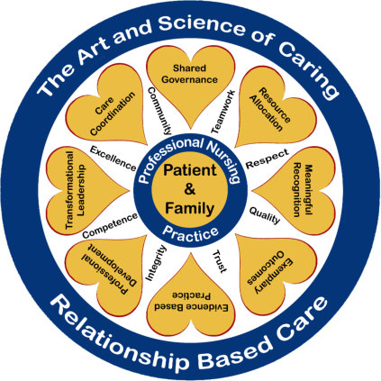
Jean Watson’s Theory of Human Caring
1) Forming humanistic-altruistic value systems
2) Instilling faith-hope
3) Cultivating a sensitivity to self and others
4) Developing a helping-trust relationship
5) Promoting an expression of feelings
6) Using problem-solving for decision-making,
7) Promoting teaching-learning
8) Promoting a supportive environment
9) Assisting with the gratification of human needs
10) Allowing for existential-phenomenological forces
Notes:
https://nurseslabs.com/jean-watsons-philosophy-theory-transpersonal-caring/
Misyuk, N. (2021, March 5). Jean Watson: Theory of human caring. Nurseslabs. Retrieved October 10, 2021, from https://nurseslabs.com/jean-watsons-philosophy-theory-transpersonal-caring/.
More patients means less time available to complete.

Slide 7
Recommendation
Many facilities do not have a policy on how nursing assignments are made or what to do if the assignment is too heavy for one nurse. Our recommendation is to implement a Patient Acuity Tool. A registered nurse would fill out each shift and post in the nurses station for the charge nurses to create assignments. Each patient is scored on a 1-to-4 scale (1-stable patient; 2-moderate risk patient; 3-complex patient; 4-high risk patient) based on the clinical patient characteristics and the care involved (workload). Then based on the unit's average acuity, staffing assignments would be made and divided equally. If the acuity is consistently high (>”X”) then a maximum patient ratio should be implemented. At this point the house supervisor would be notified and the on-call staff would be called in using the staffing decision tree.

Slide 8
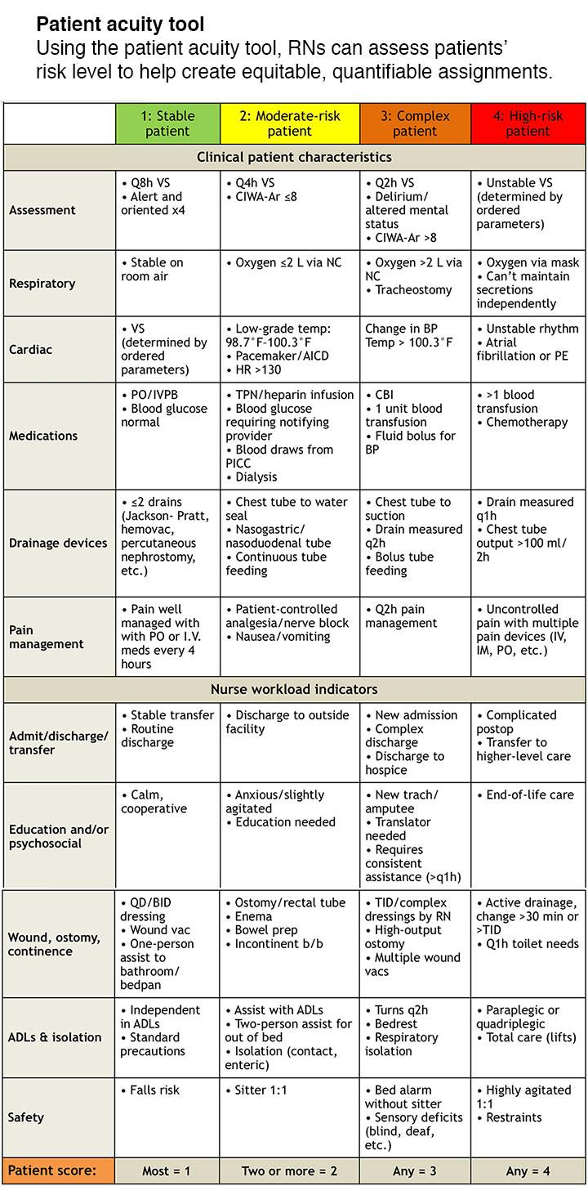
Schedule
Notes:
Patient acuity tool on a medical-surgical unit. American Nurse (March 10, 2021). Retrieved October 10, 2021, from https://www.myamericannurse.com/patient-acuity-medical-surgical-unit/.

Slide 9
Notes:
Patient acuity tool on a medical-surgical unit. American Nurse (March 10, 2021). Retrieved October 10, 2021, from https://www.myamericannurse.com/patient-acuity-medical-surgical-unit/.

Slide 10
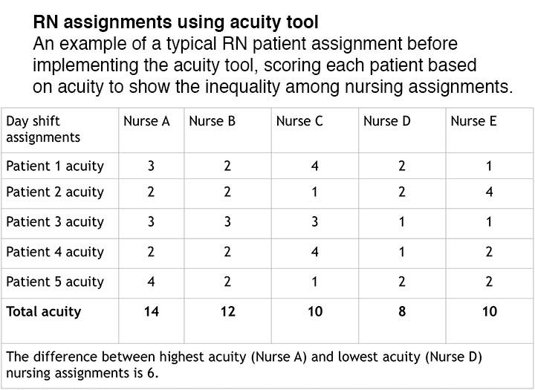
Notes:
Patient acuity tool on a medical-surgical unit. American Nurse (March 10, 2021). Retrieved October 10, 2021, from https://www.myamericannurse.com/patient-acuity-medical-surgical-unit/.

Slide 11
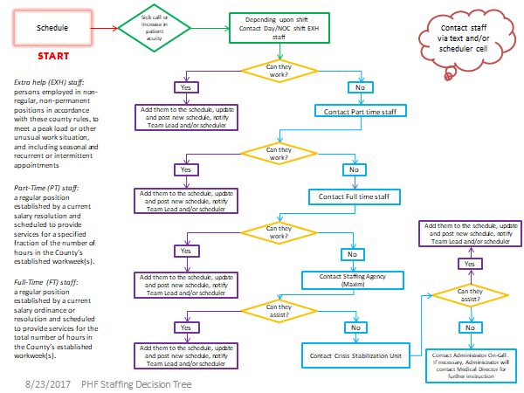
Staffing
Decision
Tree
Should be used if staffing does
not match the need.
*Borrowed from Santa Barbara Behavioral Wellness

Slide 12
Evidence
Article 3:
Study was conducted on 61 nursing students based in the Philippines
Results showed little to no improvements of nurse satisfaction, but included several limitations such as poor training and implementation of the patient acuity tool. They suggest further research needed to be done.
However, Ascension St. Thomas in Nashville TN has implemented their own version of the Patient Acuity Tool. It has received compliments on its ability to...
De escalating arguments of “unfair” assignments
Increased nurse-to-nurse communication
Increased autonomy
Provided more support on the floor
No published research to support these claims.
Notes:
The Effect of Patient Acuity Tool on Patient Clinical Practicum Assignments on Nursing Student Satisfaction Levels: A Quasi-Experimental Study | David | Jurnal Keperawatan Padjadjaran (unpad.ac.id)
David, M. L. V., Bano, R. A. V., Joven, E. F. S., Manansala, N. R., Ana, M. G. S., Cabanes, R. V. D., & Glinoga, M. G. (n.d.). The effect of patient acuity tool on patient clinical practicum assignments on Nursing Student Satisfaction Levels: A quasi-experimental study. Jurnal Keperawatan Padjadjaran. Retrieved October 10, 2021, from http://jkp.fkep.unpad.ac.id/index.php/jkp/article/view/1668.

Slide 13
Summary
Through our study we found that there is a ton of research stating that nurses are unhappy, burnout, and patients are at risk.
The Patient Acuity Tool has the potential to change this, if implemented correctly.
There is little research as to if the PAT works but within the United States this same Patient Acuity Tool is used in several facilities. Their nurses show high satisfaction regarding the implementation of the tool, specifically in nurse to nurse communication and autonomy, but there is no published research to support this.
This further proves the importance of nurses conducting research!

Slide 14
References
David, M. L. V., Bano, R. A. V., Joven, E. F. S., Manansala, N. R., Ana, M. G. S., Cabanes, R. V. D., & Glinoga, M. G. (n.d.). The effect of patient acuity tool on patient clinical practicum assignments on Nursing Student Satisfaction Levels: A quasi-experimental study. Jurnal Keperawatan Padjadjaran. Retrieved October 10, 2021, from http://jkp.fkep.unpad.ac.id/index.php/jkp/article/view/1668.
Driscoll, A., Grant, M. J., Carroll, D., Dalton, S., Deaton, C., Jones, I., Lehwaldt, D., McKee, G., Munyombwe, T., & Astin, F. (2018, January 1). Effect of nurse-to-patient ratios on nurse-sensitive patient outcomes in acute specialist units: A systematic review and meta-analysis. OUP Academic. Retrieved October 10, 2021, from https://academic.oup.com/eurjcn/article/17/1/6/5925020?login=true.
Misyuk, N. (2021, March 5). Jean Watson: Theory of human caring. Nurseslabs. Retrieved October 10, 2021, from https://nurseslabs.com/jean-watsons-philosophy-theory-transpersonal-caring/.
Patient acuity tool on a medical-surgical unit. American Nurse (March 10, 2021). Retrieved October 10, 2021, from https://www.myamericannurse.com/patient-acuity-medical-surgical-unit/.
Santa Barbara County Behavioral Wellness. (n.d.). Retrieved October 11, 2021, from https://www.countyofsb.org/behavioral-wellness/policy/4013.
Shin, S., Park, J.-H., & Bae, S.-H. (2018, February 26). Nurse staffing and Nurse Outcomes: A systematic review and meta-analysis. Nursing Outlook. Retrieved October 10, 2021, from https://www.sciencedirect.com/science/article/abs/pii/S0029655417302658.

Slide 15
Thank you for your time. Please contact me if your facility decides to implement these proposed changes!
Email:
Halie Tabor- Htabor1@murraystate.edu Perri Hogan- phogan@murraystate.edu

