Slide 1
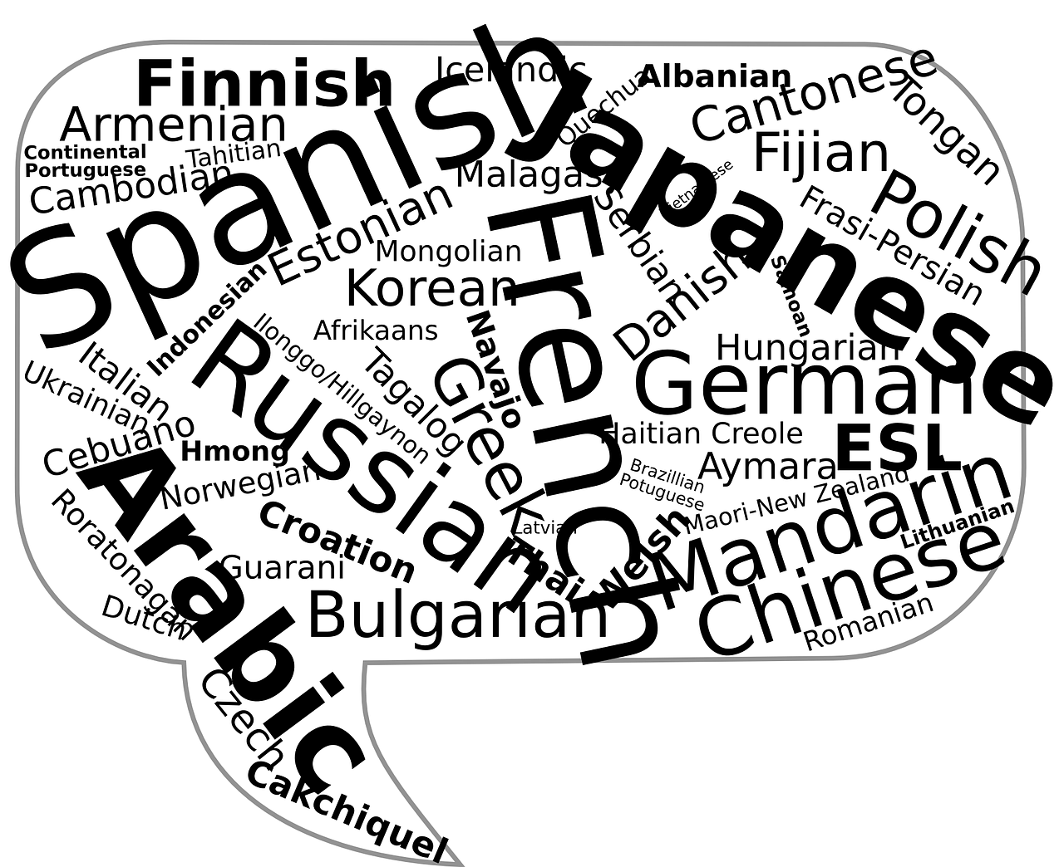

Language Barriers in Healthcare and the Need for Intervention
By: Tiarra Arant and Chanler Cole

Slide 2

Imagine….
Notes:
To start off let's imagine….
You are a foreign exchange student currently attending murray state university with the dreams of getting a bachelor's degree.
You are currently a soccer player and you LOVE this sport.
One saturday during a game you are about to go after the ball to score the very last winning goal but then BAM all of a sudden you are knocked out cold and fall to the ground.
You wake up in the Emergency room and you are terrified out of your mind.
You don't know what has happened and you don’t see a single familiar face anywhere around.
You hear people talking around you and see them hustling about but you have absolutely no idea what they are saying.
You try to ask questions but no one seems to understand you.
You then realize they don’t understand your language.
The nurses around you and physicians start to talk about sending you off to surgery because you have a slow heart rate and they think something is wrong.
This part you somehow managed to pick up on and you try your very hardest to tell them that this is normal for you but no one understands and there's no one present who can translate.
You become increasingly terrified…. What’s going to happen? What do you do?
If only there was a way to get around this barrier in this emergent situation…

Slide 3

For just a moment...
Think back on any personal experiences you have come across in your practice...
Notes:
Have you encountered a time when you had to provide care to a non english speaking patient?
What specific challenges were present?
What did you do to overcome the barrier?
How did the interventions you put into place to cross that barrier help?
Were they efficient?
Was the care provided adequate and provide that patient with the best care possible to get the best outcomes?

Slide 4


Our research question:
How do nurses and other healthcare providers overcome the growing barrier preventing efficient patient care for those who are non-English speaking?
Notes:
We realized given we live in a very diverse community due to Murray State University, that we have many different cultures and languages present at all times. When it comes to the hospital setting here, we were curious as to how the linguistic challenges present due to this were dealt with.
We decided to dive into interventions put into place to be able to provide care for non english speaking patients and to see if the hospital had any policies already present for this.
To do our research we used three different scholarly research articles and MCCH’s education center to receive information about the hospitals policies.

Slide 5
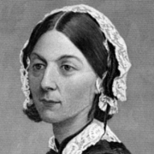
Why we chose this question:
As we know…
Our framework we chose…
Overall...
Notes:
Nursing is founded on many theoretical frameworks that provide us with a foundation of how to provide ethical and purposeful care.
A nursing theory that correlates to our subject of interest is Hildegard E. Peplau’s Theory of Interpersonal Relations. In this theory, Peplau defined nursing as being “an interpersonal process of therapeutic interactions between an individual who is sick or in need of health services and a nurse specially educated to recognize and respond to the need for help”. Within this nursing theory, therapeutic interventions are developed and implemented in the clinical setting. There are four phases of an interpersonal relationship. These phases include orientation, identification, exploitation, and resolution. During each of these phases, the patient is involved in their care and the nurse-patient relationship is emphasized. Language barriers in health care prevent therapeutic communication among patients and health care personnel. This disconnect in the ability to communicate will cause difficulty in maintaining a therapeutic relationship with patients who primarily speak a different language. In order to ensure that all patients are provided with the most therapeutic interactions and health care, it is essential to implement a solid interpretation policy.
Overall, this theory provided us the basis of why ensuring adequate communication is important for patient care.

Slide 6
What our research found according to scholarly articles:
According to the article “¿Hablas Inglés? Language barriers in healthcare”....
According to the article “Implications of Language Barriers for Healthcare: A Systematic Review”...
Based off the article “Communication interventions to support people with limited English proficiency in healthcare: a systematic review”...
Notes:
Hablas Ingles- “Miscommunication between patients and providers results in incomplete or inaccurate medical histories, leading to increased testing and potential medical errors. Studies suggest that accurate communication between patient and provider decreases unnecessary diagnostic testing and increases proper diagnosis, patient adherence, and the retention of information”(Pabon & Wisotzkey, 1970).
According to the study, nurses reported that gestures and family members acting as interpreters were the most frequently used forms of communication, with written materials and the use of Spanish interpreters being reported as the least used. These studies identified that the most effective forms of communication are utilized the least.
Implications- Among patients who did not speak the local language, “49% had trouble understanding a medical situation, 34.7% were confused about how to use a medication, 41.8% had trouble understanding a label on a medication, 15.8% had a bad reaction to a medication due to a problem understanding their health care provider’s instructions, 66.7% faced a barrier when accessing healthcare, and 20% did not seek health care services for fear of not understanding their health care provider” (Al Shamsi H;Almutairi AG;Al Mashrafi S;Al Kalbani T;, 2020).
This article gave the idea that online translation tools such as Google Translate and MediBabble present possible solutions for overcoming these challenges.
Communication interventions- We found that once again online interpretation through video conferencing is a preferred and also effective method. We also found that the use of educational material in the patient's language is highly conducive to excellent patient care.

Slide 7

What policies do Murray Calloway County Hospital have in place for language interpretation?
MCCH has two policies in place for working with language barriers.
Notes:
According to the MCCH education department the first policy is “Communicating with Guests and Guests’ Caregivers”.
This policy states, “ Staff will make every effort to provide for effective communication with all of its guests.” The policy then goes on to discuss that the staff can utilize verbal, pictorial, written, or linguistic forms of communication and if required, can request the physicians to order a Speech-Language Pathology consult.
The policy also covers that the hospital staff will utilize a device called In-Demand, which is skype like interpretation device that covers about 271 languages.
These portable computers are located in registration (which will move with patient throughout hospital), the ED, L&D, Doctor offices, and there are two floaters.
The second policy in place is “Patient/Resident Education Policy”.
This policy covers the individualized education patients are required to receive based on care provided, diagnosis, needs, and follow up.
Under procedure IV of this policy it states, “In the event that a patient/resident does not speak English, the use of the hospital approved on-line translation service is available to explain the contents of the form.”
It also discusses the responsibility of the nurse to provide educational handouts to the patient/family during patient teaching and upon discharge from the facility.
It was made known to us through the education department, that the hospital uses an online educational program called Truven which enables the staff to print out educational materials in many different languages for patients that do not primarily speak english.
While the hospital has these two policies in place, there were no policies that we saw, that prevented nurses and other caregivers from using family and friends of the patients as interpreters in times when they feel it is needed or that it will be easier, or even in emergencies. This became an area we wanted to expand on with the importance of avoiding this and putting a policy in place for.

Slide 8

The question we asked...
What can be done to improve these policies?
Notes:
The policies we found at MCCH that are in place for working around language barriers, seem to be very efficient according to the research we have found.
Due to this, there was not much that we thought needed to be adjusted.
However, it is important to ensure that nurses are aware of and able to utilize the policies when necessary in daily clinical practice. This led to the adjustments that we aspired to make in the policy.
What we thought we would suggest for the policies are:
The reinforcement of the current policies and the assurance of not using family members as interpreters.
The continued and reinforced use of the program Truvan to aid in patient teaching using the primary language of patients.
The use of In-Demand would be continued.

Slide 9
The policy we proposed...
1) POLICY TITLE
Providing care to non-english speaking patients
POLICY STATEMENT
The Murray-Calloway County Hospital organization will ensure culturally and linguistically competent care is provided to the best of their ability, to patients that do not speak English as their primary language.
PROCEDURE
The organization will ensure the use of the InDemand system when providing care to each and every non-english speaking patient.
The organization will ensure that the use of family and friends as interpreters is not instituted as a form of interpretation between patient and hospital staff and when patient teaching is being provided.
The institute will ensure that the use of the program Truven is utilized when patient education is required with non-english speaking patients.
Current organizational policies will be reinforced and evaluated during staff meetings every six months.
Notes:
As part of our evidence based practice project, we were required to form a policy of our own that was based on the research we found. What is listed on the slide is what we came up with.

Slide 10

In conclusion...
Notes:
MCCH’s current policy regarding interpretation guidelines is fluent with the research that we have found pertaining to the issue, and therefore we hope that through our presentation, we can inspire the nursing staff to be more aware of care provided to non english speaking patients and utilize the policies more frequently.

Slide 11
References:
Al Shamsi, H., Almutairi, A. G., Al Mashrafi, S., & Al Kalbani, T. (2020). Implications of
language barriers for healthcare: A systematic review. Oman medical journal, 35(2),
e122. https://doi.org/10.5001/omj.2020.40
Micah, A., Lita, Affedzie, E. O., Kel, Vera, M., Maame, Yaa, Roland, B., Johnson, E. J.,
Vachirawit, W., Ackah, V. A., Maganizo, Quin, C. E., Isik, & Sherise. (2021, July 8). Nursing theories and theorists: An ultimate guide for nurses. Nurseslabs. Retrieved October 14, 2021, from https://nurseslabs.com/nursing-theories/.
Murray Calloway County Hospital, Communicating with Guest and and Guests’ Caregivers,
2020, Personal Communication.
Murray Calloway County Hospital, Patient/Resident Education Policy, 2019, Personal
Communication.

Slide 12
References continued:
Nursing theories. Peplau’s theory of interpersonal relations: Hildegard. E. Peplau.
(n.d.). Retrieved October 13, 2021, from https://currentnursing.com/nursing_theory/interpersonal_theory.html.
Pabon, S., Wisotzkey, S. (2013). ¿Hablas inglés? Language barriers in healthcare.
Nursing Management, 44(8), 19–21. https://doi.org/10.1097/01.numa.0000432229.14948.54
Rajiv, P., Riggs, E., Brown, S., Szwarc, J., & Yelland, J. (2021). Communication
interventions to support people with limited english proficiency in healthcare: a
systematic review. Journal of Communication in Healthcare, 14(2), 176–187.
https://doi.org/10.1080/17538068.2021.1890518

Slide 13

Thank you for your time!
Notes:
We hope that this presentation has increased your understanding of the impact of language barriers on health care and the tools that you can utilize to overcome those.

