Slide 1
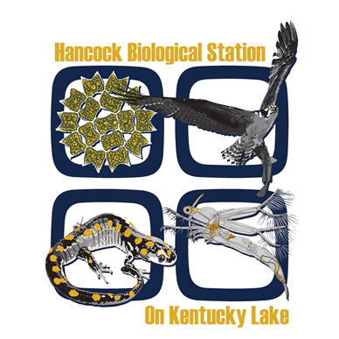
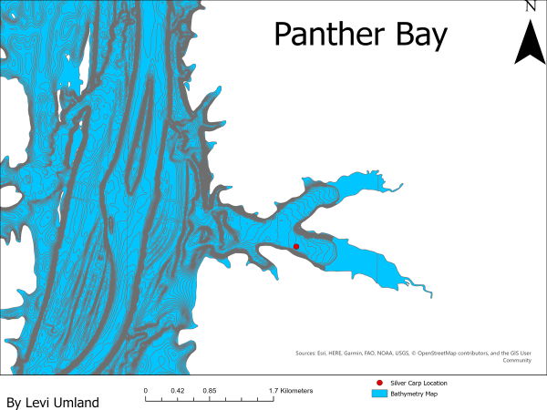
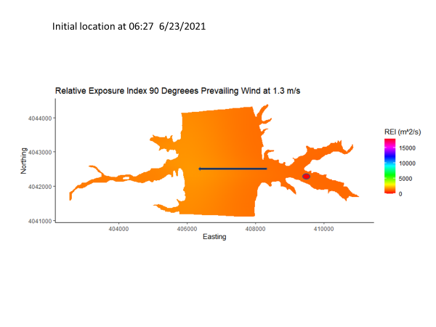
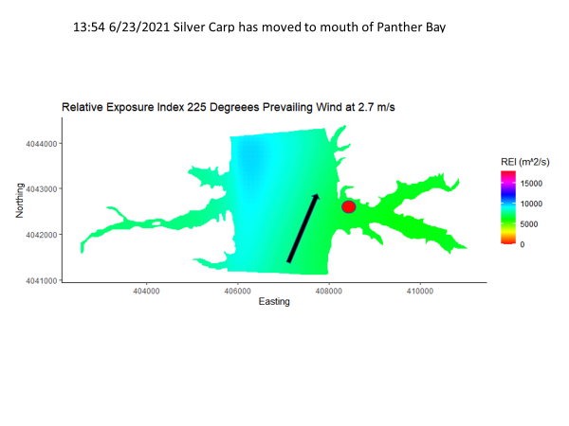
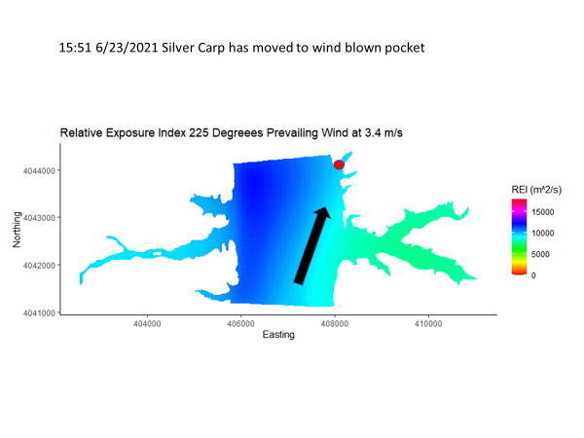
Mapping Fetch and Diel Movements of Silver Carp Hypophthalmichthys molitrix Within Kentucky Lake and Lake Barkley With GIS
Levi G. Umland and Dr. Timothy Spier
Department of Biology, Murray State University, Murray, KY 42071
Introduction/Background
Methods
Panther Bay in Kentucky Lake
Silver Carp are native to eastern Asia and were intentionally introduced within Arkansas in the 1970s.
Silver Carp being planktivorous, were brought here as a biological control for sewage lagoons and aquacultural ponds.
Escaped due to flooding during the 1970s into a tributary of the Mississippi River.
Silver Carp were first documented in Kentucky during the early 2000s.
They are classified as an invasive species and are continuing to spread through our rivers and reservoirs.
Few tracking studies of Silver Carp have been performed within reservoirs.
Currently, Murray State University and the Kentucky Department of Fish and Wildlife Resources have integrated a network of submerged passive receivers throughout Kentucky Lake and Lake Barkley, tracking Silver Carp and other native fish species long-term movements/seasonal patterns.
The Tennessee River flows from south to north through Kentucky Lake.
Fetch: distance over the waters surface where the wind remains steady in both direction and intensity.
Hypothesis/Expected Results
Outside of reproducing/spawning, life within nature, at least in general, revolves around predator avoidance and food.
Adult Silver Carp have no natural predators within the U.S.A.
That being stated, I suspect they spend most of their time following their food source, that being phytoplankton.
I suspect the fetch concentrates the phytoplankton into wind blown shoreline and coves within these reservoirs.
I suspect that fetch impacts Silver Carp behavior and movements for this reason.
Initial results indicate that wind does indeed effect Silver Carp movements.
Methods
My study uses hydroacoustic telemetry in order to track the diel movements of Silver Carp and attempt to discover daily Silver Carp patterns.
Half of the days spent tracking are committed to spending 24 hours on one individual Silver Carp and recording a location and wind data every hour.
The other half is spent locating as many Silver Carp within the reservoir as possible.
With each Silver Carp location, the boat is anchored so wind direction and wind speed may be measured and recorded.
We have used these data to map the fetch and we have overlayed the Silver Carp locations on a bathymetry map.
I used the time slider feature within ArcGIS Pro to track the Silver Carp movements through time.
Benedikt Gräler, Edzer Pebesma and Gerard Heuvelink, 2016. Spatio-Temporal Interpolation using gstat.The R Journal 8(1), 204-218
Dewey Dunnington (2021). ggspatial: Spatial Data Framework for ggplot2. R package version 1.1.5. https://CRAN.R-project.org/package=ggspatial
ESRI (2021). ArcGIS Pro Desktop: Release 2.8.3. Redlands, CA: Environmental Systems Research Institute.
Evans JS (2021). _spatialEco_. R package version 1.3-6, <URL: https://github.com/jeffreyevans/spatialEco>.
Hadley Wickham, Romain François, Lionel Henry and Kirill Müller (2021). dplyr: A Grammar of Data
H. Wickham. ggplot2: Elegant Graphics for Data Analysis. Springer-Verlag New York, 2016.
Kolar, C. S., Chapman, D. C., Courtenay Jr, W. R., Housel, C. M., Williams, J. D., & Jennings, D. P. (2005). Asian carps of the genus Hypophthalmichthys (Pisces, Cyprinidae) a biological synopsis and environmental risk assessment.
Lebeda, D. (2017). Potential for asymmetric competition among co-inhabiting invasive Silver Carp and native shad species in the Lower Midwest. Murray State University Graduate Theses and Dissertations. 69.
Manipulation. R package version 1.0.7. https://CRAN.R-project.org/package=dplyr
Pebesma, E.J., 2004. Multivariable geostatistics in S: the gstat package. Computers & Geosciences, 30:683-691.
Pebesma, E.J., R.S. Bivand, 2005. Classes and methods for spatial data in R. R News 5 (2), https://cran.r-project.org/doc/Rnews/.
Robert J. Hijmans (2021). raster: Geographic Data Analysis and Modeling. R package version 3.5-2. https://CRAN.R-project.org/package=raster
Roger Bivand, Tim Keitt and Barry Rowlingson (2021). rgdal: Bindings for the 'Geospatial' Data Abstraction Library. R package version 1.5-27. https://CRAN.R-project.org/package=rgdal
Roger S. Bivand, Edzer Pebesma, Virgilio Gomez-Rubio, 2013. Applied spatial data analysis with R, Second edition. Springer, NY. https://asdar-book.org/
Roger Bivand and Colin Rundel (2021). rgeos: Interface to Geometry Engine - Open Source ('GEOS'). Rpackage version 0.5-8. https://CRAN.R-project.org/package=rgeos
RStudio Team (2018). RStudio: Integrated Development for R. RStudio, Inc., Boston, MA UR http://www.rstudio.com/.
These fetch maps were created using R and R studio.
Initially, this specific Silver Carp was located within Tennessee in Kentucky Lake within a bay known as Panther Bay.
This Silver Carp was tagged on 4/9/2020 within Lake Barkley tailwaters and is a male weighing 2,440 grams and measuring 646mm.
Acknowledgments
I would like to thank Dr. Spier and my committee for all of their advice and guidance.
I would also like to thank Nathan Klein and Andrew Lydeard for help with tracking.
Special thanks to The Hancock Biological Station for allowing me to use their equipment.

