Slide 1
Mathematical Modeling of Devil Facial Tumor Diease (DFTD)
Abby Collins

Slide 2
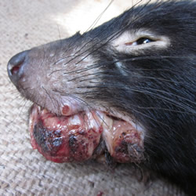
Background - Biology
Devil Facial Tumor Disease (DFTD) is present in Tasmanian devils
A form of transmissible cancer identified by tumors on the face or inside the mouth
Two forms:
DFT1: all throughout Tasmania
DFT2: south-east Tasmania
Notes:
DFTD is found in Tasmanian Devils which are the largest carnivorous marsupials still alive
Tasmanian Devils are only found on the island of Tasmania, which is located south of Australia
They are about the size of a small dog, and the animals are known for their nocturnal shriek and piercing jaws
DFTD disease is a form of transmissible cancer, and it causes the devils to get tumors on their face or inside their mouth
Once a devil is infected by DFTD, they are only estimated six months to live
There are two different forms of DFTD: DFT1 and DFT2
DFT1 is found all over Tasmania – first discovered in 1990s
DFT2 is found only in the peninsula of south-east Tasmania – first discovered in 2014

Slide 3
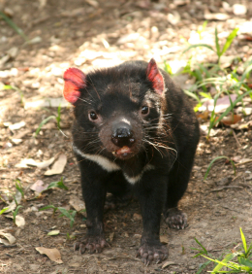
Background - Biology
Spread by biting between Tasmanian devils
Living cancer cells spreading in the body
No known cure, cannot use traditional cancer treatments
Endangered species
Notes:
DFTD is spread by biting between Tasmanian devils
Biting occurs either during mating or when devils fight
With more research being conducted, it is becoming more apparent that the living cancer cells are being transferred between the animals
There is no known cure as DFTD is spread by living cancer cells which escape detection by the devil’s immune system
How the cancer cells escape detection is completely unknown
If a cure is discovered, it would be difficult to administer it, since it would need to be used on a wildlife management view rather than an individual infected animal
Surgery (to remove the tumors) or chemotherapy would be extremely difficult to use as treatment methods due to the larger populations of devils present
In 2009, the Australian Government put the Tasmanian devils on the endangered species list, and International Union for the Conservation of Nature and Natural Resources also listed the devils as endangered

Slide 4
Background - Mathematics
Basic disease model – SIR
S – Susceptible
I – Infected
R – Removed
a
b
S
I
R
Notes:
To mathematically study diseases, a model is needed to see how the disease acts and will act in the future
A basic disease model is the SIR model
Where S is susceptible individuals
I is infected individuals
And R is removed individuals, which could mean the individual moves out of the environment, dies, or gets vaccinated
With this study, the Removed category is only going to contain the devils that die because there is no vaccination, and the death rate is high
The graph depicts the SIR model, with “a” and “b” being the rates at which individuals move to a different category
“a” being the rate at which individuals move from the susceptible to the infected category
“b” being the rate at which individuals move from the infected to the removed category
More complex models can be used, but since DFTD individuals do not recover, there is only movement in one direction

Slide 5
Background - Mathematics
System of differential equations:
$$\frac{dS}{dt}=−aSI$$
$$\frac{dI}{dt}=aSI−bI$$
$$\frac{dR}{dt}=bI$$
Notes:
The previous diagram can be modeled by differential equations
The first equation expresses the rate the individuals move out of the susceptible and into the infected category
The variable is negative because it is the rate of removal
The second equation shows the rate at which the individuals move from the infected to the removed category
One variable is positive because it is the incoming rate
The other variable is negative because it is the removal rate
Lastly, the third equation expresses the rate at which the individuals move into the removed category
The variable is positive because it is the incoming rate
There are 4 assumptions made with the system of differential equations
1. the population is fixed. There are no births or deaths, and no individuals move into or out of the population
2. there is no incubation period for the disease
3. the susceptible and infected individuals are uniformly mixed
4. once an individual is removed, they are taken out of the equation permanently

Slide 6
Background - Mathematics
Assumption of a fixed population:
$$S\left(t\right)+I\left(t\right)+R\left(t\right)=N$$
Implying,
$\frac{dS}{dt}+\frac{dI}{dt}+\frac{dR}{dt}=0$ for $t>0$
Notes:
The assumption that the population remains constant is:
The number of susceptible individuals + the number of infected individuals + the numbered of removed individuals = the total population
These are all the number of individuals at any time t
Since there is a fixed population, this implies that the addition of the three differential equations is zero for t > 0

Slide 7
Modified Model
System of differential equations:
$$\frac{dS}{dt}=−aSI$$
$$\frac{dI}{dt}=aSI−bI+mI$$
$$\frac{dR}{dt}=bI$$
Notes:
Since DFTD is not any contact spreadable disease, the basic SIR model has to be modified to fit the transmission better
To modify the basic SIR model to fit DFTD spread better, I added a variable, m to the infection rate equation
m, denoted by “madness”, is a changing variable, depending on several factors:
One factor is mating season, which is from March to May. During this season, a portion of aggressive male devils (m) seek out potential mates, which causes fights between other males. Since biting is the form of transmission, infection rates increase due to more prevalent fighting and mating
Another factor is more aggressive males. It is theorized that infected devils are more aggressive, which leads to more fights between individuals, resulting in a higher infected rate
I thought that changing the infection rate equation would better fit DFTD because the basic SIR model does not take into consideration a varying infectivity rate
I do not need to add m to any other differential equation in the system because it only applies to the rate of infection, not how many devils are susceptible or how many are removed from the population
(M can change based on the season. This means that m can be high or low)

Slide 8
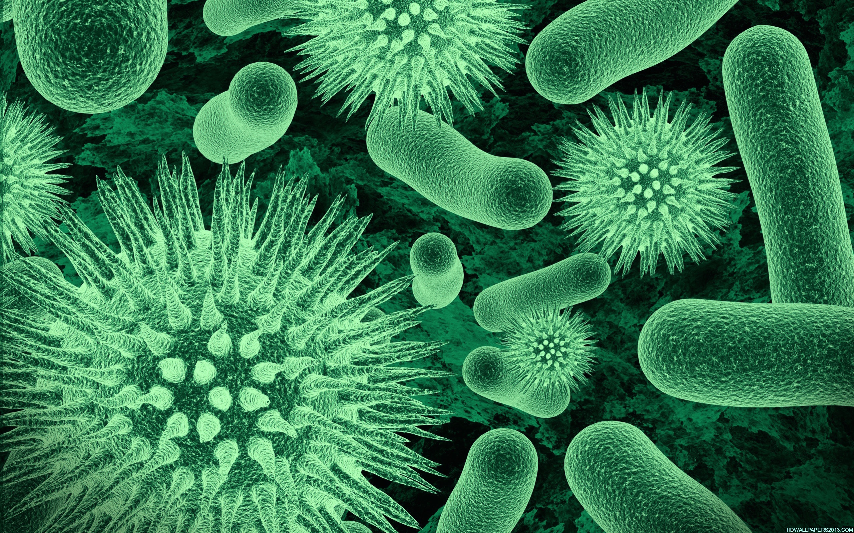
Applications
Other diseases – human or animal
New models
Better insight
Notes:
There could be many potential applications of this model, and other disease models
Taking the DFTD model as an example, the methods used could be applied to other wildlife cancers, or diseases in general
Modeling new diseases could lead to more insight in how they are spread, and have researchers understand future diseases in more detail
If researchers were better informed, they could potentially identify hot zones, where the infection rate is much higher than the average population
Knowing this information could help social leaders form a more effective plan in preventing the spread of the disease

Slide 9
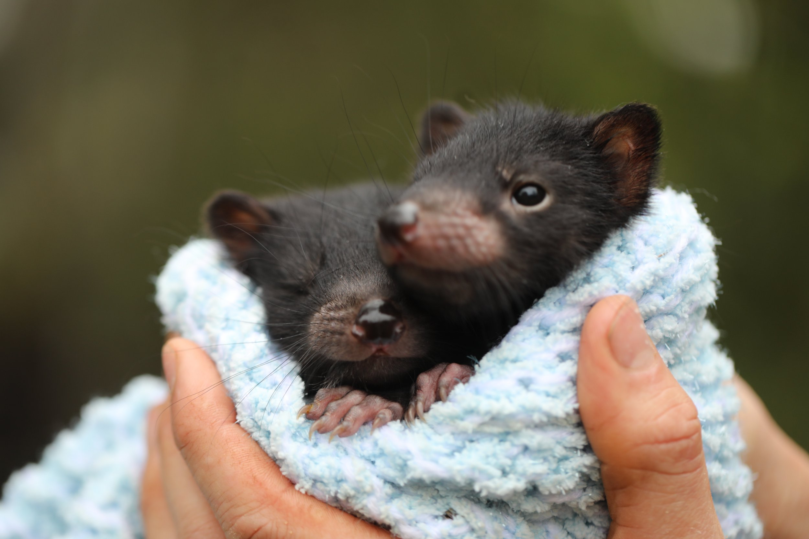
Future?
Mathematical models
Research
Treatment
Notes:
Mathematical models can always be improved, or better fit the experimental data
This model is no different, and can be combined with data to examine future infection rates of DFTD
Further research can discover new methods in treating the infected devils, or recover the diminishing populations
Some research facilities are investigating potential cures for the transmissible cancer, or ways to prevent the devils from getting the disease
This could potentially lead to a better understanding of different forms of cancer and how they work

Slide 10
Any Questions?

