Slide 1
Communication is Key
Stephanie Munsch & Bailey Ellingsworth

Slide 2
What Led Us Here
COVID-19
ICU admissions & the percentage of mechanically ventilated patients increased dramatically
Attention has been drawn to the need for better methods of communication between the patient and nurse
PTSD, anxiety, and depression have all been reported by ICU survivors

Slide 3
What Led Us Here
Communication with Mechanically Ventilated Patients
Physically and mentally draining to patients
Lack of resources leading to misinterpretation by nurses
Frustration from both the patient and the nurse from miscommunication
More time spent by nurses trying to interpret patient needs
Only basic patient needs being met
Notes:
Physically and mentally draining to patients → already exhausted and have to muster up the energy to write OR mentally exhausted when they aren’t being heard or understood
Lack of resources leading to misinterpretation by nurses → most places use only a white board or pen and paper or just lip reading
Frustration from both the patient and the nurse from miscommunication
More time spent by nurses trying to interpret patient needs → have to keep going back or asking a lot of yes/no questions in order to find what the patient is needing
Only basic patient needs being met → patients aren’t able to communicate exactly what they need especially if only being asked yes/no questions or asked to write what they need; if they are writing they will only put what they can and will leave out things; ex: if they were to choose between getting a pain medication or being repositioned in bed, they will just ask about the pain medication

Slide 4
Our Purpose
Emphasize importance of effective nurse-patient communication and care
Decrease anxiety and frustration amongst nurses and patients
Expand options for patient communication
Increase efficacy of patient care
Provide various AAC options for nurses

Slide 5
What is AAC?
Augmentative and Alternative Communication
Examples
Mobile/online apps
Communication boards
Sign language
Hand gestures
Facial expressions
Body language
Speech generating devices (SGD)
Notebook and paper
Keyboards
Communication methods that replace or assist with speech in those who are unable to use verbal or written language

Slide 6
The Science of Caring
Looking at the patient from a holistic approach
Society
Human Being
Should be valued, nurtured, respected and understood
Caring is a part of all societies
Focuses on mental and spiritual health of a patient
Supports new methods of communication
Looking at the patient rather than the machine
Health
Nursing
Involves the unity of mind, body and spirit
Science of people and human-illness experiences
Jean Watson
Notes:
We used her theory as the basis of our study because she:
Focuses on mental and spiritual health of a patient → and how it positively or negatively affects their healing process
Increased stress and anxiety from mechanical ventilation leads to further deterioration and the nurse’s role is to nurture and care for the patient in all ways not just physically
Her theory also supports new methods of communication→ new methods help the promotion and restoration of patient health which is a main part of her theory
She emphasizes looking at the patient rather than the machine→ focusing on the patient as a human being provides the nurse with the ability to better understand their patient; they are able to provide better care because they are striving to meet the needs of the patient and not the machine

Slide 7
Valuable Research
Giving voice: Nurse-patient communication in the intensive care unit
By Mary Beth Happ
SPEACS-2
COVID-19
6 modules
Online course
Recommendation for SLP consultation
National group of interprofessional experts
Free communication tools
Patient-Provider Communication website
Exploration of AAC tools
SPEACS-2 communication program
VidaTalk™
COVID-19
Notes:
Worked with a team to create the Study of Patient-Nurse Effectiveness with Assistive Communication Strategies-2 communication program
6 modules including an assessment algorithm to understand the best communication tools and strategies, ways to help patients better understand questions and instructions, ways to help cognitively impaired patients and communication strategies including unaided, writing and spelling, and simple and complex communication boards
Still available for continued education credits
Importance of consulting a speech language pathologist to assist in determining the best communication tools
Worked with a group of experts to create a variety of free communication tools for nurses and HCPs to use
Included these tools on the patientprovidercommunication.org that anyone can have access to

Slide 8
Valuable Research
Using technology to improve symptom management in ICU: a quality improvement study
By Katie Allan, Timothy Baker, et al.
Cycles
Conclusions
Resource poor settings
Staff described it as incredibly beneficial
Cycle 1: Interview
Cycle 2: Experimental
Cycle 3: Long-term
“The ICU is a branch of hell and people that have been there know what I mean”
Most distressing is the inability to communicate
myICUVoice
Notes:
Cycle 1:
Patients reported they felt that Staff had limited understanding of symptoms
Voicelessness
Cycle 2:
36 patients randomized
Felt less frightened or stressed - felt that they were better understood
Cycle 3:
Continuous positive feedback
Xerostomia 30% of all reports
Conclusions:
In resource poor settings, they advocate the introduction of routine and repeated use of any symptoms survey tool

Slide 9
Valuable Research
VidaTalk™ patient communication application “opened up” communication between nonvocal ICU patients and their family
By Ji Won Shin, Mary Beth Happ, Judith A. Tate
VidaTalk™
Conversation Topics
Interactive
Multilingual
Anatomic figures
Pain scales
“Wants”
Keyboard
Finances
Care plans
Test results
Positioning
Feelings/emotions
Expands conversation topics
Families are interpreters for nurses
Positive outcomes for patients
Unexpected benefits
Notes:
Free, interactive and multilingual app that includes things like anatomic figures, pain scales, patient “wants” like medications or food and a keyboard if they want to type something specific
Focused on the use of the app for patient-family communication
Families are an important resource for nurses to use to provide the best care to their patient
They know the patient in a different way and are a vital part of their care plan like with advanced directives, history, home care, etc.
App expanded conversation topics to include finances, care plans, test results, positioning and feelings/emotions between patients and their families
Led to positive outcomes for the patient and unexpected benefits like neuromotor coordination and psychological benefits like improved attitude, confidence, wellbeing.

Slide 10
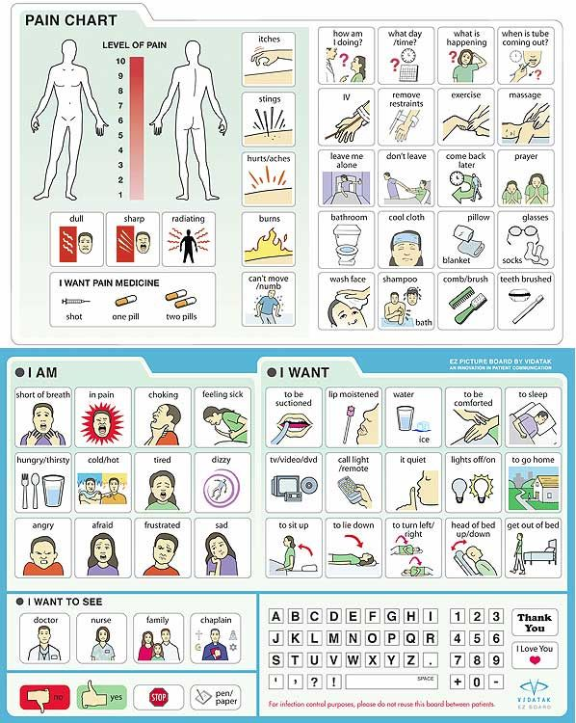
Our Recommendations
Patient Care
Utilize free AAC tools
Consult SLP
Have various communication tools available
Notes:
you can print these out and laminate them so they can use it like a whiteboard or download it onto the ipad
Examples from website: board about questions about ventilation and another one about DNRs and advanced directives
For this location specifically we recommended downloading said tools onto the iPad to have readily available
If applicable, make sure to consult the SLP to ensure the best tools are being used to communicate with the patient; as we all know, patients and their situations are not all the same and should be tailored to the individual
Have various communication tools available → low-tech and high-tech options for any scenario
make sure to have multilingual options as well

Slide 11
Conclusion
Understanding
Knowing what the patient is saying and utilizing AAC tools in the most effective way
Caring
Satisfied Patients
Mental health affects physical healing
Better Outcomes
Implementing
Putting these research ideas into practice in our local area
Notes:
Satisfied patients= better outcomes
The main takeaways from our presentation are about understanding, caring and implementing.
It’s important to know what the patient is saying and to be able to use all AAC tools effectively
Caring is one of the most important aspects of the nurse’s job and the mental health of the patient affects their physical healing. Also the mental health of the nurse impacts the patient care
Finally we believe that implementing our recommendations and reinforcing the importance of the current practices in the ICU with mechanical ventilation communication

Slide 12
References
Baker, T., Allan, K., Surman, K., & Navapurkar, V. (2020). Using technology to improve symptom management in ICU: A quality improvement study. International Journal of Surgery: Global Health, 3(6), 1-4. https://doi.org/10.1097/GH9.0000000000000040
Benedict, K. (2014, August 7). Article 00180: Communication Board, Medical Pictures, Nurse Communication Board.
Pinterest. Retrieved March 28, 2022, from https://www.pinterest.com/pin/166633254937485835/
Gonzalo, A. (2021, March 5). Jean Watson: Theory of human caring. Nurseslabs. https://nurseslabs.com/jean-watsons-philosophy-theory-transpersonal-caring/
Happ, M. B. (2021). Giving voice: Nurse-patient communication in the intensive care unit. American Journal of Critical Care, 30(4), 256–265. https://doi.org/10.4037/ajcc2021666
Happ, M. B. (n.d.). SPEACS-2 communication training program. Speacs-2 Communication Training Program. Retrieved
March 28, 2022, from https://nucleus.con.ohio-state.edu/media/speacs2/speacs.htm

Slide 13
References
Jean Watson- Nursing Theorist. (n.d.). Nursing Theory. https://nursing-theory.org/nursing-theorists/Jean-Watson.php
Shin, J. W., Happ, M. B., & Tate, J. A. (2021). VidaTalk™ patient communication application "opened up" communication between nonvocal ICU patients and their family. Intensive & critical care nursing, 66, 1-10. https://doi.org/10.1016/j.iccn.2021.103075
Tools & Resources (patient-provider communication network). Patient-Provider Communication . (2022, March 7).
Retrieved March 28, 2022, from https://www.patientprovidercommunication.org/tools-and-resources/

Slide 14
Provided by: Slidesgo
For more information about editing slides, please read our FAQs or visit Slidesgo School:
https://slidesgo.com/faqs and https://slidesgo.com/slidesgo-school

