Slide 1
Prevention of Medical Device Related Pressure Injuries (MDRPIs)
Murray State University
Mason Chandler, Mauritzio Ramirez, Audrey Fulkerson

Slide 2
Abstract
Throughout our clinical rotations, we noticed many patients who had developed pressure ulcers caused by medical devices, which are often referred to as MDRPIs. We acknowledged this as a problem and decided to look into it further. We reviewed various articles to find the best practice when it comes to preventing/minimizing these injuries. We analyzed a meta-synthesis, a qualitative study, and an experimental study and used that as our research on the topic. After reviewing these articles, we will present our findings to a local hospital to make recommendations on how they can better prevent/minimize MDRPIs. In conclusion, MDRPIs are a problem in healthcare facilities everywhere. Although they are not completely preventable, there are some things that can be done to minimize them. Based on our research, these things include: frequently assessing the skin around the device, implementing the use of the CLEAN acronym for assessment purposes, repositioning the devices if possible, and removing the devices as soon as possible.

Slide 3
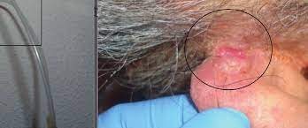
An Ongoing Problem
Throughout our clinical experiences at various facilities, we noticed that client’s would develop pressure injuries caused by medical devices being used to treat their conditions.
According to a study conducted by Cooper, the prevalence of MDRPIs for various devices were as follows:
26% nasal oxygen tubing (behind ears)
9% airway pressure masks (cheeks, chin, bridge of nose)
7.5% endotracheal tubes
5.6% nasal oxygen prongs (nostrils, nasal vestibule)
5.5% tracheostomy tubes (under flanges)
5% nasogastric tubes

Slide 4
What are MDRPIs?
Medical Device Related Pressure injuries are pressure injuries caused by medical devices such as:
Nasogastric Tube
Nasal cannula
Tracheostomy Tubing
And others….
The Reasoning as to why they cause such injuries according to a study done by Dr. Kim Cooper is that after prolonged use they:
Create unrelieved pressure
Cause friction/shearing forces that may impair sensation
Impaired circulation

Slide 5
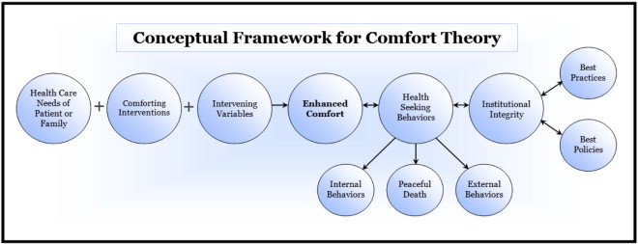
Theoretical Framework
The nursing theory that guided our project was Kolcaba’s “Comfort Theory”.
This theory was chosen based on its idea that when patients are comfortable, they are more likely to get better and pursue healthier behaviors.
How does this relate to the topic of MDRPIs?
Pressure injuries are extremely uncomfortable for patients
Although these devices are resolving the patient’s initial problem, they sometimes create a whole new problem for the patient that often takes a lengthier amount of time to resolve.

Slide 6
What the research says
According to a meta-analysis conducted by Cooper,
“skin beneath and around medical devices-especially rigid parts-should be assessed at least every 12 hours… More frequent skin assessment is warranted in patients vulnerable to fluid shifts or with localized/generalized edema.”
“Devices should be lifted and repositioned at regular intervals to redistribute pressure…”
“medical devices that are potential sources of pressure should be removed as soon as clinically feasible.”
According to a qualitative study done Jie min Tan, many of the participants stated that:
The necessary need to asses the skin frequently and even more when a known injury is present
The device helping patients are a risk factor and should pay more attention to possible development of pressure injuries

Slide 7
Recommendation
According to the research stated in the previous slide, the recommendations we can give to help prevent MDRPIs include:
Add a section to the policy stating to do a skin assessment around the devices, so the injury can be caught early and have a thoroughly documented timeline of the progression of the injury
According to a study done by Jessica Schroeder and Verna Sitzer you can Implement the use of a helpful acronym they created to help with the assessment, which is CLEAN, which stands for:
C - Correct tube position
L- stabiLize the tubing
E- Evaluate area around/near the tubing
A- Alleviate pressure where possible
N- Note the appearance of the securement Devices

Slide 8
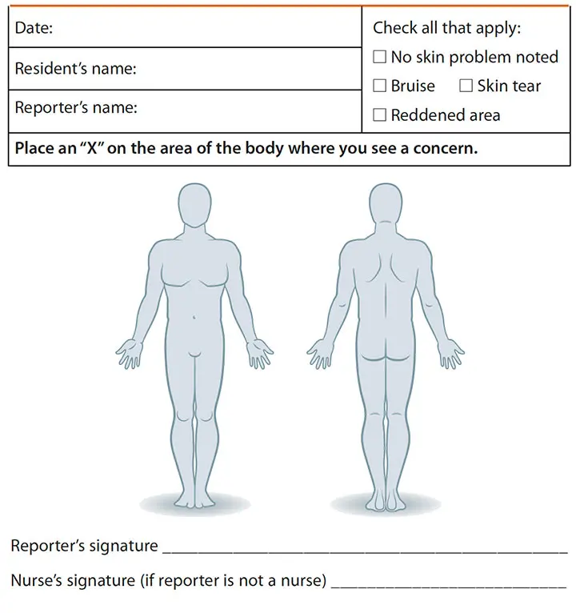
Conclusion
MDRPIs are a major problem in health care facilities everywhere
While they are not completely preventable, there are things that can be done to minimize prevalence
ASSESS frequently
Reposition devices if possible
Remove devices when able
Implementation of the CLEAN acronym
Thank you for your time!

Slide 9
References
Cooper, K. D., McQueen, K. M., Halm, M. A., & Flayter, R. (2020). Prevention and treatment of device-related hospital-acquired pressure injuries. American Journal of Critical Care, 29(2), 150–154. https://doi.org/10.4037/ajcc2020167
Kolcaba's comfort theory. Nursology. (2018, September 17). Retrieved March 29, 2022, from https://nursology.net/nurse-theories/kolcabas-comfort-theory/
Kolcaba, K., Tilton, C., & Drouin, C. (2006). Comfort theory. JONA: The Journal of Nursing Administration, 36(11), 538–544. https://doi.org/10.1097/00005110-200611000-00010
Schroeder, J., & Sitzer, V. (2019). Nursing Care Guidelines for Reducing Hospital-Acquired Nasogastric Tube--Related Pressure Injuries. Critical Care Nurse, 39(6), 54–63. https://doi-org.ezproxy.waterfield.murraystate.edu/10.4037/ccn2019872
Tan, J. J. M., Cheng, M. T. M., Hassan, N. B., He, H., & Wang, W. (2020). Nurses’ perception and experiences towards medical device‐related pressure injuries: A qualitative study. Journal of Clinical Nursing (John Wiley & Sons, Inc.), 29(13/14), 2455–2465. https://doi-org.ezproxy.waterfield.murraystate.edu/10.1111/jocn.15262

