Slide 1
Stress Management in Nursing to Prevent Burnout and Employee Retention
By: Lauren Barto, Megan Mayo, and Megan Trout

Slide 2
Abstract
This project was based on the fact that there is a severe nursing shortage happening in the United States. Studies show that an increase in stress can lead to burnout and poor employee retention. When nurses are burnt out and short staffed it easily leads to poor patient outcomes and decreased satisfaction levels. Studies show when nurses participate in stress reducing activities it has a positive outcome for staff and patients.

Slide 3
INTRODUCTION
WHY WE SELECTED THIS TOPIC
Experiencing first hand the negative effects
that stress has on nurses from being short staffed
PURPOSE OF OUR RESEARCH
To decrease nurse burnout and hopefully improve employee retention
As new nurses we can bring a whole new perspective of stress management which can lead to positive outcomes and better nursing experiences overall.

Slide 4
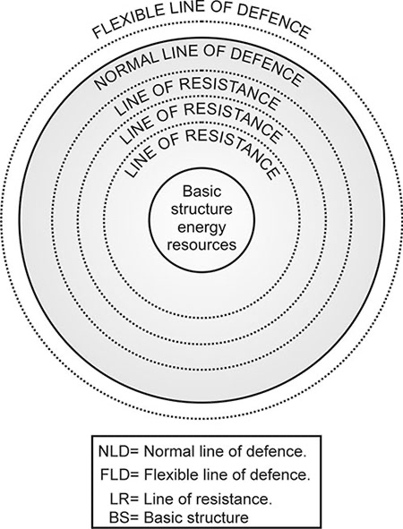
Theoretical Framework
This theory is based on the trait of
resilience that helps to deal with
stressors involved in
the nursing workforce.

Slide 5
Evidence
In 30 out of 37 studies it was shown that creative arts therapy such as drawing, music, and working with clay improved moods and created an overall relaxing environment.
Nurses who partook in an eight week MBSR course showed that after four months, the scores improved tremendously and that there was reduced perceived stress and improved satisfaction with life.
Another study showed that improved communication between employees and upper level management also created a more open and relaxed environment

Slide 6
Recommendations
Unit staff (RNs and managers) are responsible for participating in a mindfulness based stress reduction activity at least once a month. There shall be a floor meeting once every three months for the staff to share their experiences and debrief as a group.
Have music and adult coloring books in the breakrooms.

Slide 8
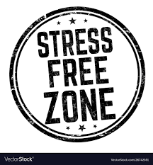
Conclusion
In conclusion, our research shows when nurses participate in stress reducing activities it has a positive outcome for staff and patients. The inability to manage stress leads to an increase in errors that can most of the time be prevented.

Slide 9
Resources
Anderson, N. (2020). An evaluation of a mindfulness‐based stress reduction intervention for critical care nursing staff: A quality improvement project. Nursing in Critical Care, 26(6), 441–448. https://doi.org/10.1111/nicc.12552
Martin, L., Oepen, R., Bauer, K., Nottensteiner, A., Mergheim, K., Gruber, H., & Koch, S. C. (2018, February 22). Creative arts interventions for stress management and prevention-A systematic review. MDPI. Retrieved March 14, 2022, from https://www.mdpi.com/2076-328X/8/2/28/htm
Worringer, B., Genrich, M., Müller, A., Junne, F., & Angerer, P. (2020). How do hospital medical and nursing managers perceive work-related strain on their employees? International Journal of Environmental Research and Public Health, 17(13), 4660. https://doi.org/10.3390/ijerph17134660

