Slide 1
Implementation of Simulation Training for Newly Graduated Nurses
Lauren Hancock and Kurstin Martin

Slide 2
Abstract
Regardless of educational opportunities it is impossible to see every possible clinical situation necessary to develop adequate clinical judgment, before graduation. For this reason, we believe that simulation trainings should be implemented for newly graduated nurses upon their hiring.

Slide 3
Theoretical Framework
Twenty-One Nursing Problems
Faye Glenn Abdellah
Human needs theory
Produced the idea of "patient - centered care"
Rooted in the pursuit of nursing education
(Faye, 2019)

Slide 4
Purpose
Exposure to new situations
Build confidence
Refine skills
Identify problem areas
Stress - 50.8%
Anxiety - 74%
Depression - 70.8%
(Kaushik et al., n.d.)

Slide 5
Effectiveness of High-Fidelity Simulation in Nursing Education for End-of-Life Care: A Quasi-experimental Design
"The current study indicated that teaching end of life care through high fidelity simulation has a positive effect on the attitudes of undergraduate nursing students towards the care of dying patients" (Rattani et al., 2020, p. 317)
Simulation Senerio
70-year-old woman diagnosed
with Ovarian Cancer. With a DNR code status, and a pain rating of 8 out of 10.
Decrease in participants that said “I would not want to care for a dying person” (Rattani et al., 2020, p. 317)
Goal of Simulation
Provide student nurses simulated experiences with care of an actively dying DNR patient
Interactions with family members of newly deceased patient
"This study also provided the students with a learning opportunity to deal with their own emotions" (Rattani et al., 2020, p. 317)

Slide 6
The Influence of Simulation Experience on New Nurses' Clinical Judgement
Qualitative study
20 New Grad RN's with 1-3 years experience
Goal
"The aim of this research was to explore new nurses' experiences with HFS to further understanding of the contributions of HFS to the development of clinical judgment" (Cason et al., 2018, p. 23)
"I liked simulation, because in clinicals in the hospital, it's not like we ever got to make a clinical decision on our own ... Until my preceptorship I never felt like I was being a nurse in my clinicals" (Cason et al., 2018, p. 24)

Slide 7
Postgraduate nursing students' experiences of simulation training and reflection in end-of-life communication with intensive care patients and their families
Simulation:
End of Life Care in the ICU setting
"Acting in these simulation scenarios contributed to the students' reflections on the importance of the nurse taking the lead and having the courage and preparedness to meet existential concerns" (Fridh & Lindberg, 2021, p. 856)
Goal:
"To explore postgraduate nursing students' experiences with simulation training involving end-of-life communication with ICU patients and their families" (Fridh & Lindberg, 2021, p. 855)
"Simulation has been found to increase the professional role and to contribute to better understanding of the different roles in a group of professionals" (Fridh & Lindberg, 2021, p. 859)

Slide 8
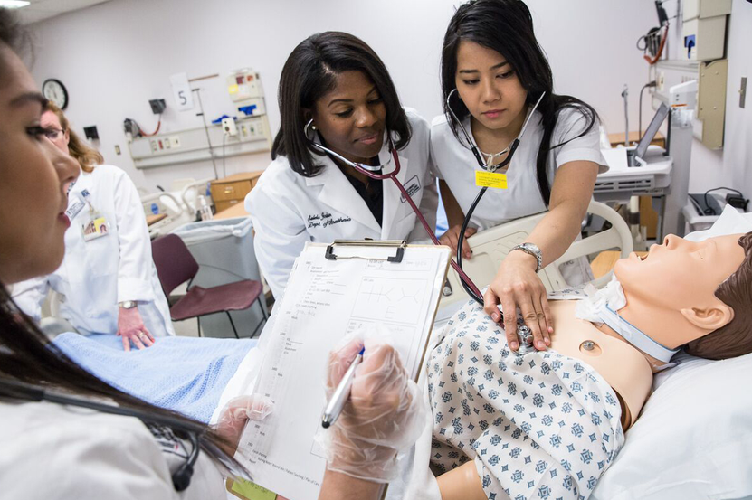
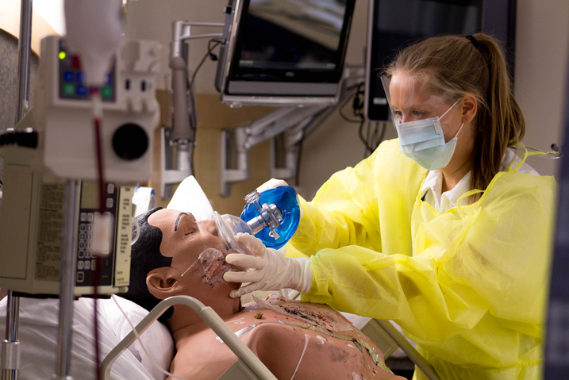
Examples
Mega code
Identifying a blood transfusion reaction
University of Maryland School of Nursing. 2020. Simulation Lab [photograph].Simulation & Learning Labs | University of Maryland School of Nursing (umaryland.edu)
Identification and management of suicidal ideation
Chest tube management
Delivery of a stillborn
Miller, M. (2015) Burn Simulation Lab.[photograph] Luther College.Burn Simulation Lab | Nursing students participated in a bur… | Flickr

Slide 9
Findings
Clinical Judgment
Providing Awareness
Clinical judgment is not one single skill, but rather a compilation of knowledge and experiences
Simulation training gives the opportunity to experience unique situations that do not happen every day
Confidence
Simulation Based Learning
As new graduates get more safe and controlled opportunites to provide hands on care and refine their skill set, their confidence will grow
Simulation based learning is providing a new way forward in both learning and teaching

Slide 10
References
Cason, M. L., Lawrence, K., & Hilfinger Messias, D. A. K. (2018). The Influence of
simulation experiences on new nurses' clinical judgment. Clinical Simulation in Nursing, 25, 22–27. https://doi.org/https://doi.org/10.1016/j.ecns.2018.10.008
Faye Abdellah. Nursing Theory. (2019, September 18). Retrieved October
22, 2022, from https://nursing-theory.org/nursing-theorists/Faye-Abdellah.php
Fridh, I,. & Lindberg, E. (2021). Postgraduate nursing students' experiences of
simulation training and reflection in end‐of‐life communication with Intensive Care Patients and their families. Nursing & Health Sciences, 23(4), 852–861. https://doi.org/10.1111/nhs.12873

Slide 11
References
Kaushik, A., Ravikiran, S. R., Suprasanna, K., Nayak, M. G., Baliga, K., & Acharya, S. D.
(2021). Depression, anxiety, stress and workplace stressors among nurses in tertiary health care settings. Indian journal of occupational and environmental medicine. Retrieved October 13, 2022, from https://www.ncbi.nlm.nih.gov/pmc/articles/PMC8259589/
Miller, M. (2015) Burn Simulation Lab.[photograph] Luther College. Burn Simulation Lab |
Nursing students participated in a burn simulation… | Flickr
Rattani, S. A., Kurji, Z., Khowaja, A. A., Dias, J. M., & AliSher, A. N. (2020). Effectiveness
of high-fidelity simulation in nursing education for end-of-life care: A quasi-experimental design. Indian Journal of Palliative Care, 26(3), 312. https://doi.org/10.4103/ijpc.ijpc_157_19

Slide 12
References
University of Maryland School of Nursing. 2020. Simulation Lab
[photograph].Simulation & Learning Labs | University of Maryland School of Nursing (umaryland.edu)
Rattani, S. A., Kurji, Z., Khowaja, A. A., Dias, J. M., & AliSher, A. N. (2020). Effectiveness
of high-fidelity simulation in nursing education for end-of-life care: A quasi-experimental design. Indian Journal of Palliative Care, 26(3), 312. https://doi.org/10.4103/ijpc.ijpc_157_19

Slide 13
THANKS
FOR WATCHING

