Slide 1
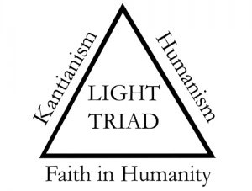
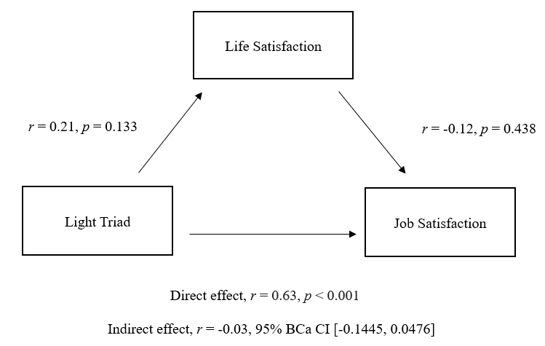
Personality Traits in the Workplace: Examining the Light Triad and its Relationship with Job Satisfaction
Sarah Overton & Daniel Wann, PhD
Murray State University
Introduction
Method
Results
Psychology has had the tendency to focus on the more negative aspects of life. An example of this is the Dark Triad, which culminates the three negative personality traits of Narcissism, Psychopathy, and Machiavellianism (Paulhus & Williams, 2002).
The Positive Psychology movement later emerged, which shifted the focus on more positive aspects of life. Consistent with this movement, Kaufman and colleagues (2019) established the Light Triad. This compromises the three benevolent personality traits of Faith in Humanity (believing that humans are fundamentally good), Humanism (valuing the dignity and worth of everyone) and Kantianism (treating others as ends unto themselves, rather than means to an end).
Kaufman and colleagues (2019) found a positive association between the Light Triad and life satisfaction. Past research has also indicated a positive association between life satisfaction and job satisfaction (Rice et al., 1980).
Participants
Participants (N = 63) were Murray State University students (19 male; 44 female).
Participants were predominantly white (94%) with a mean age of 19.70 (SD = 1.48).
Materials and Procedures
Questionnaires were distributed with the following items:
IVS: Light Triad Scale (Kaufman et al., 2019), 3 subscales, 12 items, 5-point Likert Scale; Dark Triad Scale (Jonason & Webster, 2010), 3 subscales, 12 items, 9-point Likert Scale; Satisfaction with Life Scale (Diener et al., 1985), 5 items, 7-point Likert Scale
DV: Job Satisfaction Scale (Macdonald & Macintyre, 1997), 10 items, 5-point Likert Scale
H1: The total Light Triad score was positively correlated with job satisfaction (r = 0.42, p < 0.001).
H2: Life satisfaction did not significantly mediate the relationship between the Light Triad and job satisfaction (see Figure 1).
RQ1: Faith in Humanity and Humanism were correlated with job satisfaction (r = 0.31, p = 0.007; r = 0.48, p < 0.001), while Kantianism was not (r = 0.14, p = 0.131).
RQ2: Machiavellianism was correlated with job satisfaction (r = -0.31, p = 0.007), while Narcissism and Psychopathy were not (r = 0.12, p = 0.191; r = -0.16, p = 0.108).
Discussion
Personality traits, such as those captured by the Light Triad, can influence one’s satisfaction with their occupation.
Study limitations include the modest, homogenous sample size and failure to consider other situational variables.
Future research could:
Assess these relationships in a larger, more diverse sample
Analyze both the Light Triad and situational variables (e.g., improved wages) as related to job satisfaction
Hypotheses and Research Questions
H1: The total Light Triad score will be positively associated with job satisfaction.
H2: Life satisfaction will mediate the relationship between the Light Triad and job satisfaction.
RQ1: What is the extent to which each Light Triad trait is correlated with job satisfaction?
RQ2: What is the extent to which each Dark Triad Trait is correlated with job satisfaction?
Figure 1
Hypothesis 2 Results

