Slide 1
The Benefits of
Family Presence During Resuscitation
Payton Hale, Abby Harris, Audrey Jeziorski
Murray State University

Slide 2
Table of contents
01
02
03
04
05
Abstract
Clinical
Problem
Theoretical
Framework
Evidence-Based
Practice
Recommendation
For Practice

Slide 3
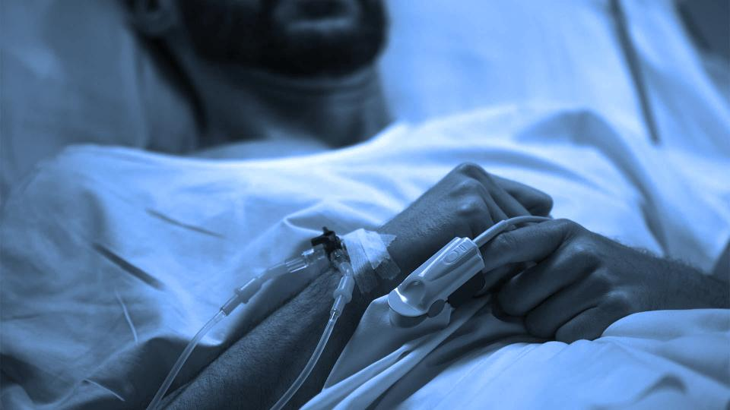
Family Presence During Resuscitation (FPDR) is the presence of family members in a location that allows them to view or have physical contact with the patient during resuscitation attempts.
-Daken et al., 2017

Slide 4
Abstract
Despite evidence that FPDR increases family satisfaction and psychological outcomes, this practice is not consistently implemented in healthcare facilities. The purpose of this project was to synthesize articles that analyze the benefits of FPDR on the family, patient, and healthcare team. This evidence was then used to develop a clear, consistent healthcare institution policy that addresses FPDR in clinical practice.

Slide 5
Clinical Problem
A lack of clear guidelines and education about FPDR in healthcare facilities often results in family members being escorted out of the room during cardiopulmonary resuscitation (CPR).
Hospital policies commonly omit protocols about FPDR, which impedes this practice by making it health care provider (HCP) based.
HCP’s often fear that FPDR will have negative effects on family members, despite evidence proving that it does not cause harm to patients, family members, or staff.

Slide 6
Theoretical Framework:
Kolcaba’s Theory of Comfort
This holistic, humanistic, mid-range nursing theory was developed by Katharine Kolcaba in 1994. It explains that comfort is a fundamental need of all human beings and it provides relief, ease, and transcendence during stressful health care situations.
Patient-Centered Care
When individuals are more comfortable, they are more likely to engage in health-seeking behaviors including internal behaviors, external behaviors, and a peaceful death. Kolcaba addresses four contexts in which patient comfort can occur: physical, psychospiritual, environmental, and sociocultural.

Slide 7
Theory Application:
Kolcaba’s Theory of Comfort
Sociocultural
FPDR provides a comforting social relationship for patients to focus on amidst the chaotic “code blue” environment, allows family members to immediately participate in spiritual or cultural practices that are comforting for the patient and family, and encourages accountability of HCP’s to maintain a calm, more organized physical environment.
Environmental
Physical
Psychospiritual

Slide 8
Evidence-Based Practice:
Health care professionals’ concerns regarding in-hospital family-witnessed cardiopulmonary resuscitation implementation into clinical practice
The study analysis yielded five themes characterizing health care professionals’ main concerns regarding family-witnessed resuscitation: (1) family’s horror, (2) disturbed workflow, (3) no support for the family, (4) staff preparation, and (5) situation-based decision. In order to successfully apply current evidence-based resuscitation guidelines, provider concerns need to be addressed through educational and organizational changes.
01
02
Family Presence during Cardiopulmonary Resuscitation
Family presence during CPR was associated with positive results on psychological variables and did not interfere with medical efforts, increase stress in the health care team, or result in medicolegal conflicts.
Family presence during cardiopulmonary resuscitation and invasive procedures: a meta-synthesis
The perception of family members, patients and professionals about family presence is still controversial. The sensitization of these subjects can potentiate the practice by making it more systematized and qualified.
03

Slide 9
Evidence-Based Practice:
01
Family’s Horror
02
Disturbed Workflow
03
No Support for the Family
04
Staff Preparation
05
Situation-based Decision

Slide 10
Evidence-Based Practice: Family’s Horror
Misconception:
Research:
Health care personnel believe that CPR is too brutal for the family to witness and that it will cause negative effects on mental health.
Our research found that FPDR:
Helps the grieving process
Subsequently improves mental health
Symptoms of PTSD and loss-related depression that occur with cardiac arrest are not increased due to FPDR
Relatives who have witnessed CPR stated they did not regret it

Slide 11
Evidence-Based Practice: Disturbed Workflow
Misconception:
Research:
Health care personnel believe that having family in the room during resuscitation leads to many problems in the flow of CPR.
Our research found that FPDR:
Can improve professionalism among staff which could build trust in the CPR team
Makes resuscitation more humane and the team focus on the patient as a human being and not a “task at hand”
Improves resuscitation efforts, enhances performance, and does not disturb workflow

Slide 12
Evidence-Based Practice: No Support for the Family
Misconception:
Research:
Health care personnel feel that there is a lack of a designated person to take care of the family members in the room during resuscitation. They also do not want to have a person taken away from resuscitation efforts.
Our research found that:
There is a need for a family support role in the resuscitation process
A family support role needs to be integrated into CPR education and training

Slide 13
Evidence-Based Practice: Staff Preparation
Concern:
Research:
Health care personnel feel that they do not know how to support and care for the family members in the room during CPR.
Our research found that:
HCPs that went through FPDR training were more favorable towards implementing it
Having the extra family support role education and training ensures that everyone involved feels prepared, confident, and able to support family members

Slide 14
Evidence-Based Practice: Situation-Based Decision
Concern:
Research:
Staff would feel more comfortable about FPDR if they knew patients preferred this option.
Our research found that:
An admission question should be added to enable staff knows about the patient’s wishes
Family members need to be informed and asked if they are willing to be present if resuscitation is needed
Admission question: “Would you like to have family members witness resuscitation efforts, if they were to be a necessary part of your care?”

Slide 15
Benefits of FPDR:
Helps the grieving process
Improves mental health
Resuscitation is more humane
Improves professionalism and trust
Gives patients determination to survive
Family members are more involved in care

Slide 16
—Belanger and Reed (1997)
“One of the participants was very
aware of his wife’s presence during his resuscitation and stated that it encouraged him to fight to survive.”

Slide 17
Recommendations for Practice:
1
Updated Code Blue policy that includes family presence during resuscitation.
2
Creating a family support role and incorporating it into CPR training and education.
3
Adding a question to the admission process that asks about the patient’s wishes for FPDR and gives the option.
4
Make this a hospital-wide change and addition to the Code Blue policies and procedures.

Slide 18
Implementation Into Practice:
1
Assess the nurses’ perceptions of the practice and realize that some may oppose FPDR.
Develop FPDR education using classroom, simulation, or online approaches.
Implement education practices based on the learning needs of nursing staff at the facility to increase compliance.
Always present patients and families with the option of FPDR.
2
3
4

Slide 19
Implementation Into Practice:
5
Adding questions about patient preferences for FPDR during the admission or advanced directive questions that are already routine for each unit of the hospital to encourage compliance.
Include a survey question following FPDR to assess patient or family satisfaction.
Providing a health care personnel to serve as a family support person during resuscitation attempts eases the performance anxiety and fears of family interruptions.
6
7

Slide 20
Conclusion
Practicing FPDR will help promote patient autonomy and patient-centered care. Research shows many benefits of FPDR including:
Improved grieving & decreased depression
Improved HCP professionalism/accountability
A more humanistic approach to resuscitation
Implementation of a clear consistent policy, can alleviate disparities caused by different HCP’s opinions on FPDR. Nurses must also be educated about this practice to encourage compliance and patient/family education.

Slide 21
References
Barreto, M. S., Peruzzo, H. E., Garcia-Vivar, C., Marcon, S. S., Barreto, M. S., Peruzzo, H. E., Garcia-Vivar, C., & Marcon, S. S. (2019). Family presence during cardiopulmonary resuscitation and invasive procedures: a meta-synthesis. Revista Da Escola de Enfermagem Da USP, 53. https://doi.org/10.1590/s1980-220x2018001303435
Belanger, M. A., Reed, S. (1997). A rural community hospital’s experience with family-witnessed resuscitation. Journal of Emergency Nursing; 23: 238–239.
Daken, A. L., Ahmad, R., Abusnieneh, H., Dweik, G., Atoum, M., Khatib, A., & Abu-Moghli, F. (2017). Policy Development: Family Presence during Resuscitation (FPDR) Procedure. International Journal of Nursing and Health Science, 10(7).
Jabre, P., Belpomme, V., Azoulay, E., Jacob, L., Bertrand, L., Lapostolle, F., Tazarourte, K., Bouilleau, G., Pinaud, V., Broche, C., Normand, D., Baubet, T., Ricard-Hibon, A., Istria, J., Beltramini, A., Alheritiere, A., Assez, N., Nace, L., Vivien, B., & Turi, L. (2013). Family presence during cardiopulmonary resuscitation. The New England Journal of Medicine, 368(11), 1008–1018. https://doi.org/10.1056/NEJMoa1203366
Porter, D. J. E. (2018). Family presence during resuscitation (FPDR): A qualitative descriptive study exploring the experiences of emergency personnel post resuscitation. Heart & Lung, 48(4). https://doi.org/10.1016/j.hrtlng.2018.09.016
Sak-Dankosky, N., Andruszkiewicz, P., Sherwood, P. R., & Kvist, T. (2018). Health care professionals’ concerns regarding in-hospital family-witnessed cardiopulmonary resuscitation implementation into clinical practice. Nursing in Critical Care, 23(3), 134–140. https://doi.org/10.1111/nicc.12294

