Slide 1
Orienting Patients to Their Own Care:
Implementing Goals and Progress on Whiteboards
Murray State University School of Nursing and Health Professions
Grace Beer and Leah McGough

Slide 2
Background
The purpose of our research is to further involve our patients in their own health care.
By creating visible goals in the patient’s room, we can further encourage patients to take a steps towards recovery and healing.
A sense of purpose and a goal to work towards for each day they are hospitalized.
We have found that some patients are unfamiliarized with what we are doing each day and this can make them feel disconnected with their care.

Slide 3
Theoretical Framework
Med-Surg nurses sometimes have trouble encouraging their patients to be involved in their own care. By implementing a more systematic and consistent approach to writing out patient goals for the day on whiteboards, there will be a higher quality of patient satisfaction. Patients can often be hesitant to ask questions and get involved in their care, therefore writing out goals to be visualized throughout the day will allow for constant exposure to the information.

Slide 4
Educating Patients through use of a Board
“Charts on walls” and “client goal boards to communicate goals” have been seen to motivate clients and impact patient outcomes.
This article explains using goal setting to enhance the rehabilitation process.
https://doi-org.ezproxy.waterfield.murraystate.edu/10.1186/s12913-022-08047-6

Slide 5
Person-Centered Goal Setting Practice
A study done in November 2021 showed that involving patients in goal setting improved patient satisfaction, participation, and patient success.
Gave staff the satisfaction of feeling that they made a difference in their care each day.
Improved teamwork function within the department.
Patients felt that they were heard and that their emotional needs were met.
Drayton, N., Stulz, V., Blake, K., & Gilbert, T. (2021). Development and evaluation of a new model for person-centred goal setting using practice development and appreciative inquiry approaches in a rehabilitation unit. International Practice Development Journal, 11(2), 1–17. https://doi-org.ezproxy.waterfield.murraystate.edu/10.19043/ipdj.112.003

Slide 6
Enhancing Communication Between Client and Nurse
A study was done on a cancer medical surgical floor that showed the use of a white board increasing patient and nurse communication and improved the ratings of the hospital.
Helped patients feel more safe and increased patient centered care.
Soper, K. (2020). Personalization in Cancer Care: Implementation of an interactive white board to improve nurse-patient communication. Clinical Journal of Oncology Nursing, 24(6), 703–772. https://doi-org.ezproxy.waterfield.murraystate.edu/10.1188/20.CJON.703-706

Slide 7
Recommendations for Future Practice
Update boards with specific goals every shift that the client can participate in
Example: “Turn every 2 hours” or “Perform DVT prevention exercises”
Always have three goals visible for patients on the board
Utilize pain scale and give client nonpharmacologic tools to decrease their pain as another goal

Slide 8
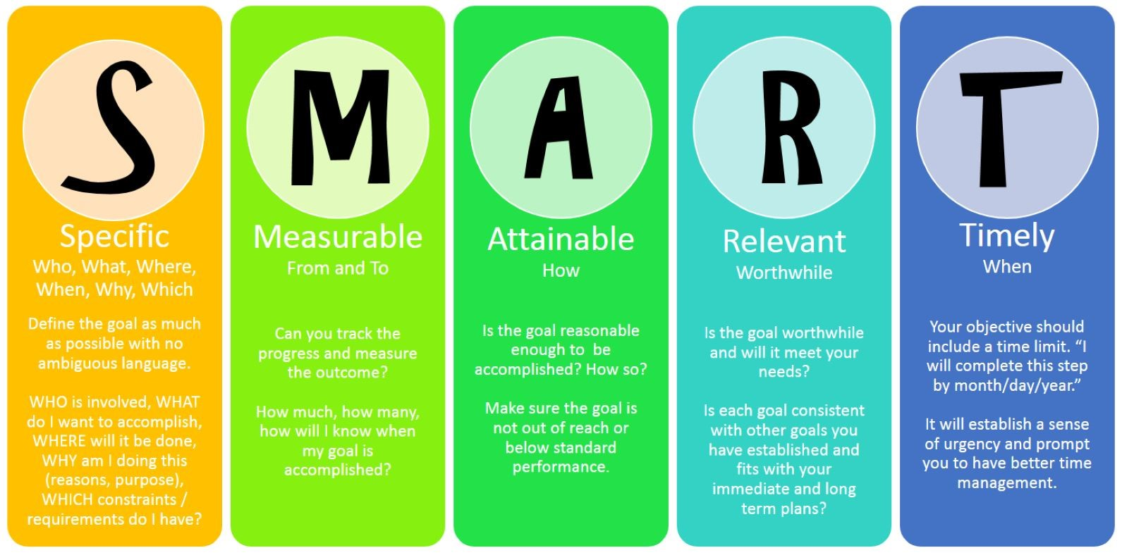
Conclusion
Whiteboards are a great way to involve patients in their goal setting and attaining.

Slide 9
References
Baker, A., Cornwell, P., Gustafsson, L., Stewart, C., &amp; Lannin, N. A. (2022). Developing tailored theoretically informed goal-setting interventions for rehabilitation services: a co-design approach. BMC Health Services Research, 22(1), 811. https://doi-org.ezproxy.waterfield.murraystate.edu/10.1186/s12913-022-08047-6
Drayton, N., Stulz, V., Blake, K., &amp; Gilbert, T. (2021). Development and evaluation of a new model for person-centered goal setting using practice development and appreciative inquiry approaches in a rehabilitation unit. International Practice Development Journal, 11(2), 1–17. https://doi-org.ezproxy.waterfield.murraystate.edu/10.19043/ipdj.112.003
Soper, K. (2020). Personalization in Cancer Care: Implementation of an interactive white board to improve nurse-patient communication. Clinical Journal of Oncology Nursing, 24(6), 703–772. https://doi-org.ezproxy.waterfield.murraystate.edu/10.1188/20.CJON.703-706

