Slide 1
CLABSI Prevention Methods
By: Noah Heine and Talon Cockrel
Murray State University

Slide 2
CLABSI Statistics
CLABSI has a mortality rate around 12%-15%
On average 28,000 critical care patients die from CLABSI each year in the US
Increases length of hospital stay
Increased healthcare cost of around $46,000 for each case

Slide 3
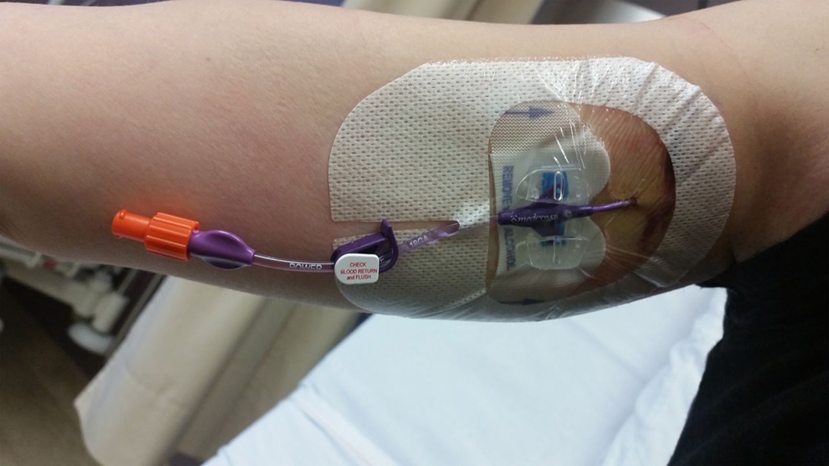
Sutureless Securement Devices
Study done by AJ Yamamato et. al. in 2022 with 170 patients, half of them had PICC lines sutured in, the other half were held in place using a statlock.
Of the 170 patients 12 of them acquired PICC related bloodstream infections.
Of the 12, 10 of the infections were with sutured PICC lines while only 2 infections occurred in patients with the statlock.
https://pubmed.ncbi.nlm.nih.gov/11788698/

Slide 4
Antimicrobial PICC Lines
A new technology and prevention method used to decrease the prevalence of CLABSI in PICC lines are antimicrobial impregnated catheters.
A systematic review and meta-analysis, Are antimicrobial peripherally inserted central catheters associated with reduction in central line-associated bloodstream infection, indicated that the the use of these new antimicrobial catheters had a statistical significance in the reduction of CLABSIs.
Emphasis was placed on the use of these PICC lines for patients who are at a higher risk of infection and those who requires a PICC line long term (several weeks- month).
The antimicrobial material utilized chlorhexidine and minocycline-rifampin.
It is emphasized that the use of these antimicrobial PICC lines must also include standard PICC line care using aseptic technique and frequent care of the line itself.

Slide 5
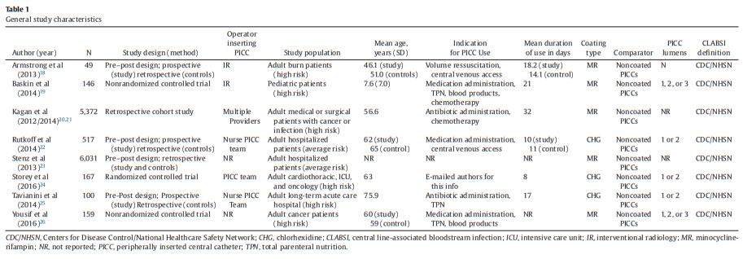
Study Descriptions
R.D. Kramer et al. / American Journal of Infection Control 45 (2017) 108-14

Slide 6
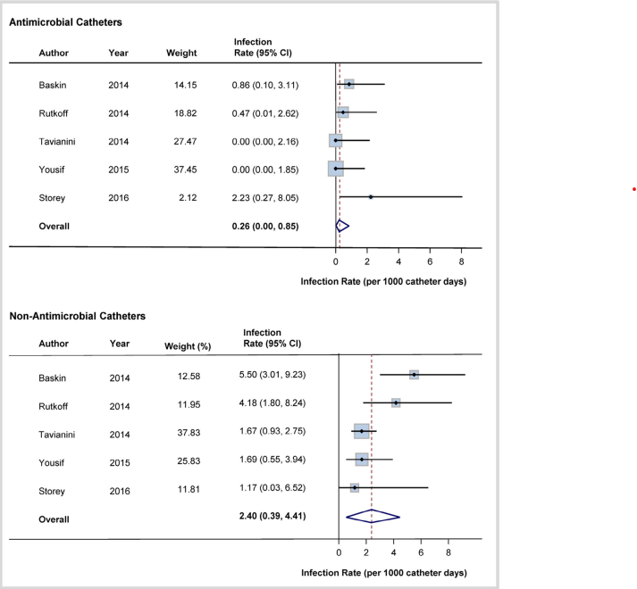
A comparison of CLABSI prevalence and the associated confidence intervals
R.D. Kramer et al. / American Journal of Infection Control 45 (2017) 108-14

Slide 7
Antibiotic and antimicrobial Locks and Flushes
A study by Safdar, et al. , Use of Vancomycin-Containing Lock or Flush Solutions for Prevention of Bloodstream Infection Associated with Central Venous Access Devices, is a meta analysis of randomized trials that found these vancomycin flushes are effective in infection prevention for long term IVDs.
The vancomycin locks are prescribed for a certain amount of time to dwell in the lumens of the IVD. After this time period the lock solution is either flushed into the bloodstream or aspirated and discarded. The prescribed times ranged from 20-30 mins to 6-24 hrs.
The analysis of 7 randomized trials indicated a near 50% reduction in risk for bacterial infection when using vancomycin locks or flush solutions.
The study also underlined the usefulness of gentamicin catheter locks for hemodialysis patients as well as an antimicrobial Taurolidine and minocycline locks.

Slide 8
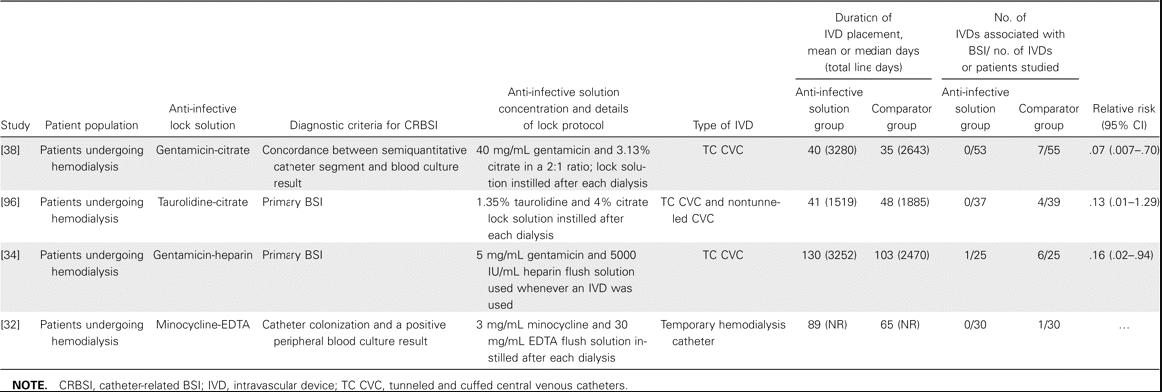
Use of antibiotics and antimicrobial solutions for hemodialysis

Slide 10
Sources
Kramer, R. D., Rogers, M. A. M., Conte, M., Mann, J., Saint, S., & Chopra, V. (2017). Are antimicrobial peripherally inserted central catheters associated with reduction in central line–associated bloodstream infection? A systematic review and meta-analysis. American Journal of Infection Control, 45(2), 108–114. https://doi.org/10.1016/j.ajic.2016.07.021
Safdar, N., & Maki, D. G. (2006). Use of vancomycin-containing lock or flush solutions for prevention of bloodstream infection associated with central venous access devices: A meta-analysis of prospective, randomized trials. Clinical Infectious Diseases, 43(4), 474–484. https://doi.org/10.1086/505976
Yamamoto AJ;Solomon JA;Soulen MC;Tang J;Parkinson K;Lin R;Schears GJ; (2022, January). Sutureless securement device reduces complications of peripherally inserted central venous catheters. Journal of vascular and interventional radiology : JVIR. Retrieved February 23, 2023, from https://pubmed.ncbi.nlm.nih.gov/11788698/

