Slide 1
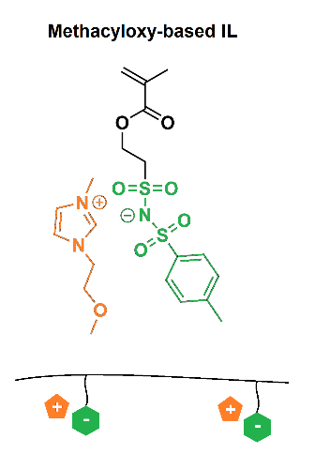
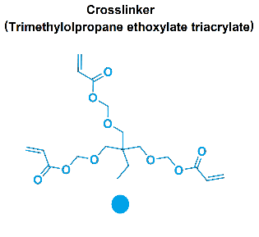
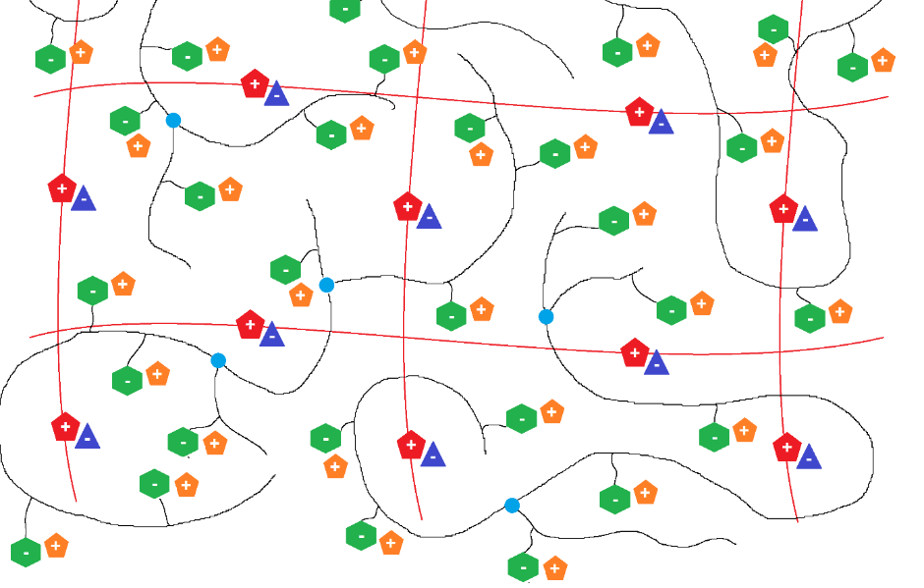
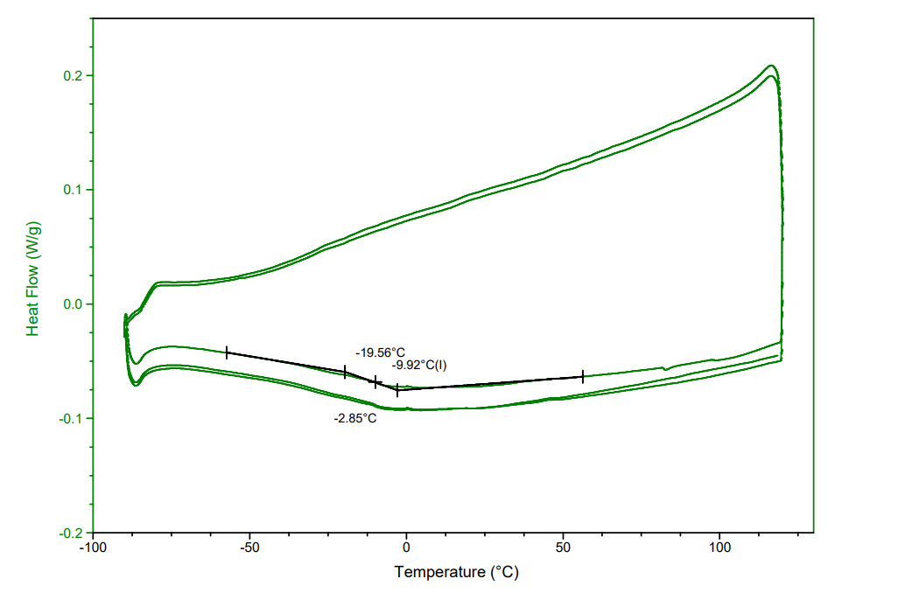
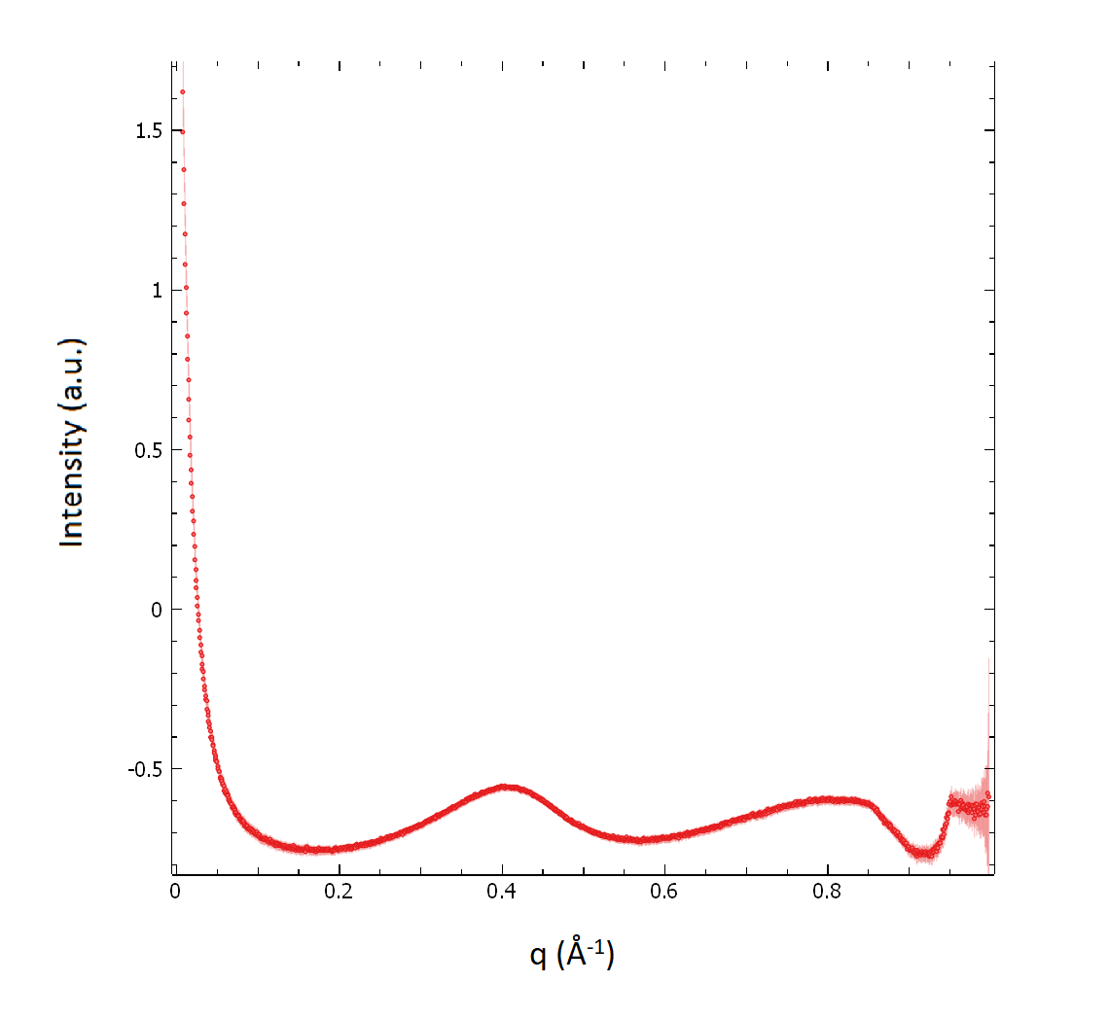
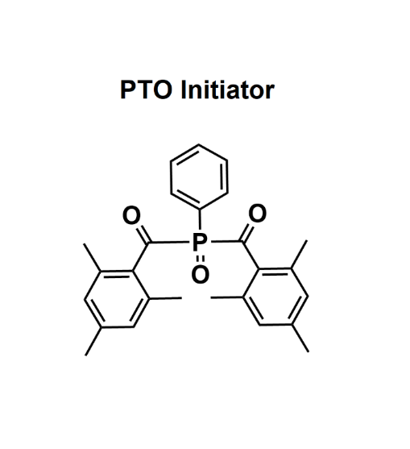
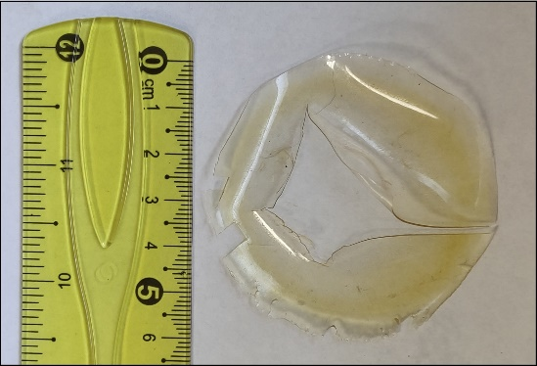
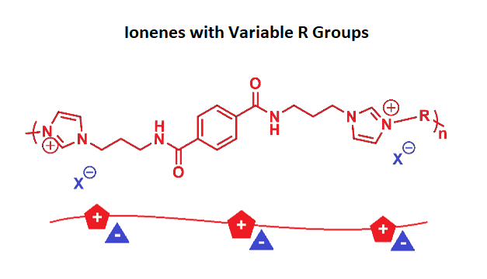
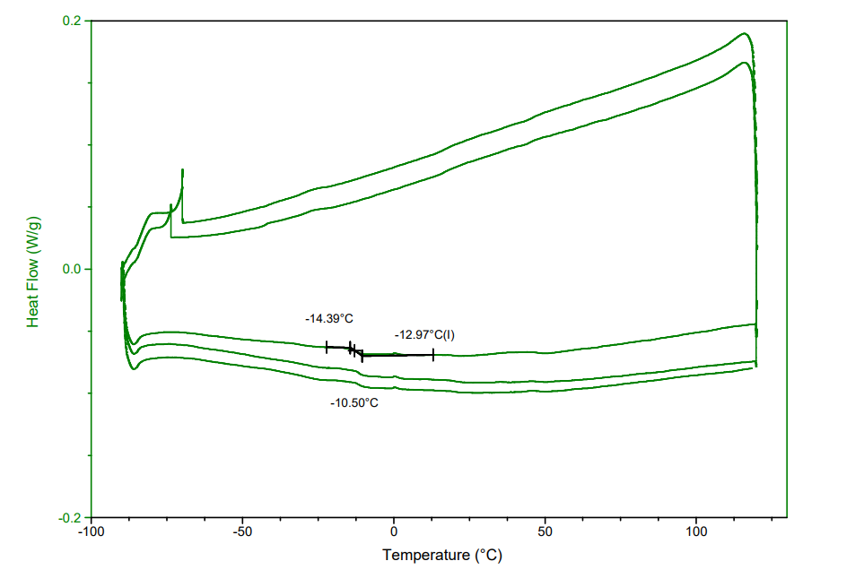
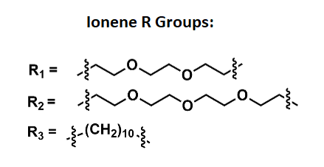
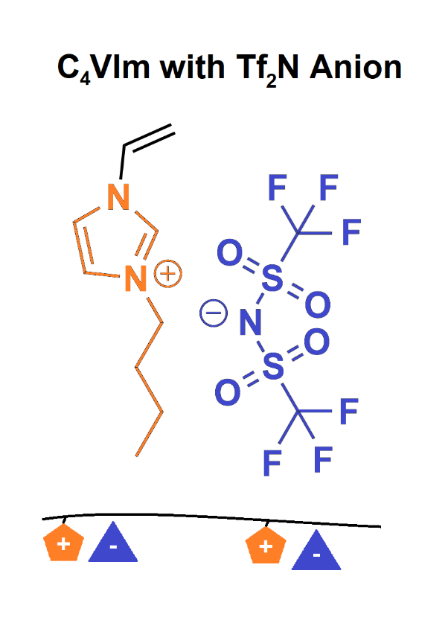
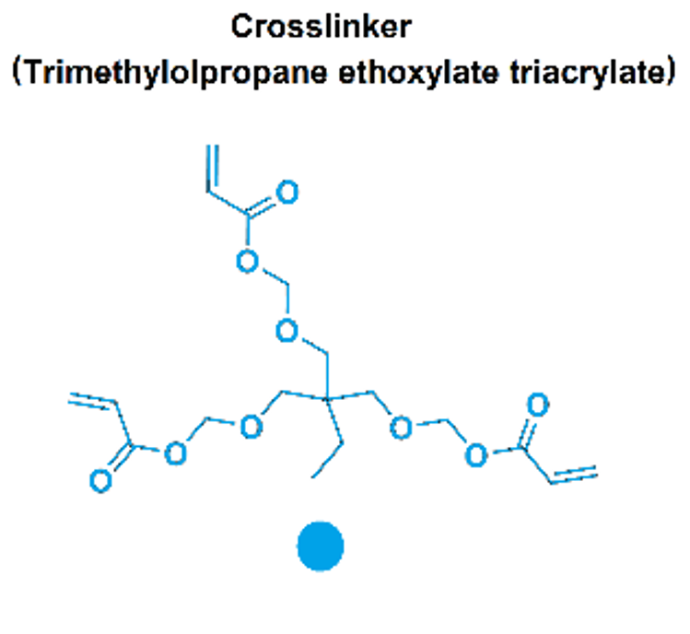
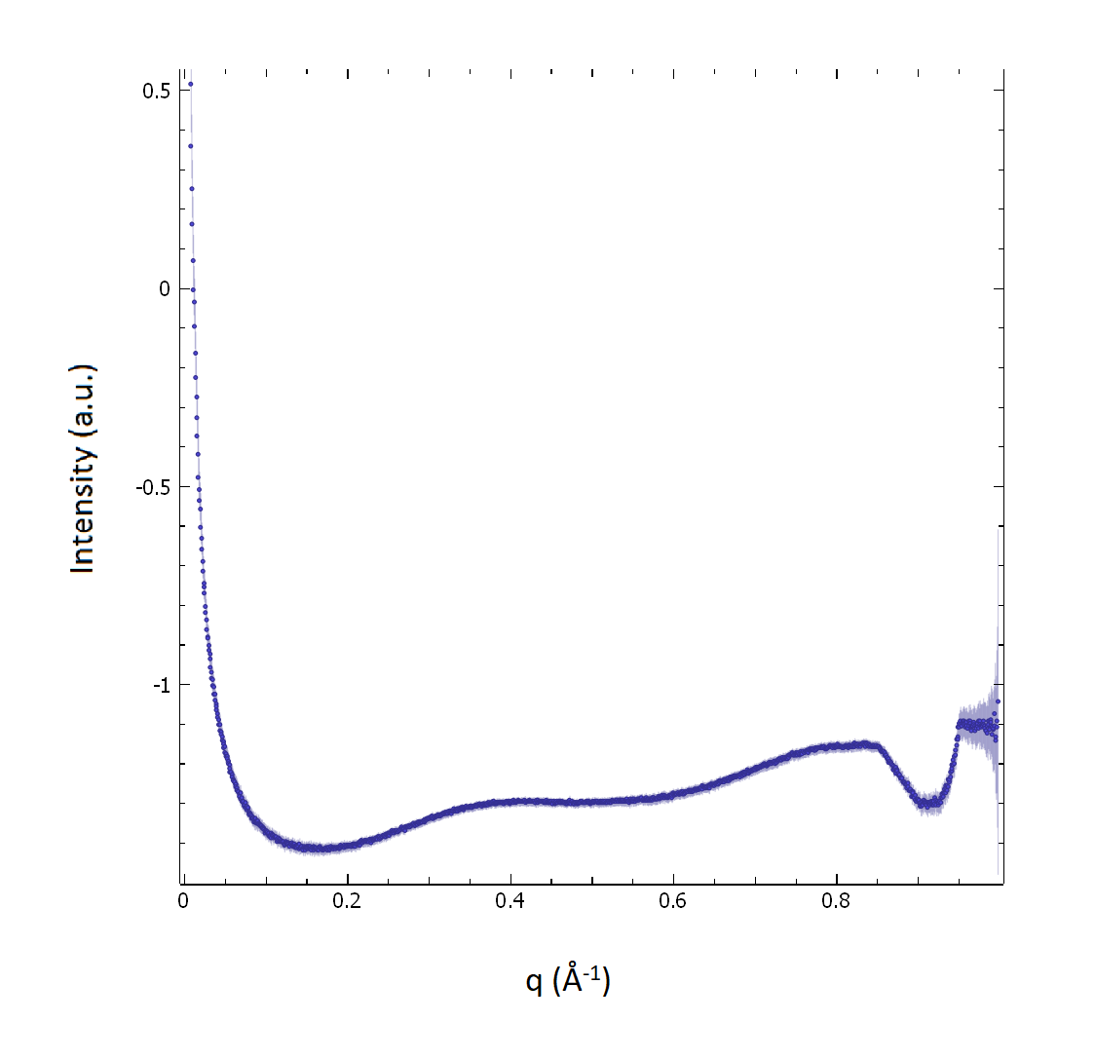
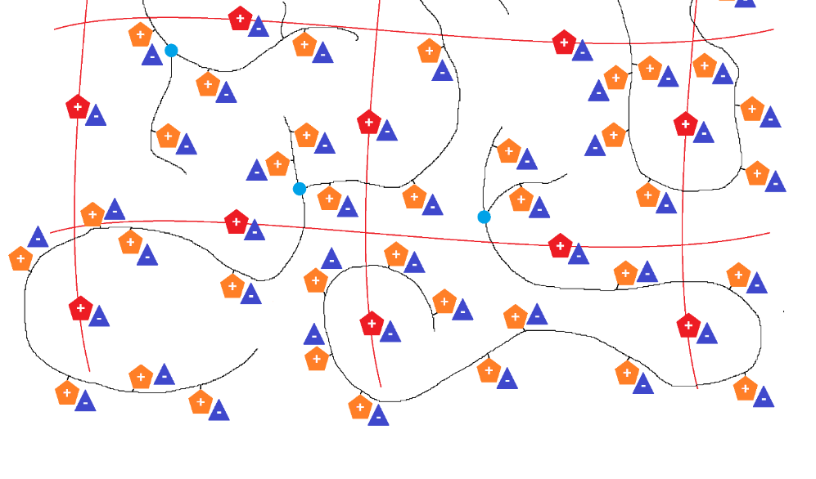
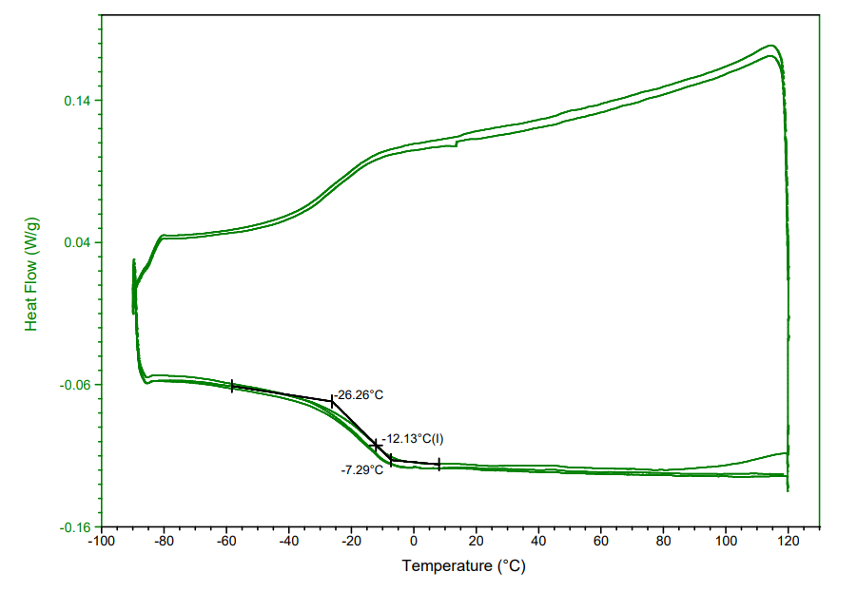
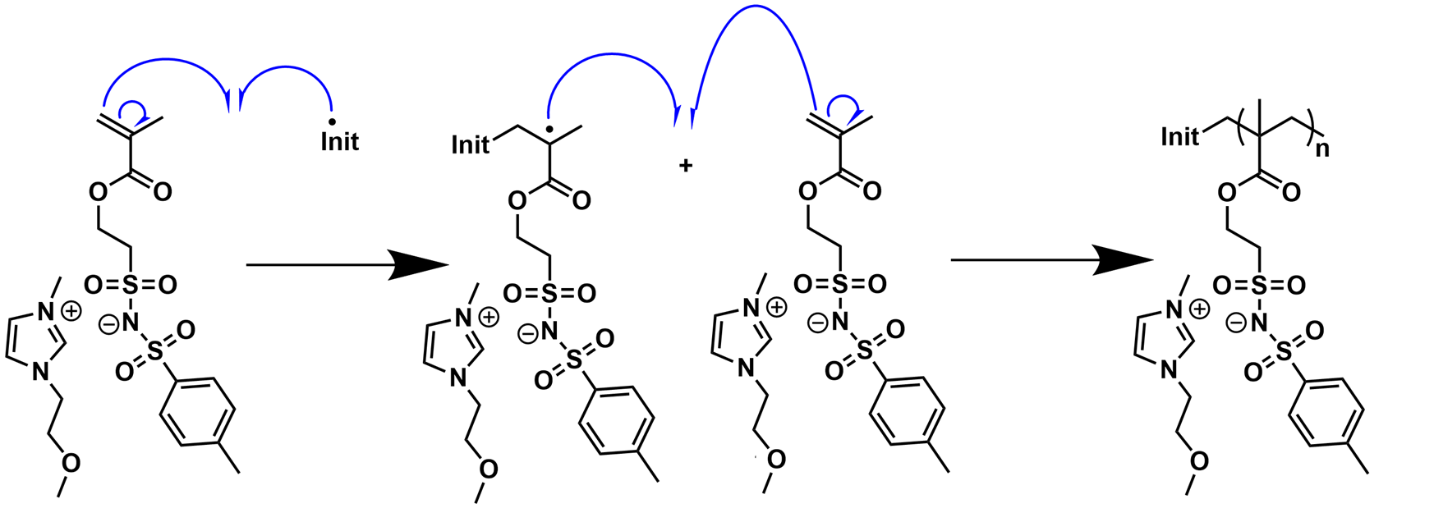
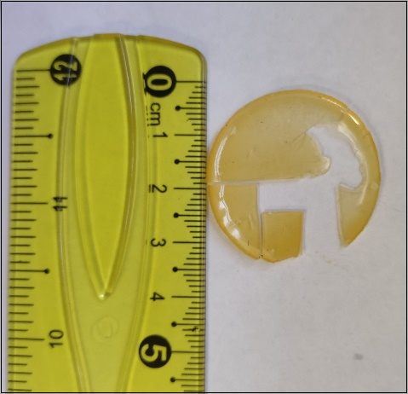
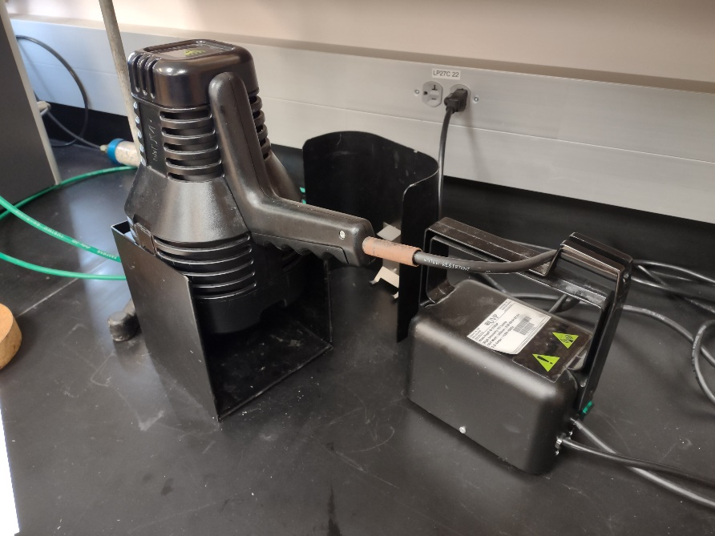
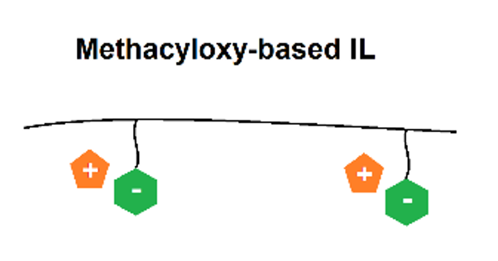
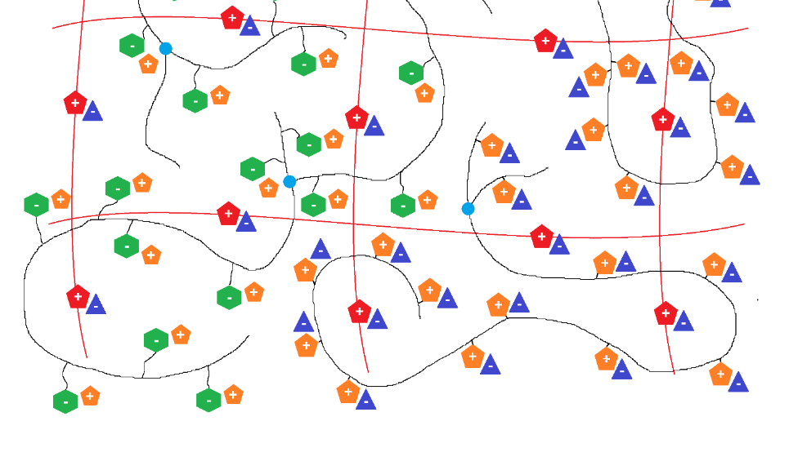
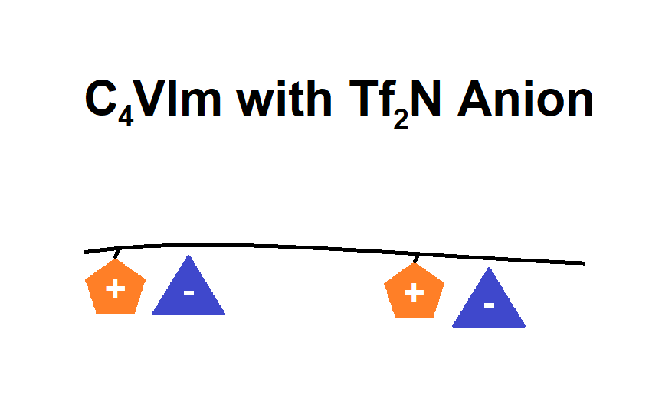
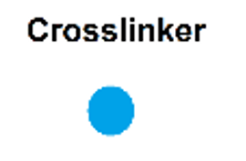
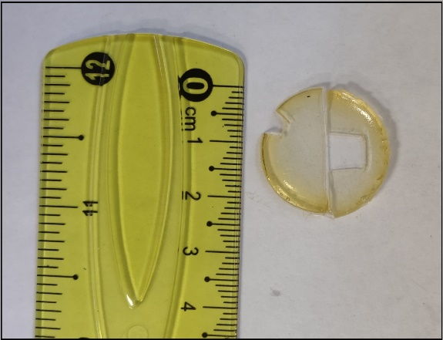
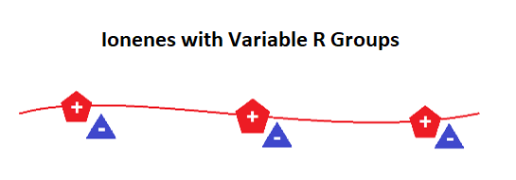
Synthesis and Characterization of Semi-Interpenetrating and Double Networks of Sulfonimide- and Imidazolium-Containing Poly(ionic liquids)
-
Jeremiah Coughlon,¹ Seth Taylor, ¹ Dr. Jason Bara², Dr. Kevin Miller,¹ Dr. Sourav Chatterjee (PI) ¹
¹ Department of Chemistry Murray State University, Murray, KY. USA 42071
²Department of Chemical and Biological Engineering, The University of Alabama, Tuscaloosa, AL. 35401
SEMI-INTERPENETRATING NETWORKS
---------------------------
EndNote X7
---------------------------
An unknown error occurred.
---------------------------
OK
---------------------------
ABSTRACT
CHARACTERIZATION
In recent years, there has been increased research interest in creating electrically conductive polymer membranes with materials that are widely available and environmentally safe. Herein, we report how polymeric membranes comprised of unique combinations of ionenes and poly(ionic liquids), including a recently developed sulfonimide- and imidazolium-containing methacryloxy-based monomer, were produced via UV photopolymerization. These membranes were specifically tailored to exhibit both ionic conductivity and an affinity for carbon dioxide, which are both crucial characteristics in such applications as electron transport in lithium-ion batteries and gas sorbency in separation techniques. Monomers, such as the aforementioned methacryloxy-based ionic liquid (IL) and C₄VIm, were combined with 10 wt % tri-functional crosslinker and 2 wt % photoinitiator to create basic single-network membranes with tri-functional crosslinker bridges. Additionally, polymer components were dissolved and combined with the monomer-based mixtures to form semi-interpenetrating networks and double networks. Imidazolium, which is generally available in low-cost and environmentally friendly materials, appears in many roles in these networks, including as an electrostatic counterpart in the methacryloxy-based IL. Notably, this IL features an ether functional group bonded to the imidazolium ring, which we hypothesize will increase affinity for quadrupolar carbon dioxide molecules. This affinity, along with the durability and flexibility provided by the polymeric ionene framework, are traits that are paramount in the gas separation strategies for which these membranes are designed.
Differential Scanning Calorimetry (DSC)
Small-Angle X-Ray Scattering (SAXS)
Double Network:
C₄VIm SIPN:
+
C₄VIm SIPN:
Double Network:
IONIC LIQUID POLYMERIZATION MECHANISM
Methacryloxy-based SIPN:
+
+
Thermogravimetric Analysis (TGA)
Derivative Weight:
Weight Loss:
DOUBLE NETWORK
References:
Kammakakam I.; Bara J.E.; et al. Tailored CO2-Philic Anionic Poly(ionic liquid) Composite Membranes: Synthesis, Characterization, and Gas Transport Properties. ACS Sustainable Chem. Eng. 2020, 8, 5954-5965. DOI: 10.1021/acssuschemeng.0c00327
O’Harra K.E.; Timmermann G.M.; Bara J.E.; Miller K.M. Designing Ionic Liquid-Derived Polymer Composites from Poly(Ionic Liquid)-Ionene Semi-interpenetrating Networks. ACS Appl. Polym. Mater. 2021, 3, 1995-2004. DOI: 10.1021/acsapm.1c00080
Shaplov, A.S.; Vlasov P.S.; et al. Design and synthesis of new anionic “polymeric ionic liquids” with high charge delocalization. Polym. Chem. 2011, 2, 2609. DOI: 10.1039/c1py00282a
+
PTO Initiator
RESULTS AND DISCUSSION
Thermogravimetric analysis (TGA) shows that membrane composition remained stabile until around 400°C.
Small-angle scattering (SAS) analysis generated two peaks in the 0.4-0.8 q (Å⁻¹) range, which indicates possible stacking in C₄Vim SIPN and double network membranes.
Further characterizations are projected to include testing of mechanical properties, gas separation properties, and ionic conductivity.
+

