Slide 1
creating a power system for a robot
Nolan Hays
School of engineering

Slide 2
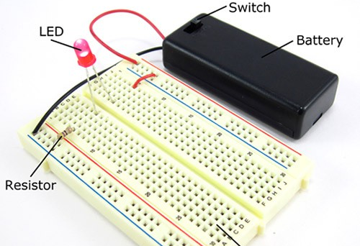
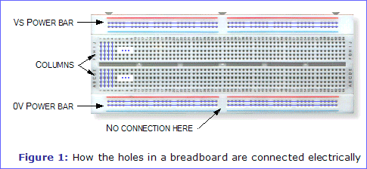
Quick introduction on breadboards
Voltage [V]
Current [A]
Battery
Power Rails
Columns

Slide 3
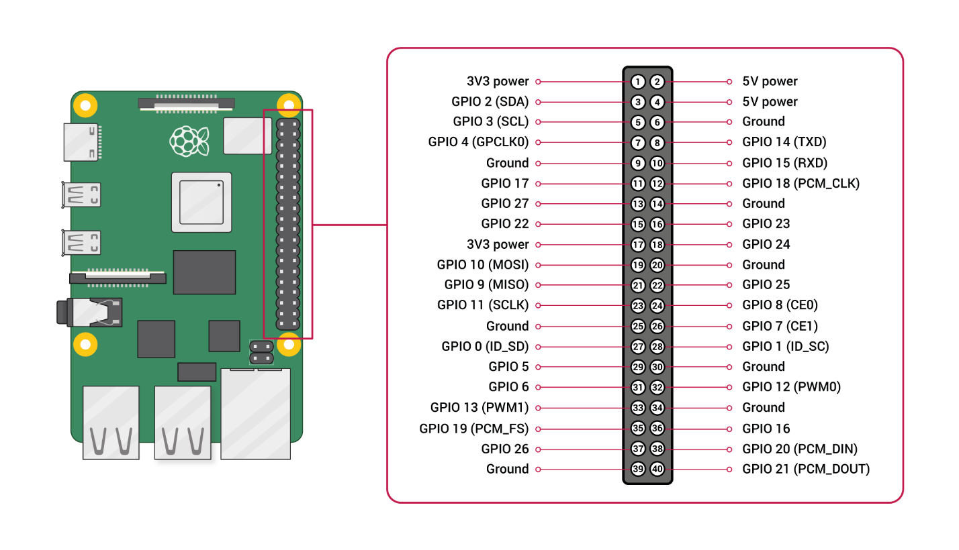
Brain of the robot
Raspberry Pi 4 Model B
3.3V pins
5V pins
GPIO (General Purpose Input/Output) pins
I2C (Inter-Integrated Circuit) pins

Slide 4
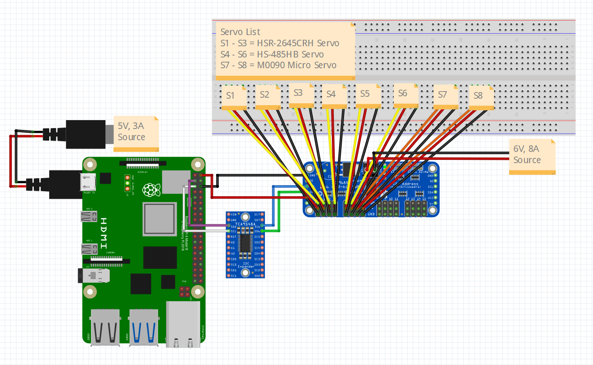
Servo motor circuit
6V 8A Battery
3 Different Servo Types
I2C Expander

Slide 5
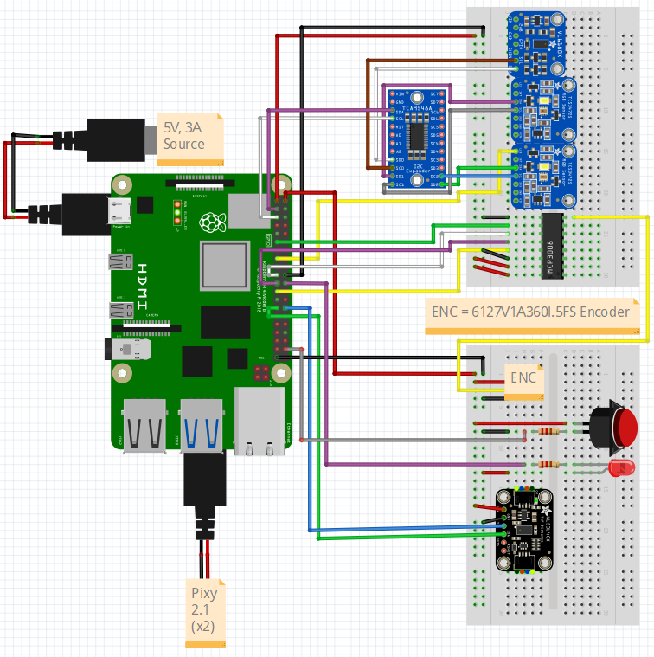
Sensor circuits
3V and 5V circuits
2 Pixy2.1 Cameras
VL6180
Color Sensors
MCP3008
Motor Encoder
Power Button with LED
VL53L5CX ToF Sensor

Slide 6
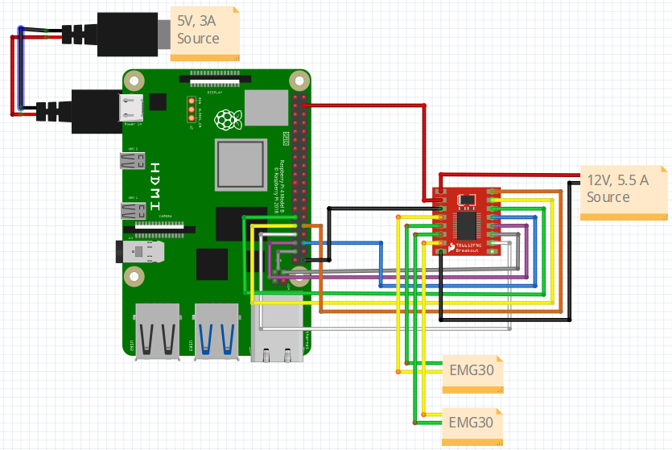
Drivetrain circuit
12V 5.5A Battery
TB6612FNG Motor Driver
2 EMG30 Motors

Slide 7
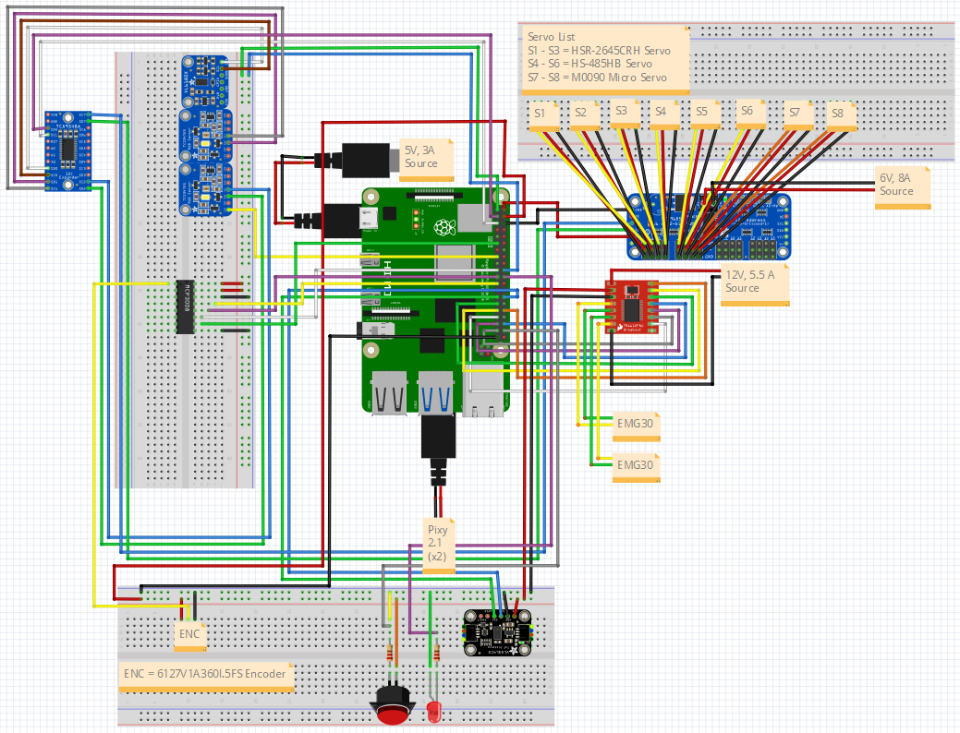
Complete power system
Servo Circuit
Sensor Circuit
Drivetrain Circuit

