Slide 1
BENEFITS OF BEDSIDE REPORT
By: Hannah Mattingly and Konner Spalding

Slide 2
Abstract
Although there is evidence benefiting outcomes from bedside shift report, this practice is not thoroughly implemented within healthcare facilities. The purpose of this project is to synthesize articles that analyze the shortcomings and the advantages of bedside shift report. This is in relation to the changing of shift between nursing staff, including but not limited to Registered Nurses, Certified Nursing Assistants, Licensed Practical Nurses. This presentation will provide a concise overview of the key aspects and implications of bedside reporting. By sharing shift change information at the patient's bedside, healthcare professionals aim to foster patient participation in their care, strengthen the therapeutic relationship, and enhance patient safety. Bedside reporting, as an innovative approach to patient-centered care demonstrates its potential to significantly improve healthcare outcomes and patient experiences while aligning with the broader goals of healthcare quality and safety.

Slide 3
What is Bedside Report?
Bedside reporting entails the practice of disseminating shift change information directly at the patient's bedside, as opposed to the traditional method of conducting such exchanges at the nursing station. This approach not only fosters patient engagement in their own care but also facilitates an environment of transparent and efficacious communication between the healthcare professionals and the client.

Slide 4
Background/Introduction
Common Practice
Shift Report at the Nurses station
Improving Techniques
To efficiently guide the bedside report to enhance the patient and nurses experience
Guiding Principles of Nursing
Encompass the roles of a nurse

Slide 5
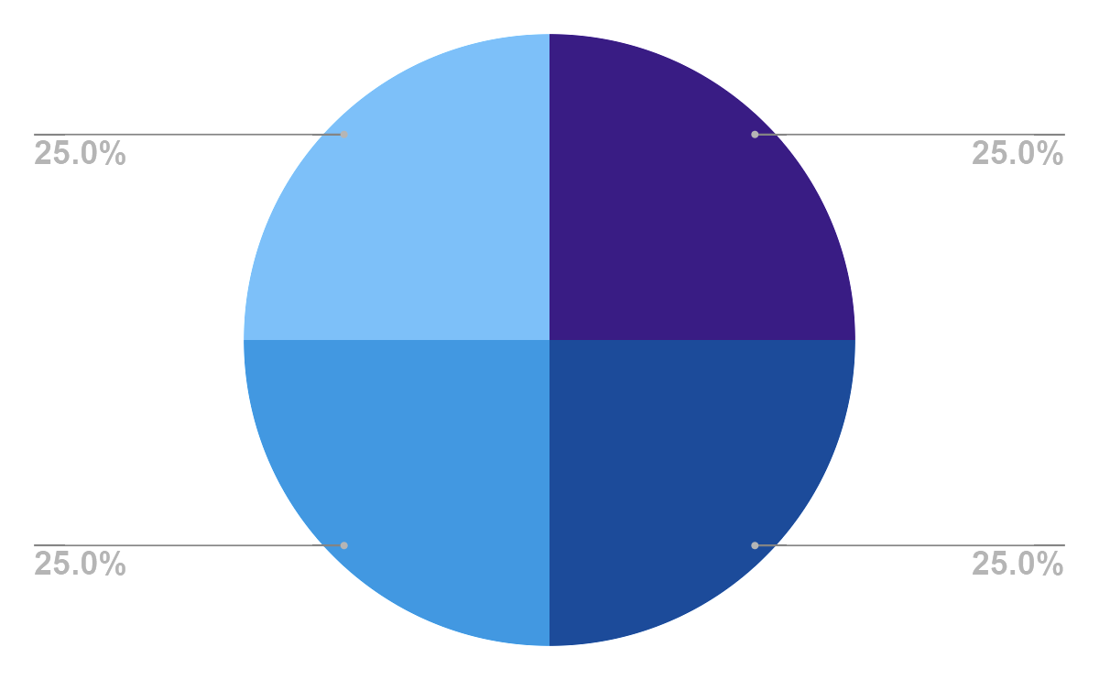
Guiding Principles of Nursing
Patient Centered Care
Advocacy
Caring
Professionalism

Slide 6
Theoretical Framework
Dorothea Orem’s Self-Care Deficit Theory
Jean Watson’s Theory of Human Caring
Hildegard Peplau’s Interpersonal Relations Theory
Promotes patients’ independence and self care. Bedside reporting empowers patients by involving them in their care decisions and informing them about their health status, promoting self-care and self-management.
Emphasizes the significance of the caring aspect in nursing. Bedside reporting enhances the perception of care and empathy as healthcare providers communicate with patients directly and demonstrate a genuine concern for their well being.
Focuses on the therapeutic nurse-patient relationship. Bedside reporting fosters a more intimate nurse-patient connection, allowing for trust, open communication, and collaboration, which are central elements in Peplau’s theory.

Slide 7
Common Misconceptions
IT TAKES TOO MUCH TIME
THERE IS NO DIFFERENCE
THE PATIENTS DON’T GAIN ANYTHING
SHIFT REPORT IS ONLY FOR NURSES
INTRUSIVE FOR PATIENTS

Slide 8
Evidence Based Practice
Improve Patient Safety
Improves Communication
Decrease risk of medication errors
Safety checks
Medical professionals
Patients
Family
Patient Centered Care
Time Management
Transparency
Less anxiety about care
Cluster care
Reduces redundancy

Slide 9
Time Management
Key Points
Evidence
More time efficient
Able to cluster care
Organization and prioritizing client needs is streamlined
“After a prolonged handoff time, some nurses have difficulty getting organized, prioritizing their workflow, and starting their nursing care”
Regarding shift handoff at the Nurses Station
“Nurses involved patients in this process and it only spent 1.5 min.”
“Better communication also helps the oncoming nurse prioritize assignments according to need. The nurse is informed about the patient earlier in the shift because report time is shortened.”
“The advantages for the nurse begin with the efficiency of report, which streamlines all pertinent information and saves nursing time.”

Slide 10
Safety
Key Points
Evidence
Reduced adverse events
Two-person verifier for the patient
There is not as much ‘alone’ time for the patient
“when handovers are based on an unreliable process of communication with missed, redundant or inconsistent data, they have been associated with an increase in the occurrence of adverse events affecting patient safety”
“Transitions in care create the potential for medication errors. BSR can reduce the risk, in part because of a two-verifier system lets the oncoming nurse verify with the off going nurse I.V. medications, pump settings, blood product compatibility, and possible drug adverse reactions.”
“sentinel events, call bell usage, and patient falls are all more frequent during this period of patient ‘alone’ time”

Slide 11
Communication
Key Points
Evidence
Concise and accurate information sharing
Improves teamwork between nurses
“A study conducted by Chaboyer, McMurray and Wallis found that the implementation of bedside handovers could improve the information delivery accuracy.”
“Bedside handover is a strategy to improve communication accuracy during handovers so nurses can share information between them, involve patients in nursing care, and improve bedside patients environmental safety.”
“BSR improves staff’s teamwork by giving nurses the opportunity to work together at the bedside, ensuring accountability.”

Slide 12
Patient Centered Care
Key Points
Evidence
Initiates interaction between the nursing staff and the patient
Promotes patients voice in the care they are receiving
Patient satisfaction increases
“Through bedside handover, the RNs perceived that patients experienced less anxiety about their care.”
“This inclusion of the patient and family, if appropriate, during bedside report (BSR) enhances communication between the patient and nurses as part of patient- and family-centered care.”
“By having a real-time conversation with the patient and family, the nurses can establish a trusting relationship that encourages the patient and family to feel more comfortable voicing their questions and concerns.”
“Promotes a sense of security and empowerment among patients when they feel that they play an active role in maintaining the accuracy of the patient handoff”
“Research has shown that when patients are that third voice engaging in decisions that impact their health, measurable improvement in safety and quality result.”

Slide 13
The Five Stages of Bedside Report
1. Preparation
2. Introduction to the Patients
3. Exchange of Information
Allocation of patient
patient status
Asking family and visitors to leave the room
Introducing the next shift nurse
Builds trust
Systematic and concise
4. Patient Involvement
5. Safety Scan
Maintains confidentiality
Patient is aware of their treatment plan
Patients' environment
Equipment
Identify safety risks
Notes:
Yusrawati, Kamil, H., & Tahlil, T. (2022). The effectiveness of bedside handover training to
improve knowledge, attitudes, and skills among nurses. Enfermería Clínica, 32, S11–
S14. https://doi.org/10.1016/j.enfcli.2022.03.009

Slide 14
Roles During Bedside Shift Report
Outgoing Nurse
Incoming Nurse
Patient/Family
- Introduces self with name, occupation, duty (NOD) says “My shift is over”
- Asks for consent to give the report at the patient's bedside
- Introduces incoming nurse using NOD
- Gives patients diagnosis, status, care goals, etc.
- Conducts safety checks
- Update patients whiteboard
- Asks the patient: anything to add or ask?
- Contributes additional information
- Ask questions

Slide 15
Why Bedside Report?
REDUCES AMOUNT OF MISINFORMATION
STREAMLINES THE ORGANIZATION
REAL-TIME ASSESSMENT
DECREASES SAFETY CONCERNS
PATIENT CENTERED CARE
INTERPROFESSIONAL ACCOUNTABILITY
ENHANCES COMMUNICATION AND SATISFACTION
BUILDS TRUST BETWEEN THE NURSE AND THE PATIENT
Notes:
facilitates regular communication between the incoming nurse, outgoing nurse, and patient
promotes a culture of collaborative practice
invites patients to be active partners in their care
builds rapport and trust
reassures and informs patients
saves time
allows nurse to meet the patient early and face-to-face
confirms patient status at shift change
perform safety checks
identify emerging issues
change white board
Education is for improving the lives of others and for leaving your community and world better than you found it. - Marian Wright Edelman

Slide 16
References
Bressan, V., Cadorin, L., Pellegrinet, D., Bulfone, G., Stevanin, S., & Palese, A. (2019). Bedside
shift handover implementation quantitative evidence: Findings from a scoping review. Journal of Nursing Management, 27(4), 815–832. https://doi.org/10.1111/jonm.12746
Brown-Deveaux, D., Kaplan, S., Gabbe, L., & Mansfield, L. (2022). Transformational leadership
meets innovative strategy: How nurse leaders and clinical nurses redesigned bedside
handover to improve nursing practice. Nurse Leader, 20(3), 290–296.
https://doi.org/10.1016/j.mnl.2021.10.010
Labriole, J. BSN, RN, MacAulay, C. MSN, RN, Williams, K. MSN, RN, Bunting, D. R. EdD,
MSN, RN, CNE, & Pettorini-D'Amico, S. DNP, RN, NEA-BC. (2018). Implementing
bedside shift report: Walking the walk and talking the talk. Nursing, 48(3), 1-4.
https://doi.org/10.1097/01.NURSE.0000830528.23737.21
Ofori-Atta, J. MSN, BSN, RN; Binienda, M. BSN, RN; Chalupka, S. MSN, EdD. (2015). Bedside shift report: Implications for patient safety and quality of
care. Nursing, 45(8), 14. https://doi.org/10.1097/01.NURSE.0000469252.96846.1
Yusrawati, Kamil, H., & Tahlil, T. (2022). The effectiveness of bedside handover training to
improve knowledge, attitudes, and skills among nurses. Enfermería Clínica, 32, S11–
S14. https://doi.org/10.1016/j.enfcli.2022.03.009

