Slide 1
Preventing Pressure Injuries in Critical Care Settings
Cassady Coomes & Chassidy Eddlemon
Murray State University

Slide 2
Introduction
2.5 million people develop a HAPI each year, and 60,000 of these result in death as an outcome
HAPI development leads to longer hospital stays, delayed recovery, and increased pain and suffering
Higher acuity patients are especially susceptible to PI
Current practices do not offer sustained structural support, newer processes may prove to be more beneficial

Slide 3
Theoretical Framework
Jean Watson- Theory of Human Caring
“Nursing is concerned with promoting health, preventing illness, caring for the sick, and restoring health.”
Research Purpose
To identify prevention strategies that reduce the risk and incidence of hospital-acquired
pressure injuries.
Notes:
Prophylactic treatment of pressure injuries is extremely important for providing quality care.

Slide 4
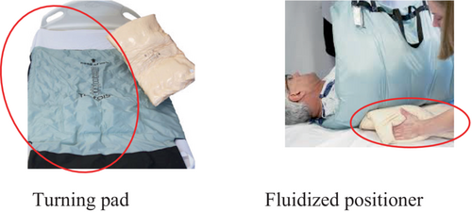
Research Article #1
Mölnlycke Tortoise Turning & Positioning System
Turning Pad
Illustrated indicators for optimal patient positioning
Adapts to patient’s body
Ergonomic handles
Fluidized Positioner
Can be moulded by hand to fit specific areas
Maintains shape
Use of the system showed decreased soft tissue deformation on MRI.
Notes:
Control group just had conventional prevention measures (linen draw sheet, wedges, pillows). Intervention group used turning system.
Turning pad- designed to redistribute pressure over larger surface area

Slide 5
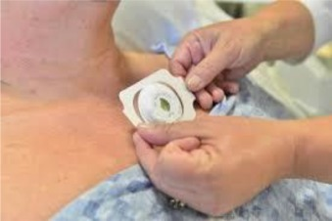
Research Article #2
Leaf Patient Monitoring System
Wearable patient sensor that records body position & provides feedback
Nurses receive times for repositioning
Visual warnings given if turning protocols were not met
Results: Turning compliance increased
Control group- 15 HAPIs
Treatment Group- 5 HAPIs
Notes:
Done in the UK ICU, found that patients were being turned on average q4hrs and 5% of patients stayed in same position longer than 8hrs.

Slide 6
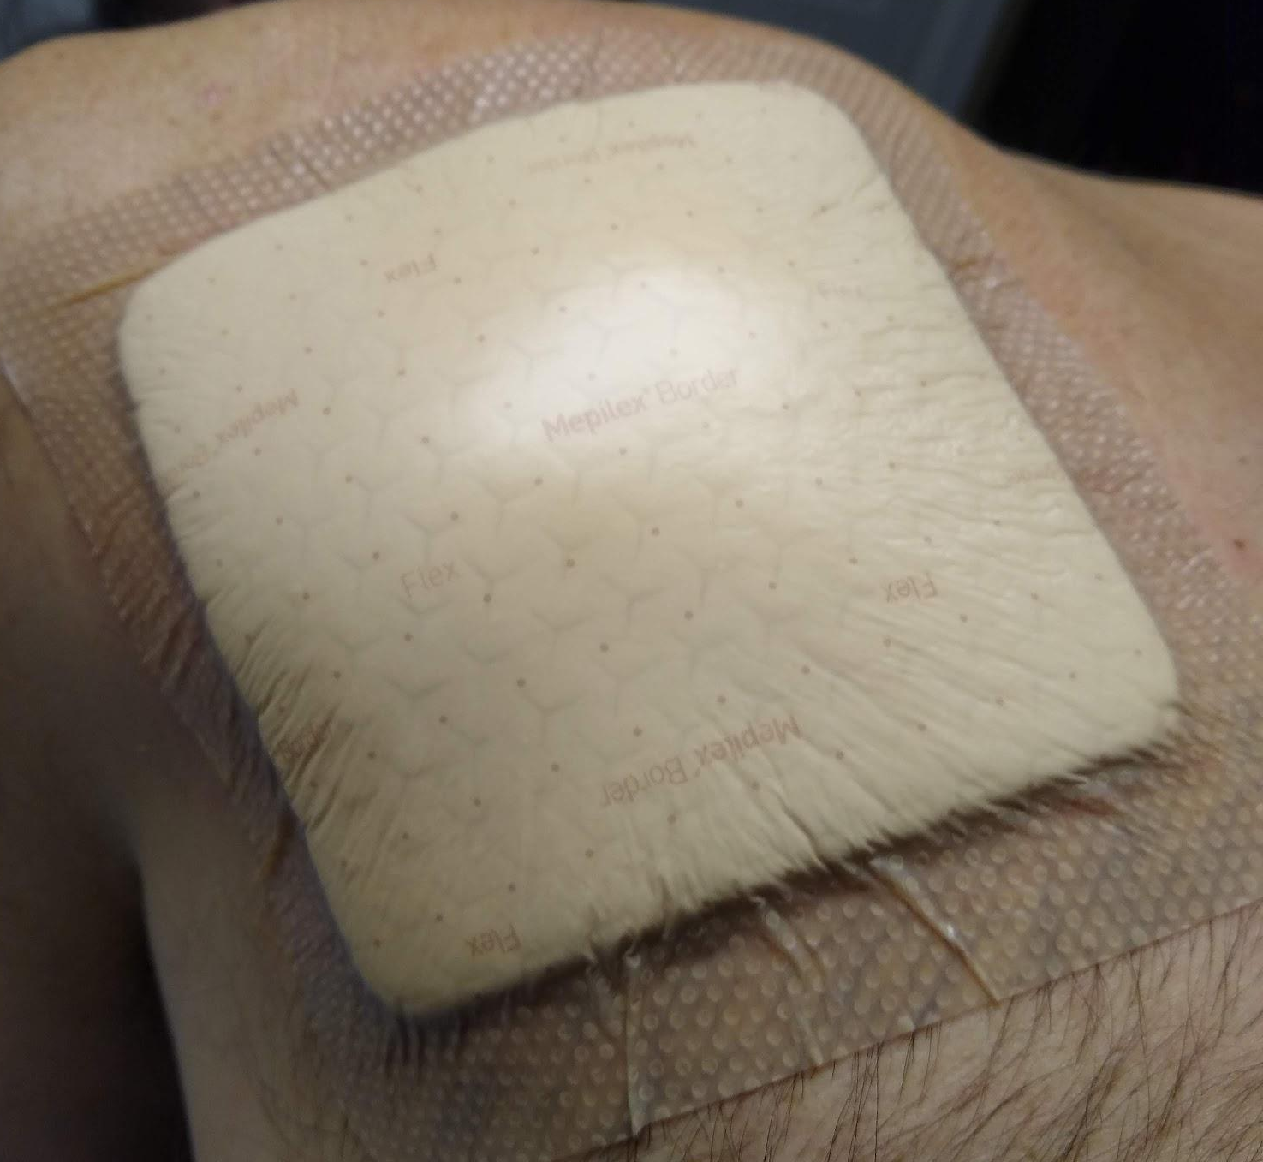
Research Article #3
Effectiveness of Mepilex Dressings in Highly Dependent Older Adults
The aim of this study was to determine if multi-layer soft silicone dressings were effective in preventing sacral and heel PIs.
The use of Mepilex dressings was shown to be most effective when applied upon admission
Results of Study:
18 PIs in Control Group
5 PIs in Intervention Group

Slide 7
Recommendations for Practice
01
02
03
Product Consideration
A “Buddy System”
Frequent Inservices
Correctly using the products mentioned will prevent HAPIs. Even if it isn’t every product, the number of pressure injuries can be reduced.
Instead of staff just charting that they repositioned a patient, create a buddy system that requires staff to sign off every two hours.
Inservices informing staff on how to use proper materials for repositioning patients and the rules of a “buddy system” will cover the “I didn’t know about that” excuse and, hopefully, increase compliance.

Slide 8
Conclusion
Based on our research, the Mölnlycke Tortoise Turning & Positioning System shows decreased deep tissue deformation, monitoring systems can refine patient turning, and Mepilex dressings are an effective preventative measure for sacral and heel pressure injuries. The use of even one of these recommendations can potentially decrease the occurrence of PIs.

Slide 9
References
Kapp, S., Gerdtz, M., Gefen, A., Padula, W., Alves, P., Trevellini, C., Ghosh, A., Shea, A., Cross, A., Sousa, I., &;
Santamaria, N. (2023). Clinical and cost effectiveness of a system for turning and positioning intensive care unit patients, when compared to usual care turning and positioning devices, for the prevention of hospital-acquired pressure injuries. A randomised controlled trial. International Wound Journal, pp. 1–11. https://doi.org/10.1111/iwj.14230
Lyder, C. H., Wang, Y., Metersky, M., Curry, M., Kliman, R., Verzier, N. R., &; Hunt, D. R. (2012).
Hospital-acquired pressure ulcers: results from the national medicare patient safety monitoring system study. Journal of the American Geriatrics Society, 60(9), pp. 1603–1608. https://doi.org/10.1111/j.1532-5415.2012.04106.x
Misyuk, N., Biira, L., Marilene, Pajimola, J., &amp; Kokuma, P. W. (2023, July 1). Jean Watson: Theory of
human caring. Nurseslabs. https://nurseslabs.com/jean-watsons-philosophy-theory-trans personal- caring/ #theory_ of_human_caring_of_jean_watson
Pickham, D., Berte, N., Pihulic, M., Valdez, A., Mayer, B., & Desai, M. (2018). Effect of a
wearable patient sensor on care delivery for preventing pressure injuries in acutely ill adults: A pragmatic randomized clinical trial (LS-Hapi Study). International Journal of Nursing Studies, 80, pp. 12–19. https://doi.org/10.1016/j.ijnurstu.2017.12.012
Santamaria, N., Gerdtz, M., Kapp, S., Wilson, L., &; Gefen, A. (2018). A randomised
controlled trial of the clinical effectiveness of multi-layer silicone foam dressings for the prevention of pressure injuries in high-risk aged care residents: The Border III Trial. International Wound Journal, 15(3), pp. 482–489. https://doi.org/10.1111/iwj.12891
The problem of pressure injuries. The Hospital & Healthsystem Association of
Pennsylvania. (2023). https://www.haponline.org/Clinical-Quality/Quality- Safety/Pressure-Injury
Tschannen, D., &; Anderson, C. (2019). The pressure injury predictive model: a
framework for hospital-acquired pressure injuries. Journal of Clinical Nursing, 29(7–8), pp. 1398–1421. https://doi.org/10.1111/jocn.15171

