Slide 1
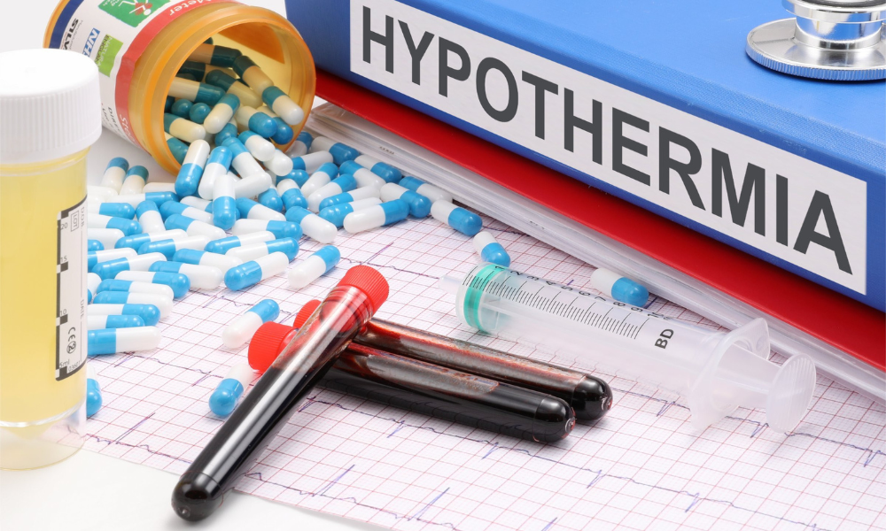
The Benefits of Therapeutic Hypothermia Post-Cardiac Arrest
Anthony Burrows and Jarrod Mathis
Murray State University School of Nursing
Notes:
We need to look at examples on scholar’s week

Slide 2
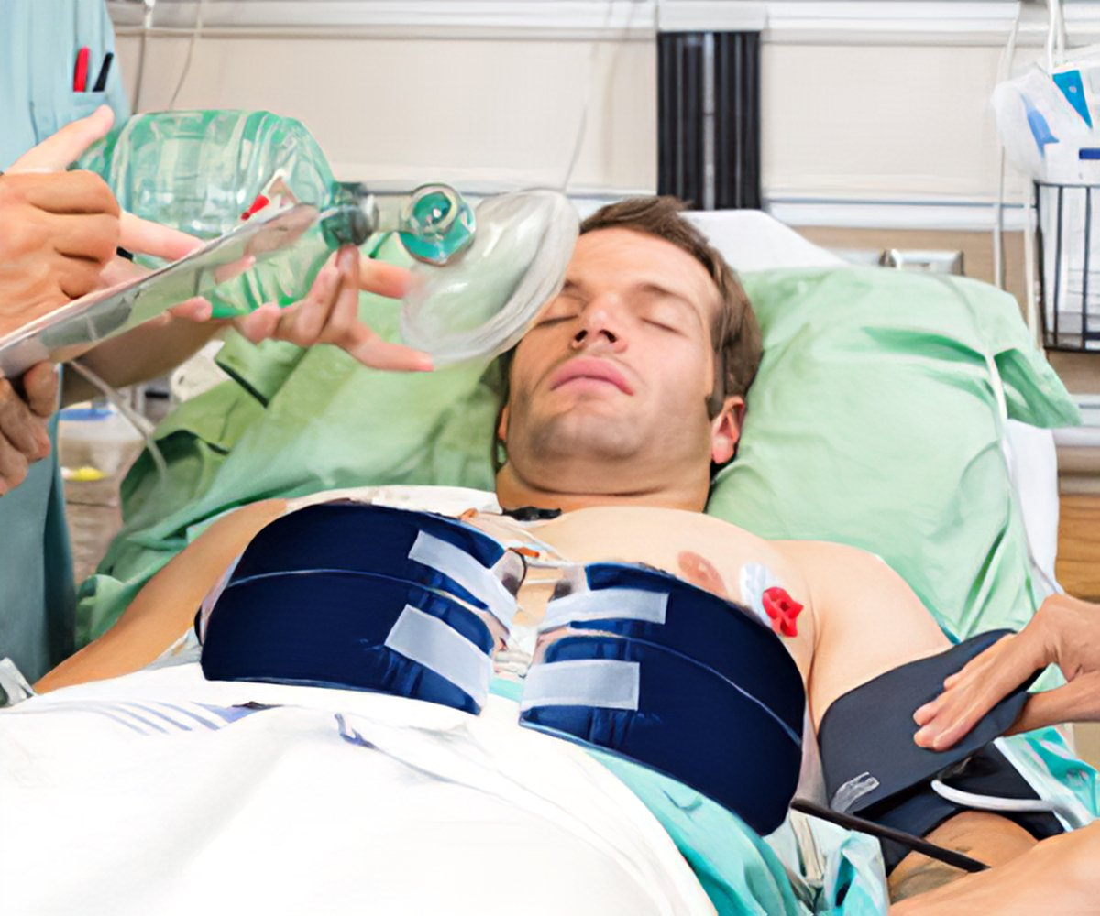
Abstract
During cardiac arrest, the body is susceptible to ischemic injuries to the brain and/or other vital organs. Initiating therapeutic hypothermia post-resuscitation has been shown to provide neuroprotection and improve patient outcomes in different facilities. Education regarding this intervention is important as there is a lot of conflicting research. Therapeutic hypothermia is still being tested in many facilities worldwide.
Goal: The goal for this project is to synthesize academic research that proves the effectiveness of therapeutic hypothermia post-cardiac arrest. Furthermore, we researched different treatment plans to help build a cohesive protocol of therapeutic hypothermia for a better neurological outcome.
Notes:
We are not attempting to change your protocol, we are just giving different therapeutic plans for hypothermia.

Slide 3
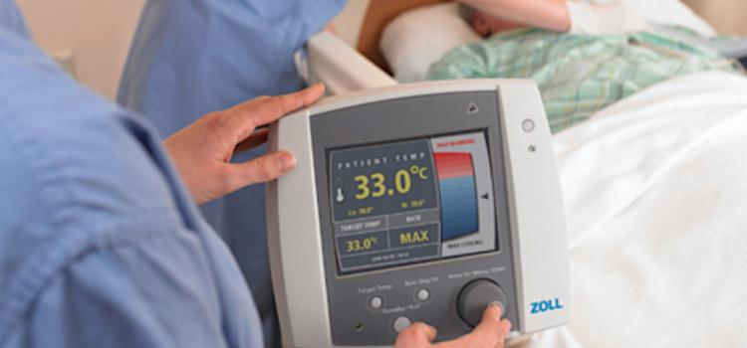
What is Therapeutic Hypothermia(TH)?
TH is the process of reducing the core body temperature down to levels that are still able to maintain life but preserve key functions.
Reduction in brain metabolic rate, effects on cerebral blood flow, blockade of excitotoxic mechanisms, a decrease in edema formation, and modulation of the inflammatory response.
Typical levels are suggested to range from 89-93 degrees fahrenheit (32-34C)
Notes:
Cerebral blood flow:resulting in an apparent relative luxuriant brain flow and promotes brain homeostasis
Excitotoxic mechanisms: This refers to the ability of glutamate or other excitatory neurotransmitters to mediate the death of central neurons
https://pubmed.ncbi.nlm.nih.gov/17692002/#:~:text=The%20basic%20mechanisms%20through%20which,of%20excitotoxic%20mechanisms%2C%20calcium%20antagonism%2C

Slide 4
Clinical Problem
The probability of a good neurologic outcome decreases with every minute of resuscitation
Only 7-30% of patients are discharged without neurological damage
There is not a sufficient amount of current research or an overall consensus indicating the effectiveness of therapeutic hypothermia after cardiac arrest

Slide 5
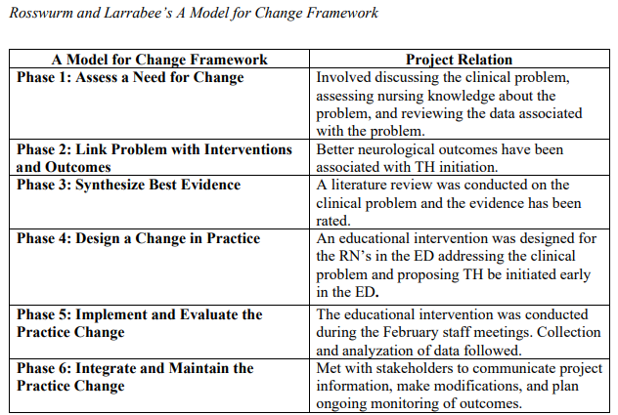
Theoretical Framework
In using this theoretical framework we were able to utilize a targeted approach by breaking down therapeutic hypothermia into categories for proper evaluation.

Slide 6
It's Getting Chilly in Here!
Inclusion Criteria
Intubated patients with treatment initiated within 6 hours after cardiac arrest. Some studies within 4-6hrs.
Patients able to maintain a systolic blood pressure above 90 mm Hg, with or without pressors, after cardiopulmonary resuscitation.
Recent studies are showing that there is also improvement in patients with non shockable rhythms
It is indicated that the patient should remain in TH for at least 24hrs
EEG and CT may be needed
Follow local protocol
Notes:
This would be with VF and non perfusing VT(pVT)

Slide 7
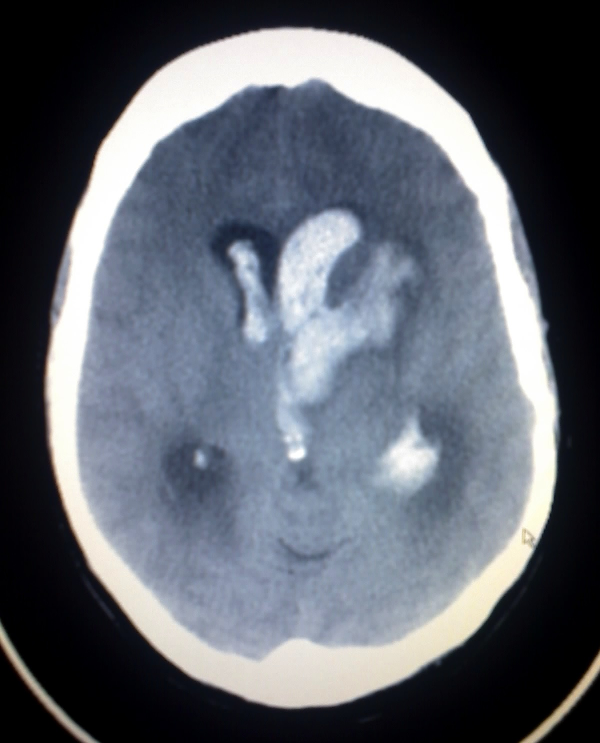
Contraindications for TH
Patients under 18 years of age
Major Surgery within two weeks of arrest
Caution with patients who are in severe septicemia.
Intracranial hemorrhage, severe hemorrhage leading to exsanguination, hypotension refractory to multiple vasopressors, and pregnancy.
EMS initiation of TH has been shown to have no known benefits and should not be performed.
Notes:
https://www.ahajournals.org/doi/10.1161/CIRCULATIONAHA.111.076851#:~:text=There%20are%20few%20true%20contraindications,%2C%20severe%20sepsis%2C%20and%20pregnancy.

Slide 8
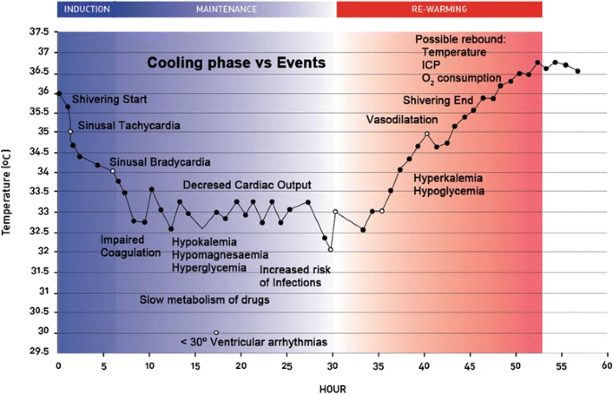
Complications with TH
Notes:
https://sjtrem.biomedcentral.com/articles/10.1186/s13049-015-0121-3
I need info on this

Slide 9
Findings and Outcomes
Patients that are receiving both internal and external cooling for management of hypothermia showed a decrease in hospital mortality
These methods were such as NS infusions at 30ml/kg at 4 degrees C along with NG tube and bladder tubes. External agents used were cooling fans and use of ice packs. Patients were left without blankets and monitored through an esophageal temperature probe.
Patients that receive eCPR along with TH after suffering cardiac arrest with shockable rhythms showed a favorable survival rate along with favorable neurological outcomes on patients within three months of arrest.
Strict Targeted temperature management at 33 degree C for 24hrs was shown to have a higher percentage of patients that had favorable neurological outcomes at the 90 day period vs normothermia.
Notes:
https://www.ncbi.nlm.nih.gov/pmc/articles/PMC7063549/
Out of 152 patients included in the study, 58 (38.7%) underwent TH treatment. After matching (which left 70 patients in the analysis), death during hospital stay occurred less often in TH group (28.6% vs 57.1%, P = 0.029
Core temperature was measured by esophageal temperature probe. TH was initiated in all patients within 6 hours from cardiac arrest. Rapid bolus (200-300 mL/min) of 2000 mL of cold saline (4°C) was given using pressurized bags via a large bore catheter inserted in the femoral vein. This was immediately followed by the administration of frozen ice-packs on large body areas. Additional 500 to 1000 mL of cold saline was allowed. The aim was to reach the target core temperature of 33°C (32-34°C) during 24 hours.

Slide 10
References
Duan, J., Ma, Q., Zhu, C., Shi, Y., & Duan, B. (2021). ECPR combined with therapeutic hypothermia could improve survival and neurologic outcomes for patients with cardiac arrest: A meta-analysis. Frontiers in Cardiovascular Medicine, 8.
Fujihashi, A., & Jones, J. (2020). Targeted temperature management for cardiac arrest with Nonshockable Rhythm. The Journal of Emergency Medicine, 59(6), 988.
Granja, C., Ferreira, P., Ribeiro, O., & Pina, J. (2011). Improved survival with therapeutic hypothermia after cardiac arrest with cold saline and surfacing cooling: Keep it simple. Emergency Medicine International, 2011, 1–4.
Newman, M. (2023). Latest statistics. Sudden Cardiac Arrest Foundation. https://www.sca-aware.org/about-sudden-cardiac-arrest/latest-statistics#:~:text=The%20American%20Heart%20Association%20has,nearly%2090%25%20of%20them%20fatal.
Purnsley, T. (2020). Early initiation of therapeutic hypothermia in the emergency department. Doctors of Nursing Practice Papers. Paper 63.
Rosswurm, M. A., & Larrabee, J. H. (1999). A model for change to evidence-based practice. Image: The Journal of Nursing Scholarship, 31(4), 317–322.
Targeted Temperature Management. Retrieved from Bon Secours Mercy Health, Dr. Bechtel. October 2023.

