Slide 1
Fire Safety in the OR
Raghda Abo Al Haija, Leah Cullop, Keeli McKeel

Slide 2
Introduction
Operating rooms contain a lot of the factors necessary for the formation of fires. For this reason, fire safety is especially important in the OR.
To ensure safety, it is important for the staff to be aware of fire risks that are present in the OR, ways to prevent a fire, and ways to manage a fire.
It is also crucial for each team member to review the fire safety policies and understand the most recent evidence-based practices regarding fire safety in the OR.

Slide 3
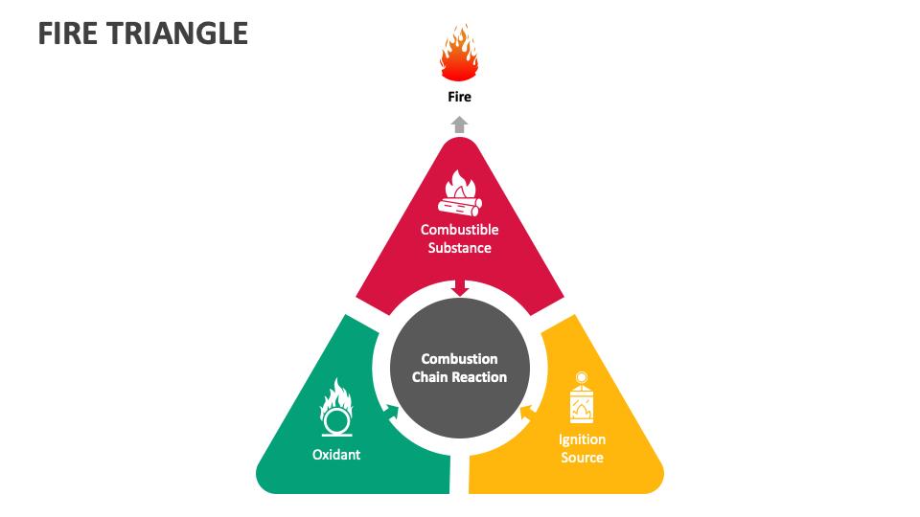

Slide 4
Jean Watson’s Theory of Human Caring
OR fires are preventable if the operating team devotes enough attention and consideration to fire prevention measures
The surgical team has the ability to offer the patient total safety and security by bringing genuine human care into the OR suite

Slide 5
Managing the Ignition Source- Ignition sources include equipment such as an ESU, lasers, or fiber-optic light cord.
Avoid cords from coiling.
Turn off unnecessary equipment and surgical equipment that is not in use or on standby.
Keep surgical drapes and other flammable materials away from an ignition source that is in use.
Use the lowest power setting needed.
Might use wet towels or sponges around the surgical area.
All staff have a responsibility to watch for safe usage of equipment.

Slide 6
Managing the Use of Oxygen or Nitrous Oxide- the risk of fire increases significantly when oxygen concentration is over 30%.
Oxygen should be delivered at the lowest saturation possible.
A patient draping technique should be used that does not allow for oxygen to collect under a tunneling of the drapes near the surgical site. Also utilizing a system to suction or flush oxygen concentrations from under the drapes can reduce the risks.
Allow surgical smoke to escape to prevent it from accumulating in enclosed spaces such as the back of the throat.
The use of oxygen should always be used with caution, especially with procedures of the head, neck, and upper chest.

Slide 7
Managing Fuel Sources/Combustible Substances
The patient’s body tissue and hair can act as a fuel source:
Non-flammable gels may be used to coat the patient’s hair
Use drapes to separate from the surgical site
The presence of combustible gases, such as methane or hydrogen, in the patient’s GI tract has been reported to have caused some cases of fires. The use of bowel preparations might have an influence on this.

Slide 8
Managing Fuel Sources/Combustible Substances
Sponges, drapes, and linens also act as fuel sources:
Dampen dry sponges and gauzes with saline can help reduce likelihood of a fire
Alcohol-based skin preparations are a major contributor to fires:
Wait at least 3 minutes for alcohol to dry after application, or until it is fully dried in order for the isopropyl alcohol to evaporate
Do not allow alcohol to pool
Some airway devices are made of combustible material such as polyvinyl chloride.
If possible, use fireproof materials

Slide 9
Managing a Fire Occurrence
Actions to take will vary depending on each individual situation, however, the priority must always be the safety of the patient and the team members.
When a fire is recognized, airflow of oxygen and other gases should be immediately stopped. In the case of an airway fire, the airway device should be removed and saline should be poured in the airway. All burning materials should be removed and the fire should then be extinguished.
Care of the patient should resume when safety is restored.

Slide 10
Communication
Consistently assessing fire risk during “time out” can greatly prevent surgical fires all together.
Perform a fire risk assessment prior to starting the procedure.
All medical staff should be aware of risks and how to minimize them.
Assign roles for each team member before the surgery begins.

Slide 11
Training and Education
Ensure that each team member knows the location of the nearest fire alarm.
Ensure that team members know how to properly operate a fire extinguisher:
Use the PASS technique: Pull, Aim, Squeeze, Sweep.
Use simulation techniques and training for realistic practice.
Have a fire safety manual in the OR that is accessible to all staff.

Slide 12
Proposed Policy
Protocol for determining the oxygen delivery system
Benefits of laryngeal mask airway instead of nasal cannula
Semi annual fire drills rather than annual

Slide 13
References
Jones, T. S., Jones, E. L., Black, I. H., & Robinson, T. N. (2019). Operating room fires: Reply. Anesthesiology, 131(4), 947–947. https://doi.org/10.1097/aln.0000000000002923
Misyuk, N., Biira, L., Marilene, Pajimola, J., Kokuma, P. W., Abraham, J., & BSN, M. V. (2023). Jean Watson: Theory of human caring. Nurseslabs. https://nurseslabs.com/jean-watsons-philosophy-theory-transpersonal-caring/#h-theory-of-human-caring-of-jean-watson
Sentinel Event Alert 68: Updated surgical fire prevention for the 21st Century. (2023). The Joint Commission Journal on Quality and Patient Safety, 50(2), 157–160. https://doi.org/10.1016/j.jcjq.2023.10.003
Tewari, M. (2023). Surgical Fire: Where, Why, and What to Do. Indian Journal of Surgery, 85(4), 723–729. https://doi-org.ezproxy.waterfield.murraystate.edu/10.1007/s12262-022-03553-7

