Slide 1
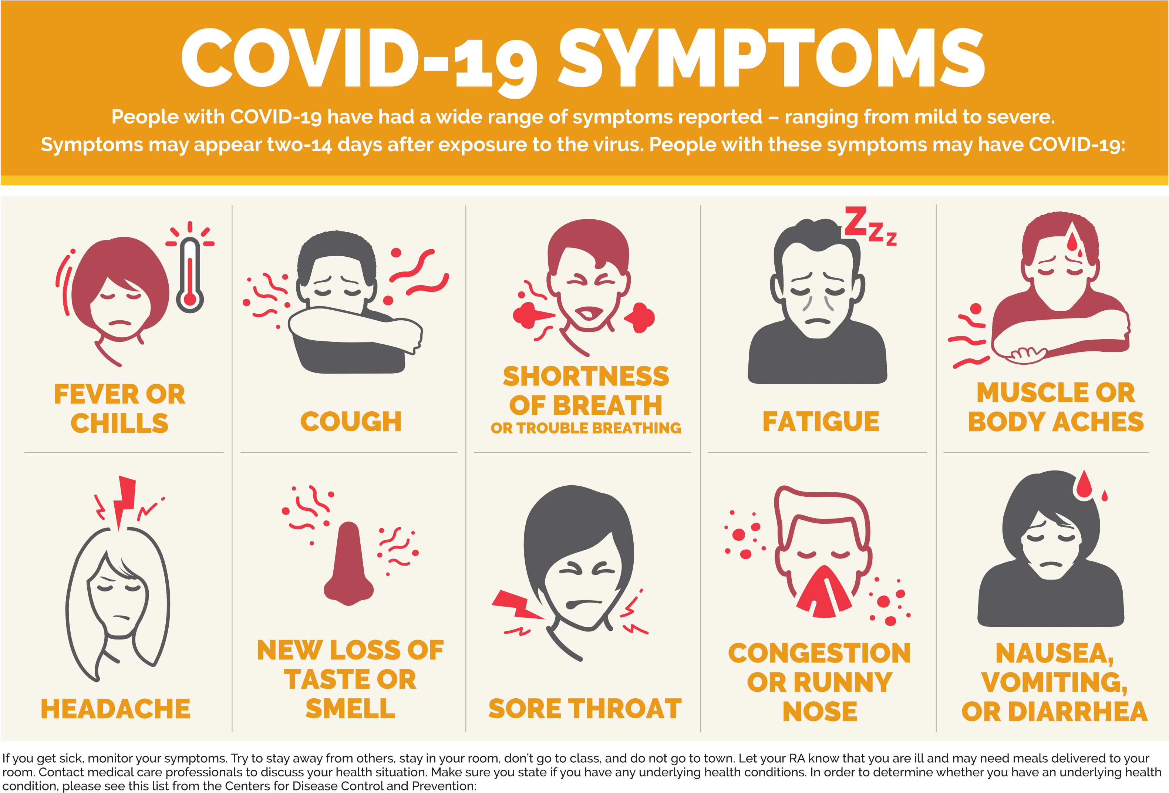
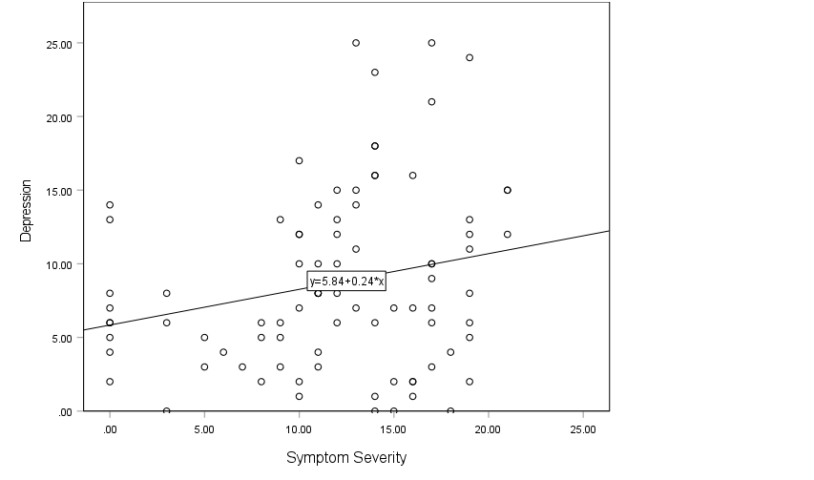
Lingering Effects of COVID-19 on
Mental Health in College Students
Morgan Bodker & Dr. Megan St. Peters, Murray KY, Murray State University
INTRODUCTION
Conclusion
Rising depression rates since first COVID cases
Past COVID patients have different health problems than non-COVID patients (Affairs, 2023).
Severe symptoms lead to additional health and life issues (Williamson, 2023).
Study Aims
Explore if severity of past COVID symptoms predicts current depression rates
Help individuals in the future physically and mentally
Allow medical professionals to be proactive
Individuals diagnosed with COVID are at a higher risk for depression than those who have never had COVID.
Males were reported to have a higher prevalence of COVID-19 symptoms than females (Patel et al., 2023)
Meta-analysis reported a 12.9% increase in prevalence of depression after having COVID (Shetty et al. 2023).
Depression rates rising because of unknown of illness and lack of resources rather than severity of symptoms (Sakib et al. 2021).
The desire to end life throughout the population increased, depression did not (Kupcova et al. 2023).
Help those who have been diagnosed with COVID understand why they may experience depression.
Provide a guideline for medical professionals as to what questions to ask a patient when concerned about having depression
Help medical staff prevent future depression in those who currently have COVID
Hypothesis:
The number and severity of COVID symptoms predicts current depressive symptoms.
METHODS
RESULTS
Participants
N = 129 MSU students
79.1% of participants were female ; 20.9% were male
Average age of participants was 19.57 years old (S=4.14)
79.1% Caucasian, 9.3% African American, 3.9% Hispanic, 1.6% Asian/Pacific Islander, 6.2% Bi-racial
Procedure
Online survey through SONA
Participation took 20 minutes
Measures
4-point Likert Scale
7 questions based on COVID symptom severity (Eloy et al. 2021)
Patient Health Questionnaire
9 questions on mental health regarding depression (Vahratian et al., 2021)
REFERENCES
COVID-19: Long-term effects. (2023, June 22). Mayo Clinic. https://www.mayoclinic.org/diseases-conditions/coronavirus/in-depth/coronavirus-long-term-effects/art-20490351#:~:text=The%20experience%20of%20having%20severe,triggered%20by%20a%20terrifying%20event.
Kupcova, I., Danisovic, L., Klein, M., & Harsanyi, S. (2023). Effects of the COVID-19 pandemic on mental health, anxiety, and depression. BMC Psychology, 11(1). https://doi.org/10.1186/s40359-023-01130-5
Patel, J. R., Amick, B. C., Vyas, K. S., Bircan, E., Boothe, D., & Nembhard, W. N. (2023). Gender disparities in symptomology of COVID-19 among adults in Arkansas. Preventive medicine reports, 35, 102290. https://doi.org/10.1016/j.pmedr.2023.102290
Sakib, N., Akter, T., Zohra, F., Bhuiyan, A. K. M. I., Mamun, M. A., & Griffiths, M. D. (2023). Fear of COVID-19 and Depression: A comparative study among the general population and healthcare professionals during COVID-19 pandemic crisis in Bangladesh. International Journal of Mental Health and Addiction, 21(2), 976–992. https://doi.org/10.1007/s11469-020-00477-9
Shetty, P. A., Ayari, L., None Jessica Madry, Betts, C. M., Robinson, D. R., & Kirmani, B. F. (2023). The relationship between COVID-19 and the development of depression: implications on mental health. Neuroscience Insights, 18. https://doi.org/10.1177/26331055231191513
What are the most common COVID-19 symptoms? | Keuka College. (n.d.). Keuka College. https://www.keuka.edu/together-and-ready/what-are-most-common-covid-19-symptoms
Severity of COVID symptoms is a predictor of mental health, regarding depression (p=.032).
Linear regression table to show that the severity of COVID-19 symptoms predicts depression: F(1, 84) = 4.74, p=.032.
23.2% variance is accounted for by its linear relationship with COVID symptoms
Notes:
Intro:
Going to a university introduces many students to a more diverse peer group than to which they are accustomed.
While this diversity offers a great opportunity for students to learn and experience different cultures, unfamiliarity can result in reliance on stereotyped perceptions – not only in how one perceives others, but also how one believes they are being perceived by others.
Meta-stereotypes are the stereotypes individuals hold about the ways members of another racial group will view them.
Study Aims
Explore racial meta-stereotypes in African American/Black and Caucasian/White students
Evaluate various predictors for negative racial meta-stereotypes
RESULTS:
Overall regression model to examine whether sense of control and/or subjective social status predict racial meta-stereotypes: (R² = .016, F(2, 142) = 1.136, p = .324).
Neither Sense of Control (β = -.112, p = .182) or SSS (β = .053, p = .522) significantly predicted racial meta-stereotypes

