Slide 1
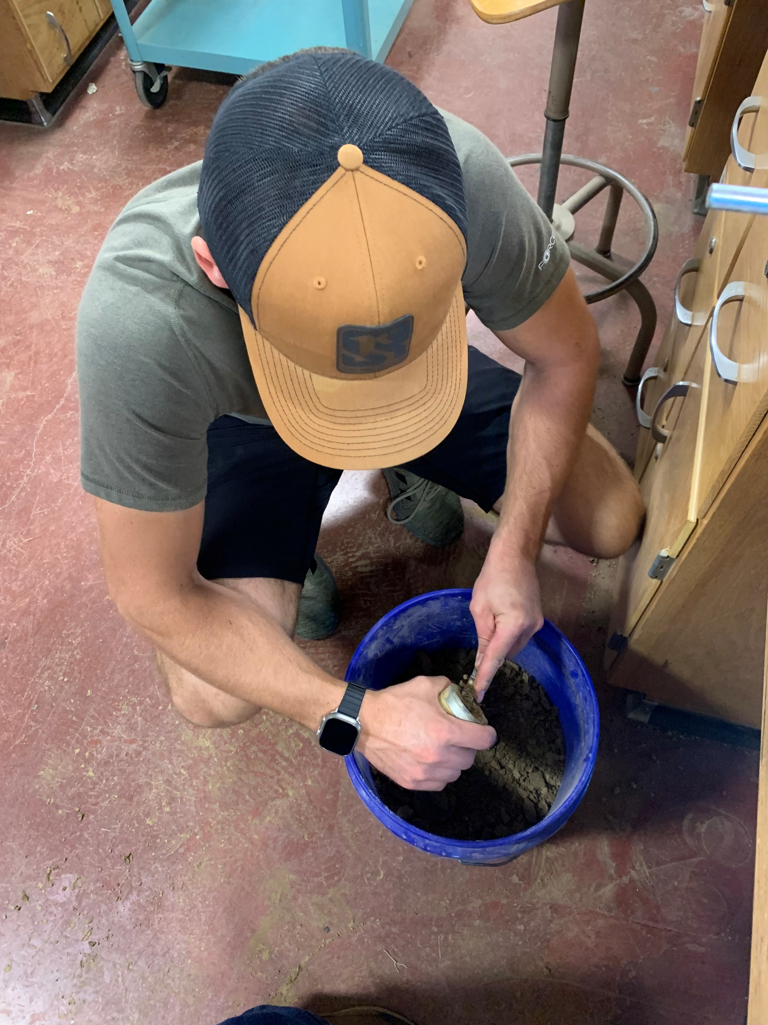
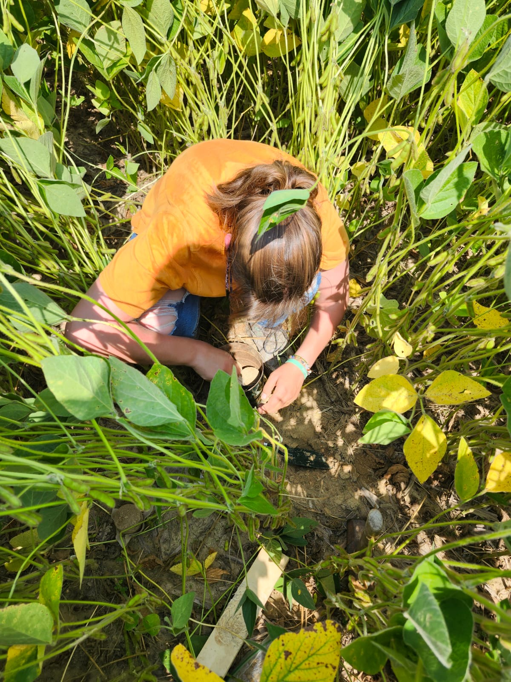

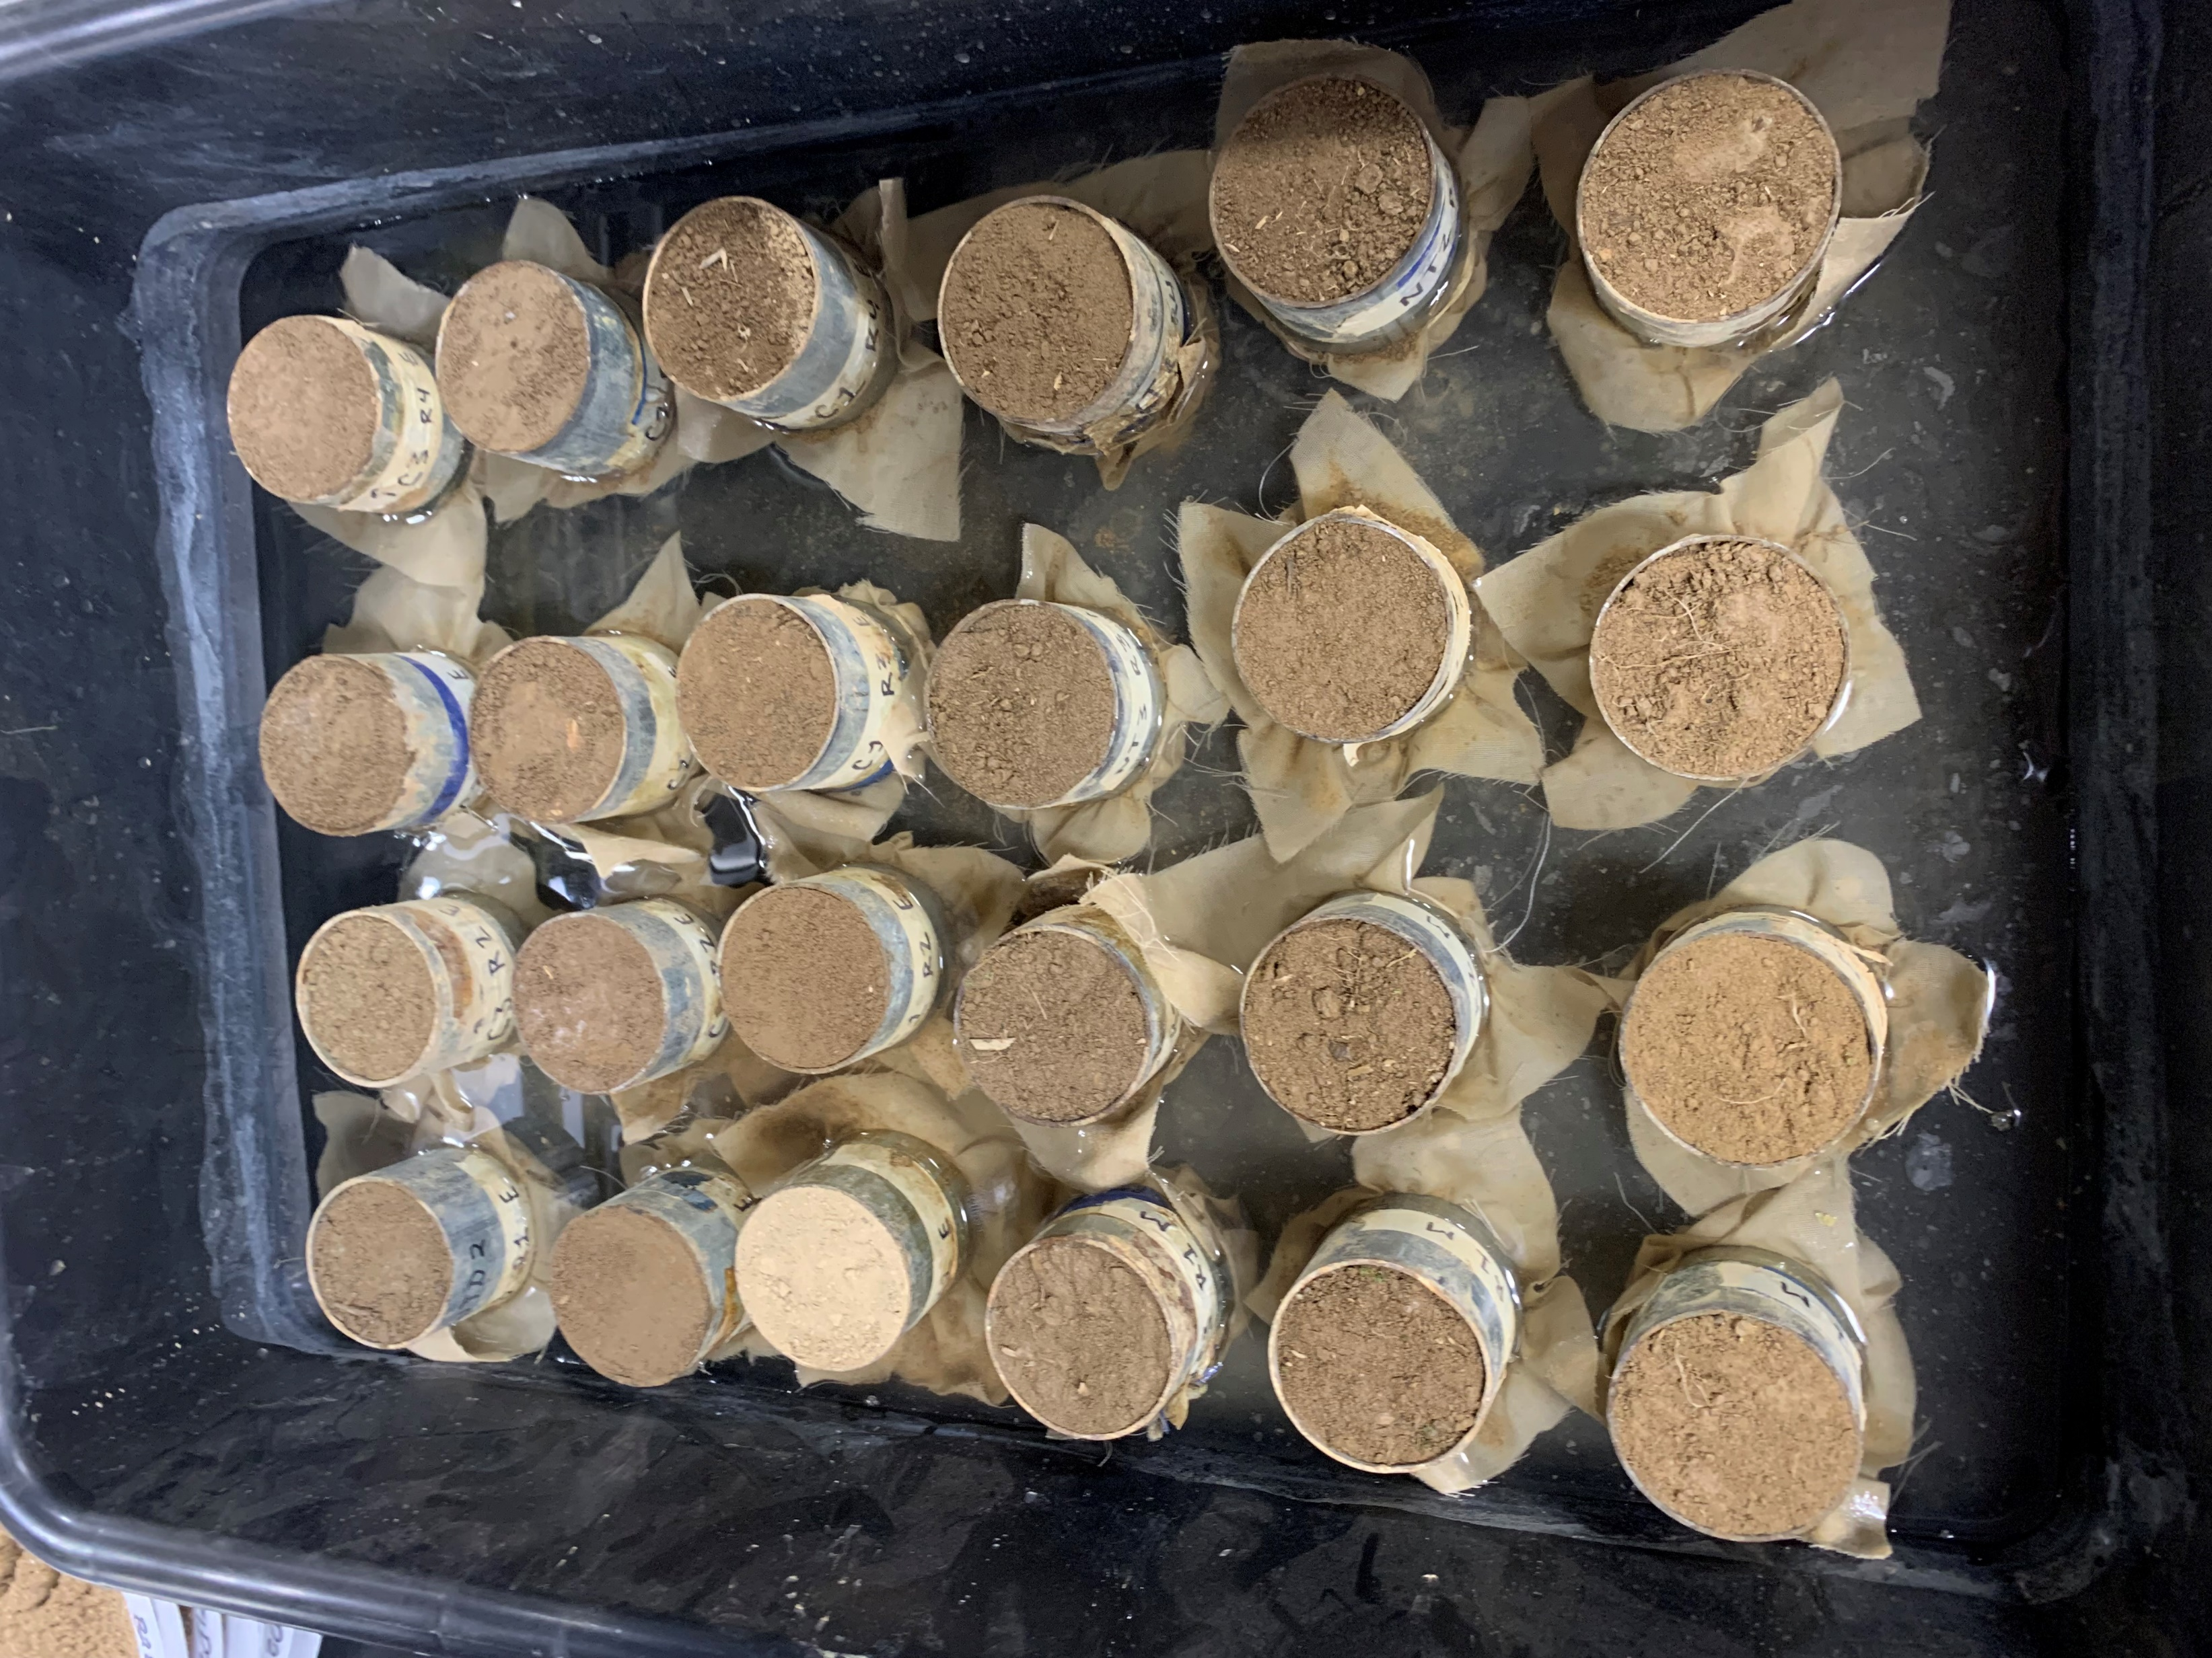
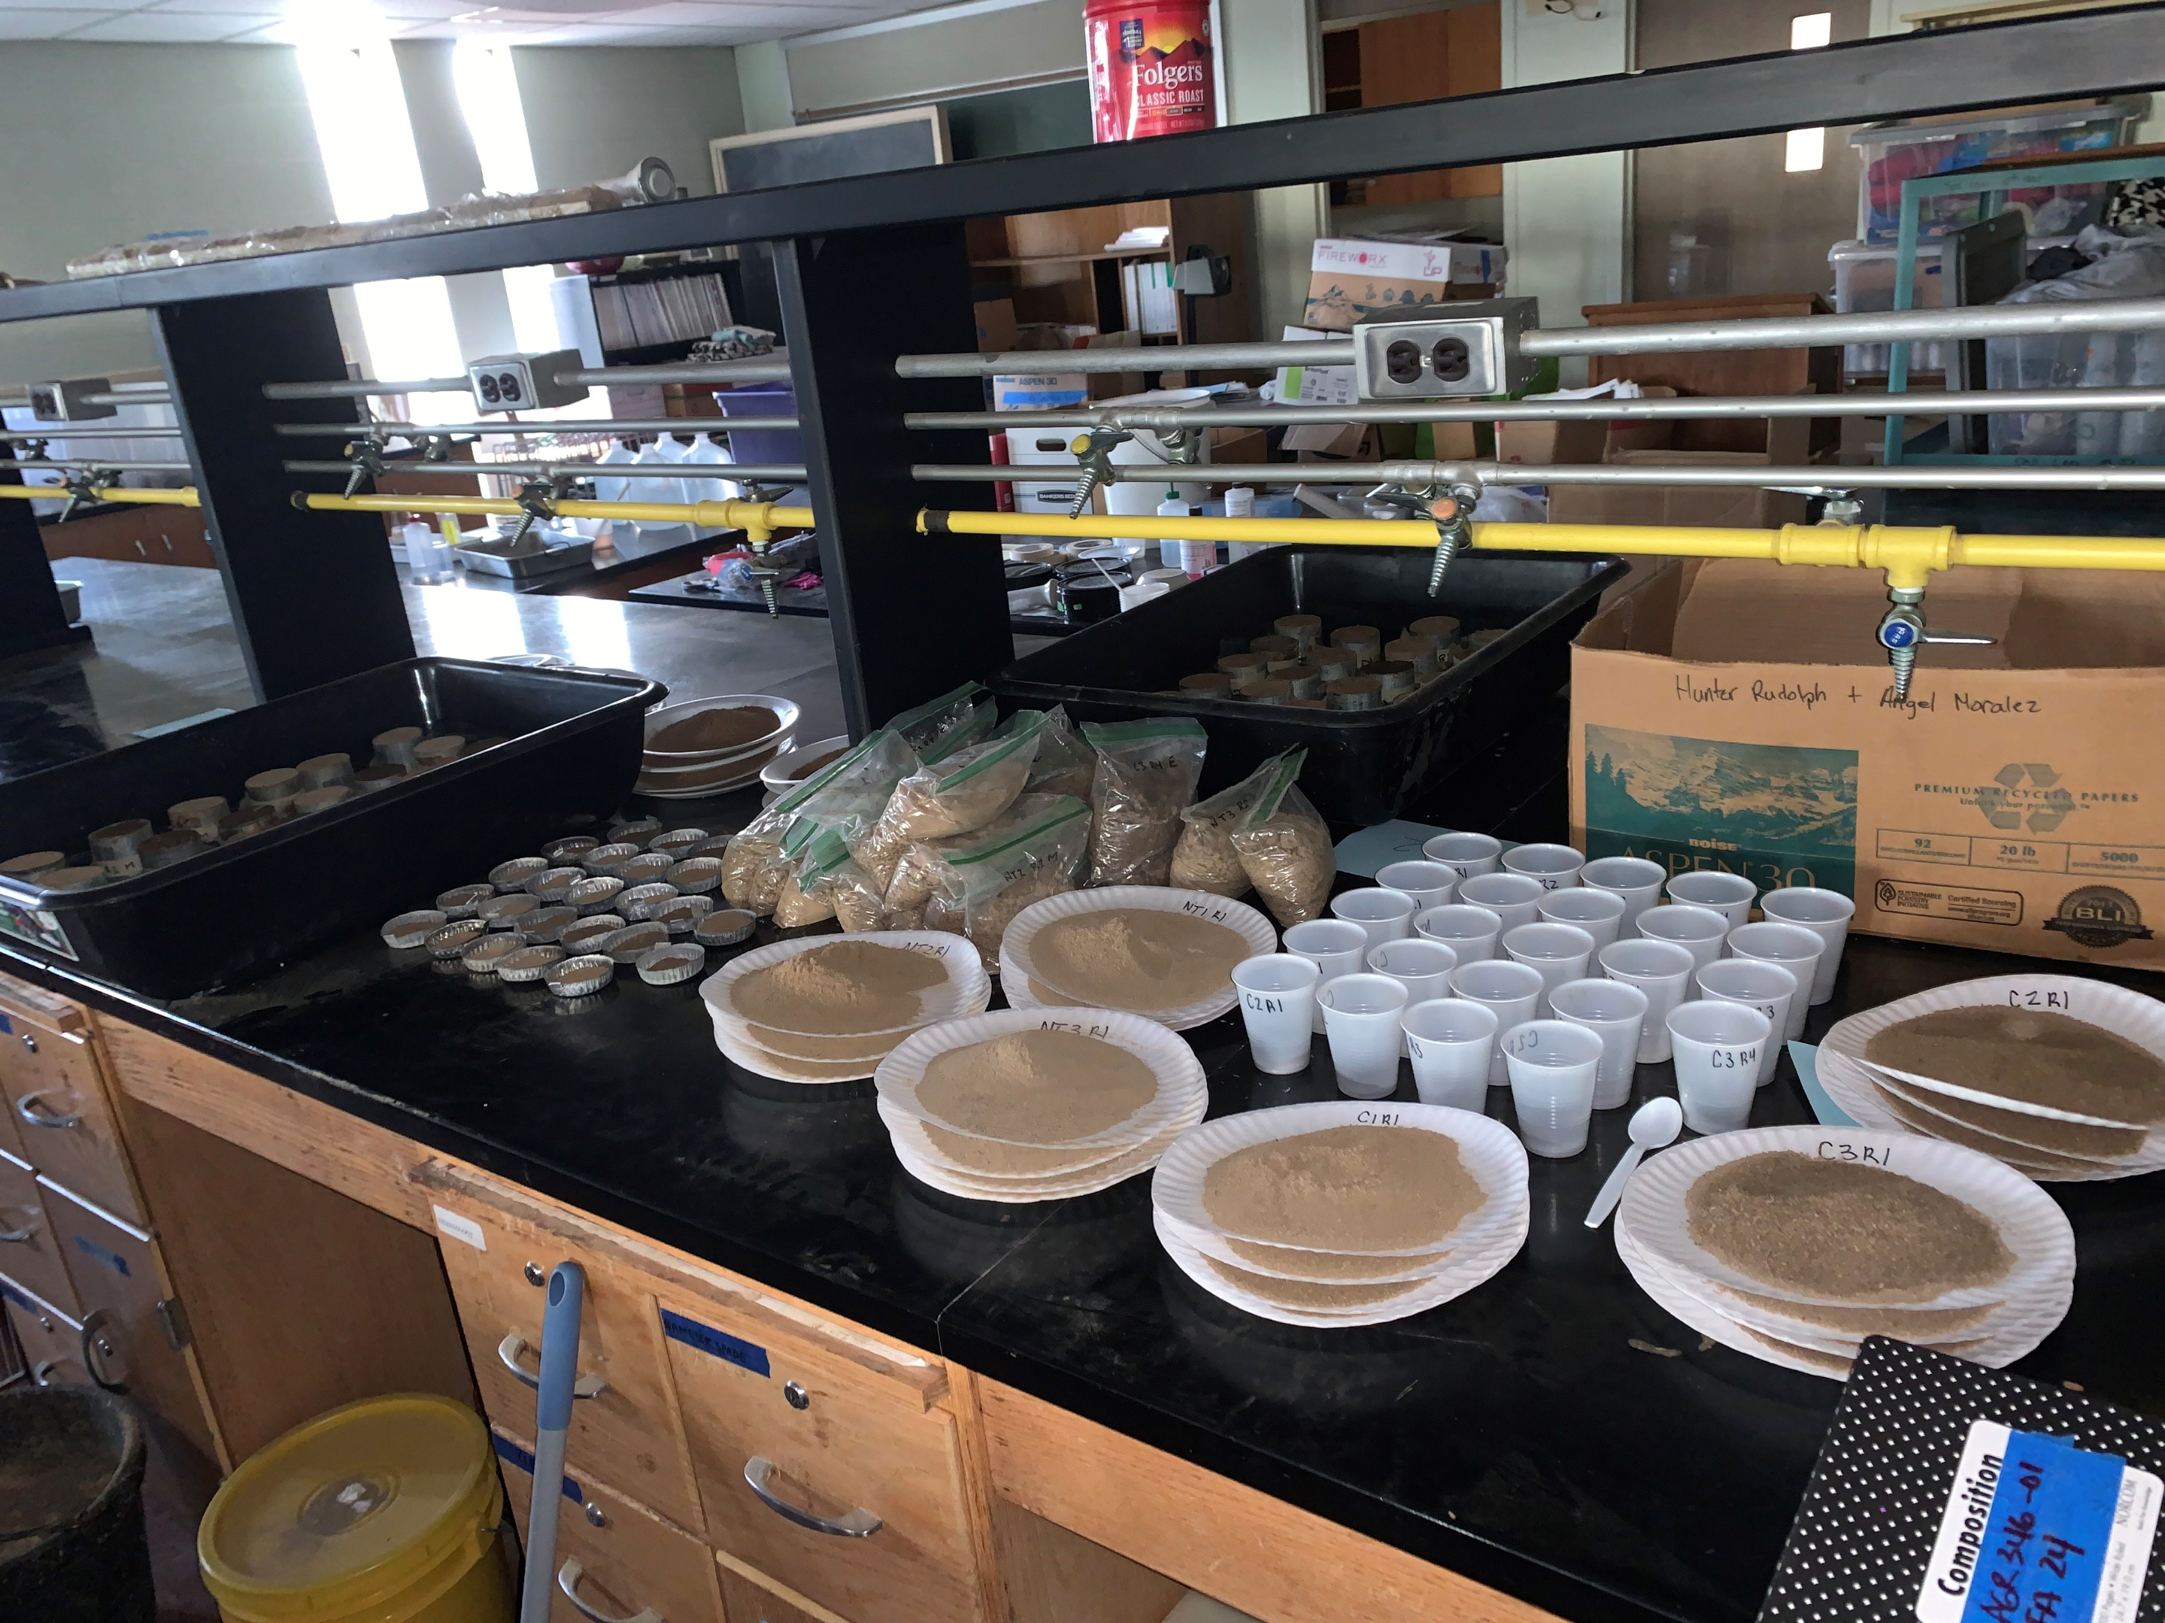
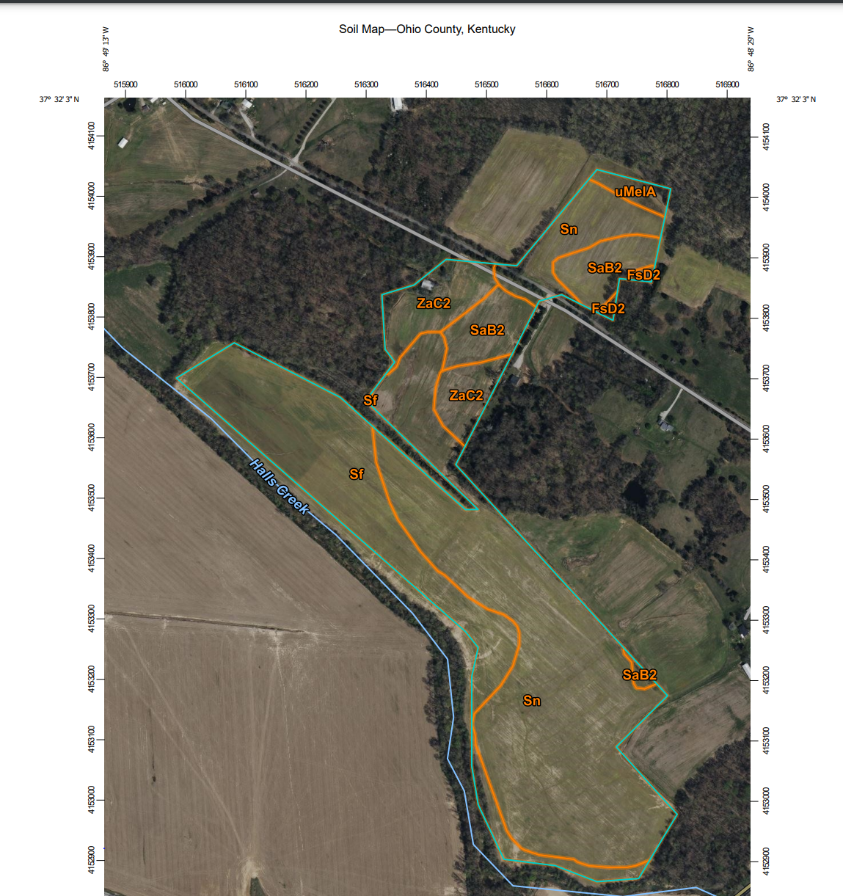
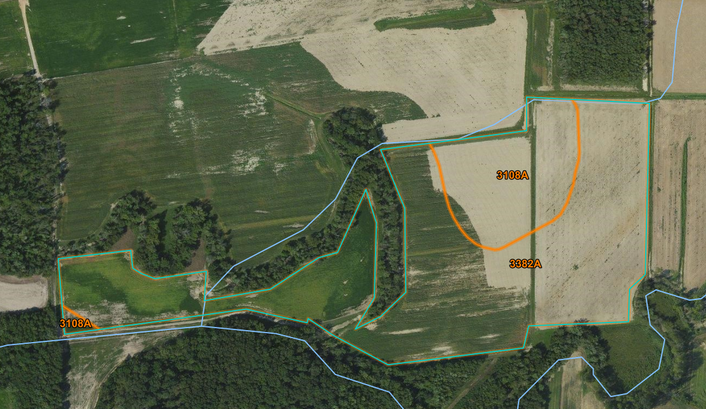
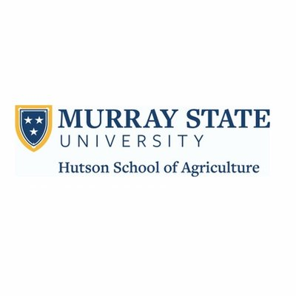
The Significance of Tillage Systems in Kentucky and Illinois on Soil Properties
Madison Westerfield & Ethan White
Mentors: Dr. Iin P. Handayani, Caleb Unverfehrt
Hutson School of Agriculture, Murray State University, Murray, Kentucky, USA
Introduction
Results
Pictured at left: Undisturbed soil samples being saturated.
Pictured at right: Set up of research with undisturbed on the left side of photo and disturbed on the right.
Tillage practices can have a variety of effects on soil properties depending on type of tillage and intensity. No-till is implemented to decrease soil disturbance and preserve soil health, and accounts for over half of Kentucky’s total cropped acres (Huang et al., 2021). No-till has been proven to help soil structure and improve other soil properties over time (Blanco-Canqui & Ruis, 2018). In particular, no-till typically allows for higher soil organic matter and soil organic carbon percentages than conventional tillage does (Sindelar et al., 2015). On the other hand, tillage is practiced to increase aeration in the soil and increase the rate of organic matter decomposition (Dozier et al., 2017).
Conclusions
The objective of this research was to compare conventional tillage practices in Illinois against the no-till practices in Kentucky to see how soil properties compare. This study benefits farmers and managers to direct them to reassess their current tillage practices to preserve soil health.
CT1 had the highest average soil bulk density of 1.40 g/cm³
CT3 had the highest average total porosity of 57.71%
The soil water holding capacity, soil macroporosity, and soil water content at field capacity for NT3, CT2, and CT3 all yielded similar results, around 30 to 35%
The highest average soil organic matter percentage of 4.96% was in NT2
The lowest average soil organic matter percentage of 3.11% was found in CT1
All three Kentucky no-till fields had 1 to 2% higher soil organic matter percentages than the Illinois conventional tillage fields
The average soil pH (ranging from 6.01 to 7.80) was generally higher in the Kentucky no-till fields than the Illinois conventional tillage fields
CT1 had the most significance throughout the study, showing that the soil health is poorer in this field
  This field had the highest bulk density, lowest porosity, soil water holding capacity, microporosity, soil water content at field capacity, and soil organic matter percentages.
Study Site
This study was conducted in 2024. The sites included three no-till fields and three conventional tillage fields. All three no-till fields were in Ohio County, Kentucky. All three conventional tillage fields were in Williamson County, Illinois. The main soil type for the Ohio County, KY location was Stendal Silt Loam. The soil type for Williamson County, IL location was Belknap Silt Loam.
The three no-till fields have been in corn-soybean rotation under no-till practices for over twenty years. The three conventional tillage fields have been under corn-soybean rotations for over twenty years.
There were quite a few similarities in results from the no-till fields and the conventional tillage fields focused on in this study. This could result from the intensity of the tillage, environmental factors, or similarities in farming practices. Further research should be done on conventional tillage in Kentucky and no-till in Illinois to see how the results compare to this study to see if geography is a significant factor on soil properties in different tillage practices in these two states.
Methods
Acknowledgements
Four soil samples were collected from each of the six fields for a total of twenty-four samples. Both the undisturbed and disturbed samples were collected at the same depth of 0 to 7.5 centimeters. The soil properties measured by the undisturbed soil samples were bulk density, total porosity, soil water holding capacity, macroporosity, and soil water content at field capacity. The samples were saturated, air dried, oven dried, and measured. The soil properties measured by the disturbed samples were soil organic matter and soil pH. The soil organic matter was found by placing the samples in the oven and muffle furnace. The ratio for measuring soil pH in water was 1:2.5 (soil:distilled water).
This research was made possible by the Hutson School of Agriculture at Murray State University and the use of the soils lab. Lastly, this research would not have been possible without the help and guidance of Dr. Iin P. Handayani.
References
Blanco-Canqui, H., & Ruis, S. J. (2018). No-tillage and soil physical environment. Geoderma, 326: 164–200. https://doi.org/10.1016/j.geoderma.2018.03.011
Dozier, I. A., Behnke, G. D., Davis, A. S., Nafziger, E. D., & Villamil, M. B. (2017). Tillage and cover cropping effects on soil properties and crop production in Illinois. Agronomy Journal, 109(4): 1261–1270. https://doi.org/10.2134/agronj2016.10.0613
Huang, Y., Tao, B., Yang, Y., Zhu, X., Yang, X., Grove, J. H., & Ren, W. (2021). Simulating no-tillage effects on crop yield and greenhouse gas emissions in Kentucky corn and soybean cropping systems: 1980-2018. Agricultural Systems, 197: 1-30. https://doi.org/10.1016/j.agsy.2021.103355
Larsen, E., Grossman, J., Edgell, J., Hoyt, G., Osmond, D., & Hu, S. (2014). Soil Biological Properties, soil losses and corn yield in long-term organic and conventional farming systems. Soil and Tillage Research, 139: 37–45.
https://doi.org/10.1016/j.still.2014.02.002
Sindelar, A.J., Lamb, J.A. and Coulter, J.A. (2015), Short-Term Stover, Tillage, and Nitrogen Management Affect Near-Surface Soil Organic Matter. Soil Science Society of America Journal, 79: 251-260. https://doi.org/10.2136/sssaj2014.08.0337
Below at left: The three Kentucky no-till fields studied
Below at Right: The three Illinois conventional tillage fields studied
NT: No-till
CT: Conventional tillage

