Slide 1
Childhood Experiences and Obesity in Adulthood
Hannah Eriksen and Dr. Esther Malm
Murray State University
Acknowledgement:
The Office of Research and Creative Activity (ORCA)

Slide 2
Introduction
Adverse Childhood Experiences
(ACEs; Felitti et al., 1998)
Mental and Physical Health Outcomes
(Doom et al., 2021; Shevlin et al., 2022)
Benevolent Childhood Experiences
(BCEs; Narayan et al., 2018)
Example:
Obesity

Slide 3
Hypothesis
H1: BCEs would significantly moderate the relationship between ACEs, and obesity scores (BMI)
Proposed Moderation Model
BCEs
ACEs
Obesity

Slide 4
Methods
278 Participants from Prolific
BCES
              Memories of Home and Family Scale (28 items; MHFS; Shevlin et al., 2022)
              BCEs Scale (10 items; Narayan et al., 2018)
ACES
              Childhood Trauma Questionnaire – Short Form (28 items; Bernstein et al., 2003)
              ACEs Questionnaire (10 items; Felitti et al., 1998)
'
Obesity
Perceptions of weight: How would you describe your weight?
BMI: Calculated with NIH.gov
Categories

Slide 5
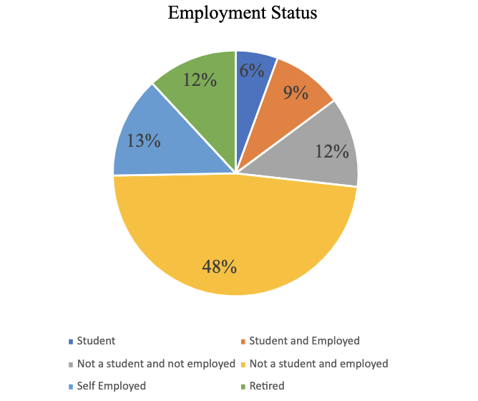
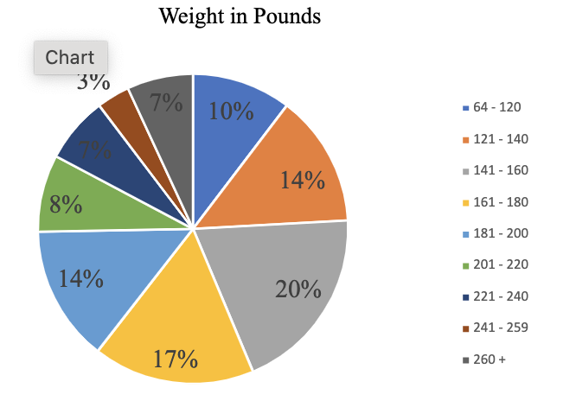
Demographics
Figure 1. Employment Status pie chart, which shows the amount of people in each employment category
Figure 2. Pie chart featuring the weight distribution of the sample

Slide 6
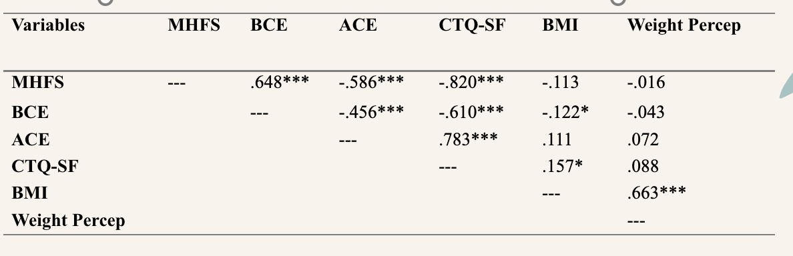
Results
Figure 3. Correlations among key variables
* p < .05, ** p < .01, *** p < .001

Slide 7
BCEs
BMI
CTQ-SF
BMI
BCEs
ACEs
Obesity

Slide 8
Discussion & Future Directions
As BCEs increase BMI was more likely to decrease
As ACEs increase BMI was more likely to increase
Type of Trauma
Validation of MHFS
Utilize data collected from SONA (n = 239)
Investigate other variables that were measured such as anxiety and resiliency

Slide 9
References
Bernstein, D. P., Stein, J. A., Newcomb, M. D., Walker, E., Pogge, D., Ahluvalia, T., ... & Zule, W. (2003). Development and validation of a brief screening version of the childhood trauma questionnaire. Child Abuse & Neglect, 27(2), 169–190.
Doom, J. R., Seok, D., Narayan, A. J., & Fox, K. R. (2021). Adverse and benevolent childhood experiences predict mental health during the COVID-19 pandemic. Adversity and resilience science, 2(3), 193–204. https://doi.org/10.1007/s42844-021-00038-6
Felitti, V. J., Anda, R. F., Nordenberg, D., Williamson, D. F., Spitz, A. M., Edwards, V., Koss, M. P., & Marks, J. S. (1998). Relationship of childhood abuse and household dysfunction to many of the leading causes of death in adults. The Adverse Childhood Experiences (ACE) Study. American journal of preventive medicine, 14(4), 245–258. https://doi.org/10.1016/s0749-3797(98)00017-8
Javier, Hoffman, L. R., & Shah, S. I. (2019). Making the case for ACEs: adverse childhood experiences, obesity, and long-term health. Pediatric Research, 86(4), 420–422.
Narayan A. J., Rivera, M. L., Bernstein R., Harris W., Liberman A. (2018) Positive childhood experiences predict less psychopathology and stress in pregnant women with childhood adversity: A pilot study of the benevolent childhood experiences (BCEs) scale. Child Abuse & Neglect, 78, 19–30. ttps://doi.org/10.1016/j.chiabu.2017.09.022
Shevlin, M., Redican, E., McElroy, E., Ben-Ezra, M., Karatzias, T., & Hyland, P. (2023). Measuring positive memories of home and family during childhood: The development and initial validation of the ‘Memories of Home and Family Scale.’ Current Psychology (New Brunswick, N.J.), 42(26), 22255–22264. https://doi.org/10.1007/s12144-022-03220-w
U.S. Department of Health and Human Services. (n.d.). Calculate your BMI - standard BMI Calculator. National Heart Lung and Blood Institute. https://www.nhlbi.nih.gov/health/educational/lose_wt/BMI/bmicalc.htm

Slide 10
Questions?
Thank you for your time!

